Slide 1

Your Strategic HR partner
Application for Human Resources which enables to hire, train, and deploy, assess, motivate and reward its people more effectively than ever before
Recruit
Manage
Motivate
Engage
Notes:
Four-part teardrop graphic in perspective
(Advanced)
To reproduce the effects on this slide, do the following:
On the Home tab, in the Slides group, click Layout, and then click Blank.
On the Home tab, in the Drawing group, click Shapes, and then under Basic Shapes click Teardrop (second row, fourth option from the left). On the slide, drag to draw a teardrop shape.
Select the teardrop shape. Under Drawing Tools, on the Format tab, in the Size group, do the following:
In the Shape Height box, enter 2.45”.
In the Shape Width box, enter 2.45”.
On the Home tab, in the bottom right corner of the Drawing group, click the Format Shape dialog box launcher. In the Format Shape dialog box, click Fill in the left pane. In the Fill pane, select Solid fill, click the button next to Color, and then click White, Background 1, Darker 35% (fifth row, first option from the left).
Also in the Format Shape dialog box, click Line Color in the left pane, and then select No line in the Line Color pane.
Also in the Format Shape dialog box, click 3-D Format in the left pane, and then do the following in the 3-D Format pane:
Under Bevel, click the button next to Top, and then under Bevel click Circle (first row, first option from the left). Next to Top, in the Width box, enter 10 pt, and in the Height box, enter 10 pt. Click the button next to Bottom, and then under Bevel click Circle (first row, first option from the left). Next to Bottom, in the Width box, enter 10 pt, and in the Height box, enter 10 pt.
Under Surface, click the button next to Material, and then under Standard click Warm Matte (second option from the left). Click the button next to Lighting, and then under Neutral click Balance (first row, second option from the left).
Select the teardrop shape. Press and hold CTRL and SHIFT (to duplicate and constrain the duplicate shape to a perpendicular axis), and then drag the teardrop shape to the right on the slide to create a duplicate.
Select the duplicate teardrop shape. On the Home tab, in the Drawing group, click Arrange, point to Rotate, and then click Flip Horizontal.
Press and hold SHIFT and select both teardrop shapes.
Press and hold CTRL and SHIFT (to duplicate and constrain the duplicate shapes to a perpendicular axis), and then drag the teardrop shapes to the right on the slide to create two duplicate teardrop shapes.
Press and hold SHIFT and select the two new teardrop shapes. On the Home tab, in the Drawing group, click Arrange, point to Rotate, and then click Flip Vertical.
On the slide, drag the two new duplicate teardrop shapes directly above the original teardrop shapes.
Select the top left teardrop. Under Drawing Tools, on the Format tab, in the bottom right corner of the Size group, click the Size and Position dialog box launcher. In the Format Shape dialog box, click Position in the left pane, and in the right pane, under Position on slide, do the following:
In the Horizontal box, enter 2.5”.
In the Vertical box, enter 0.83”.
On the Home tab, in the Drawing group, click Shapes, and then under Basic Shapes click Oval (first row, second option). On the slide, drag to draw an oval.
Select the oval. Under Drawing Tools, on the Format tab, in the Size group, do the following:
In the Shape Height box, enter 2.11”.
In the Shape Width box, enter 2.11”.
Select the oval. Under Drawing Tools, on the Format tab, in the bottom right corner of the Size group, click the Size and Position dialog box launcher. In the Format Shape dialog box, click Position in the left pane, and in the right pane, under Position on slide, do the following:
In the Horizontal box, enter 2.67”.
In the Vertical box, enter 1”.
On the Home tab, in the Drawing group, click the arrow next to Shape Fill, and then under Theme Colors click Olive Green, Accent 3, Darker 25% (fifth row, seventh option from the left).
On the Home tab, in the Drawing group, click the arrow next to Shape Outline, and then click No Outline.
On the Home tab, in the Drawing group, click Shape Effects, point to Shadow, and then under Inner click Inside Diagonal Top Right (first row, third option from the left).
Right-click the oval and click Edit Text.
Enter text in the text box, select the text, and then on the Home tab, in the Font group, select Trebuchet MS from the Font list, select 28 from the Font Size list, click the button next to Font Color, and then under Theme Colors click White, Background 1, Darker 5% (second row, first option from the left).
On the Home tab, in the Paragraph group, click Center to center the text in the oval.
Select the top right teardrop shape. Under Drawing Tools, on the Format tab, in the bottom right corner of the Size group, click the Size and Position dialog box launcher. In the Format Shape dialog box, click Position in the left pane, and in the right pane, under Position on slide, do the following:
In the Horizontal box, enter 5.2”.
In the Vertical box, enter 0.83”.
Select the oval on the top left teardrop shape. Press and hold CTRL and SHIFT (to duplicate and constrain the duplicate shape to a perpendicular axis), and then drag the oval onto the top right teardrop shape to create a second oval.
Select the second oval. Under Drawing Tools, on the Format tab, in the bottom right corner of the Size group, click the Size and Position dialog box launcher. In the Format Shape dialog box, click Position in the left pane, and in the right pane, under Position on slide, do the following:
In the Horizontal box, enter 5.33”.
In the Vertical box, enter 1”.
On the Home tab, in the Drawing group, click the arrow next to Shape Fill, and then under Theme Colors click Purple, Accent 4, Darker 25% (fifth row, eighth option from the left).
Click the text in the second oval, and then edit as needed.
Select the bottom left teardrop shape. Under Drawing Tools, on the Format tab, in the bottom right corner of the Size group, click the Size and Position dialog box launcher. In the Format Shape dialog box, click Position in the left pane, and in the right pane, under Position on slide, do the following:
In the Horizontal box, enter 2.5”.
In the Vertical box, enter 3.53”.
Select the oval on the top left teardrop shape. Press and hold CTRL and SHIFT (to duplicate and constrain the duplicate shape to a perpendicular axis), and then drag the oval onto the bottom left teardrop shape to create a third oval.
Select the third oval. Under Drawing Tools, on the Format tab, in the bottom right corner of the Size group, click the Size and Position dialog box launcher. In the Format Shape dialog box, click Position in the left pane, and in the right pane, under Position on slide, do the following:
In the Horizontal box, enter 2.67”.
In the Vertical box, enter 3.7”.
On the Home tab, in the Drawing group, click the arrow next to Shape Fill, and then under Theme Colors click Blue, Accent 1 (first row, fifth option from the left).
Click the text in the third oval, and then edit as needed.
Select the bottom right teardrop shape. Under Drawing Tools, on the Format tab, in the bottom right corner of the Size group, click the Size and Position dialog box launcher. In the Format Shape dialog box, click Position in the left pane, and in the right pane, under Position on slide, do the following:
In the Horizontal box, enter 5.2”.
In the Vertical box, enter 3.53”.
Select the third oval on the bottom left teardrop shape. Press and hold CTRL and SHIFT (to duplicate and constrain the duplicate shape to a perpendicular axis), and then drag the oval onto the bottom right teardrop shape to create a fourth oval.
Select the fourth oval. Under Drawing Tools, on the Format tab, in the bottom right corner of the Size group, click the Size and Position dialog box launcher. In the Format Shape dialog box, click Position in the left pane, and in the right pane, under Position on slide, do the following:
In the Horizontal box, enter 5.33”.
In the Vertical box, enter 3.7”.
On the Home tab, in the Drawing group, click the arrow next to Shape Fill, and then under Theme Colors click Orange, Accent 6, Darker 50% (sixth row, 10th option from the left).
To edit the text in the fourth oval, right-click the oval and click Edit Text.
Press CTRL+A to select all of the shapes on the slide. On the Home tab, in the Drawing group, click Arrange, and then click Group.
On the Home tab, in the bottom right corner of the Drawing group, click the Format Shape dialog box launcher. In the Format Shape dialog box, click 3-D Rotation in the left pane, and then do the following in the 3-D Rotation pane:
Click the button next to Presets, and then under Perspective click Perspective Front (first row, first option from the left).
In the X box, enter 325°.
In the Y box, enter 325°.
In the Z box, enter 40°.
In the Perspective box, enter 40°.
Also in the Format Shape dialog box, click Shadow in the left pane. In the Shadow pane, click the button next to Presets, and then under Outer click Offset Center (second row, second option from the left).
To reproduce the background on this slide, do the following:
Right-click the slide background area, and then click Format Background. In the Format Background dialog box, click Fill in the left pane, select Gradient fill in the Fill pane, and then do the following:
In the Type list, select Linear.
Click the button next to Direction, and then click Linear Diagonal (first row, first option from the left).
In the Angle box, enter 45°.
Under Gradient stops, click Add gradient stop or Remove gradient stop until two stops appear in the slider.
Also under Gradient stops, customize the gradient stops that you added as follows:
Select the first stop in the slider, and then do the following:
In the Position box, enter 0%.
Click the button next to Color, and then under Theme Colors click White, Background 1 (first row, first option from the left).
Select the last stop in the slider, and then do the following:
In the Position box, enter 100%.
Click the button next to Color, and then under Theme Colors click White, Background 1, Darker 35% (fifth row, first option from the left).

Slide 2

Exenta – A Fresh Approach to Business
1
Human Resource Management for building a world-class workforce
2
Launched in the Market in 2013
3
Flexible Implementations- Both cloud and on-premise deployment models
4
Global Architecture – to Manage Global Payroll and Global Organizations
5
Over 100 Implementations in 10 Countries
6
Completely Configurable to your Organizational Needs

Slide 3
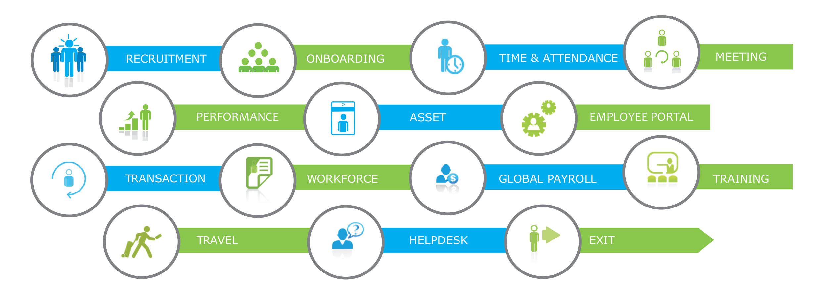
Overview of Exenta

Slide 4
Why choose Exenta?
Easy to use, upgrade and configure
Comprehensive Functionality
Dynamic Customizations
Flexible Implementation
Multi-Branch Administration
Integrate with attendance system
Multi-user based solution
Multi currency and languages
Hassle Free Integration
Powerful Analytics and Reporting
Exceptional Support
Unbeatable Pricing
Explore Exenta

Slide 5
Multi-Branch Administration
As companies expand globally, they face a great challenge of managing global workforce. Exenta HRMS can help your organization to strategically manage your Global Human Resource. It provides you the facility to create Multi-Organisation (Establishment units) with unlimited geographical units and Functional Sections. It takes care of the multi-currencies, multi pay points and legal & statutory needs of different countries of operation.
1
Support Multiple Organizations , Currencies & Pay points
2
User defined level of Organizations Hierarchy
3
Organizations own Skill Set, Service Conditions, Measurement Technique & Ratings
4
Multiple Duty Schedules, Calendars etc. as per your Company Policy
5
Graphical display of Organization Hierarchy through Organization Chart

Slide 6

Multi-Branch Administration
Corporate
Branch
Branch
Work Location
Work Location
Work Location
Work Location

Slide 7
Workflow Automation
1
Flexibility to set Multiple levels of approval
2
Flexibility to set Approvals by Department / Job Titles / Reporting Manager
3
Ability to decide and assign the approval personnel for each module where needed
4
Functional and process flow is described for each module with appropriate picture and excellent GUI

Slide 8
Powerful Analytics and Reporting
1
Workforce Analytics improves decision making by helping organizations to find solutions for their key challenges and provides guidance to solve them.
Workforce Analytics is fully integrated with Exenta and provides concrete and actionable insights and tools that help you make impactful decisions and drive your business strategy.
2
3
Advanced analytics identifies pertinent HRMS drivers, Key Performance Indicators and develop relevant data models to support analytics.
Comprehensive and interactive reports along with intuitive graphs generated in Exenta helps to analyze workforce performance, attrition trends and expenditure with HR analytics.
4
5
Standard and personalized ad-hoc reports can be exported in convenient formats for later use in accurate processing and management decision making.

Slide 9
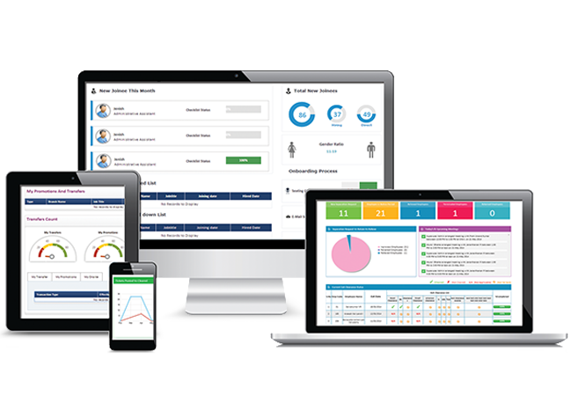
Exenta Deploys interactive dashboards across for all Business Users and provide Custom Application Development when integration with 3rd party tools are required.
Exenta HRMS provides you with the mobile version which keeps you accessed anywhere, anytime.

Slide 10
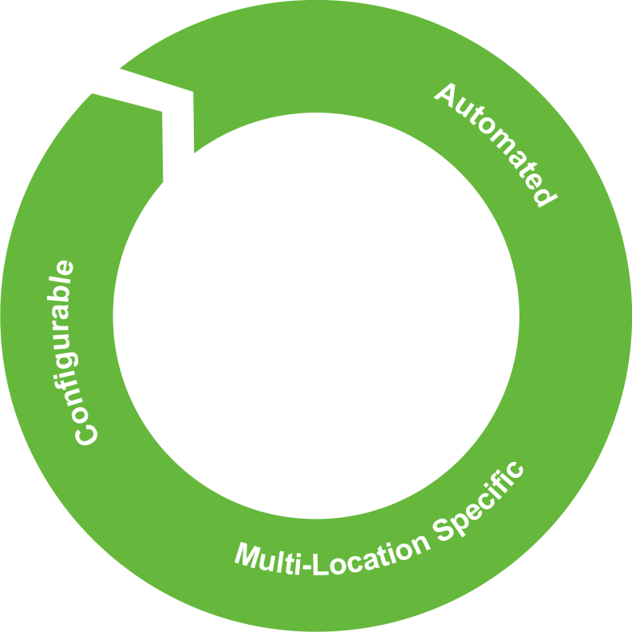



ORGANISATION MANAGEMENT
Position Management
Organization Chart
Organisation Structure
Organisation Profile
Branch / Location setup

Slide 11

MY TEAM
Early out
Late in
Attendance
Leave
POD

Slide 12
HR UTILITY
News and announcements: Post date, Expiry date, Action
Letter Generation: Approve request, All letter request, Issue letter
Company Policy
New Employee Handbook
Organisation Documents

Slide 13
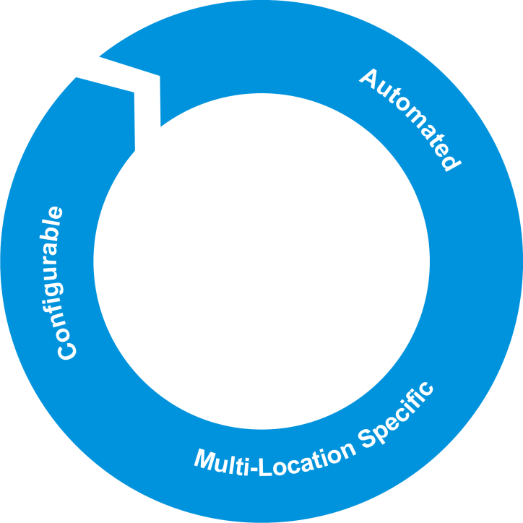

Hiring
Open jobs
Closed jobs
Hiring report
Quick Hiring, Manage jobs,Recruitment team, Manage Applicants, Resume bank,Recruiter page
Manage offer letter,recruitment agency,Refferal management,manage job portal

Slide 14

Employee On-boarding
Candidate Joining
Details
Automated Employee verification
(Agency/Direct)
Induction Program
Extended and Turned
down Employee
On-boarding Process – e-Mail setup, Login, Seating configuration ,Job Responsibilities
Employee Bulk Import
Manage Active/ Inactive Employees

Slide 15
Staff Info
Employee list, employee report, employee skill matrix, organization profile head
Org-profile page, other reporting manager history, reporting manager
Salary details, my team
Service record
Employee bank info
Profile change approval

Slide 16

Time & Attendance
Attendance Rules configured as per HR Policy.
Custom Attendance Capture – Biometric/ Access Cards/Manual
Shift Planning
Employee Timesheets
Maintain multi location Holiday List, Define Optional Holidays
Leave and Permission Management, Leave Encashment
HR Views for effective leave applications monitoring

Slide 17

Performance & Appraisal
Appraisal Management – scheduling and reviewing
Company defined Appraisal templates setup
E-Compensation
Summary and Reports
Performance Exploration – Goal, KRA, Development plan
Performance Assessment –Appraisal Forms, 360 Degree Feedbacks
Normalization Process through Bell Curve Analysis

Slide 18

Compensation
Payroll Management
Salary register
Locked list
Approved salary list
Disburse salary
Failed payments
Salary history

Slide 19
Global Payroll
Payroll Management
Income Tax Management
ESI, PF, GF Management
Employee Benefits
pay-outs
Loans Management
Claims Management
Automated Declaration and Tax Forms
Built CTC Components

Slide 20
Recruitment Management
Budgeting and Requisition Approval
Automated Job Posting to Job Portals, Social Media and Recruitment Agencies
Candidates Application and Shortlisting
Automated Hiring Process and Interview Feedbacks
Automated Generation of Offer Letter and CTC Structure
Acceptation and Turndown List of Letters
Generation of Appointment Letter
Recording and Requisition Closed

Slide 21
Awards
Panel members
Final approval
Awards history
Employee award
Manage award
Manage nomination
My nomination

Slide 22
Social feeds
Group
Private messages
Projects
Events

Slide 23
Training Management
Evaluates Employee Performance and Proficiency after completion
Templates for Course Feedbacks and Participants Evaluation
Track training budgets, actual costs and variances
Training Requirement Analytics – planning, budgeting, scheduling
Training Conduction - online or agency or an instructor
Training Calendar -scheduled trainings databank

Slide 24

Workforce Management
Employee Data Management
Team /Division/ Department
Management
Employee Skill Matrix
Employee Service Management
Employee Profile Change Approval
Employee Reports

Slide 25
Benefits
Statutory Benefits
Benefit Enrollment
Benefits Approval
Benefit Claim
Reports
Manage Benefits

Slide 26


Transaction
Employee Transfer Management - Work Location/ Branch/ Department/Reporting Manager
Employee Promotion
Probation Management
Employee Role Change
Employee Onsite Management
Automated Clearance process and Letter Generation
Reports

Slide 27
Workflow
Workflow management:
Manage workflow, workflow list, employee list, workflow history
Authority:
Workflow authority, escalation days, escalation authority, status

Slide 28

Exit
Separation Management
Termination Management
Automated - Asset, Payroll, Benefits Clearance
Manage Succession Planning
Define employee separation and notice periods
Setting up termination due to unauthorized absence
Summary page & Reports

Slide 29

Travel
Organization defined Travel Architecture – Travel types and Modes
Types of travelling expenses, allowances ,accommodation etc. can be defined according to employee level and position
Travel Plan – Budget and Scheduling
Travel Check – Travel Cards, Visa Process, Travel Insurance
Travel Desk Management - In-house or Agency
Travel extensions or pre-closure

Slide 30

Meeting
Meeting Diary – Upcoming, Current Date, Action Update Required Meetings showcased
Meeting Scheduling Management
Meeting Status, Alerts and Notifications
Manage Meeting Rooms and Schedules on Calendar
Manage Action Items
Manage Meeting Reports and Minutes

Slide 31
Succession Planning
Talent review
Final Review
Talent pool
Talent History

Slide 32

Employee Self Service
Internal Job Postings
Employee Referral Management
Meeting Scheduler and My Meetings
Employee Directory
Employee Profile Management
Organization Structure
Company Policies
Employee Job Profile and Skills Proficiency

Slide 33

Helpdesk
Ticket Workflow Management
Ticket Analytics - tickets received, resolved, pending, escalated and average closing time
Auto-assign and Re-assign
Tickets Escalations
Ticket Status Notifications

Slide 34
Background Verification
Verification List : company/branch, services offered, Employee name,month,verification mode, verification type
Verification History:
Emp-name, department, job title, date of joining, source action

Slide 35
How Exenta Simplifies your Workforce?
Exenta prepares, completes and sends forms, reports and notifications automatically, thereby reducing administrative costs and eliminating the need for additional admin staff in the organization.
Automated reporting and analytics helps you to be more focussed and take the right decisions at the right time.
Eliminate bad hires by using Exenta’s Applicant tracking and Recruitment system and thus save about 30-40% of your annual salary budget.
The exit process is completely automated and bullet proofed which allows you to reduce wrongful terminations lawsuits and claims expenses.
Exenta allows you to integrate easily to other software programs which are an add-on for streamlining all other business requirements.
Exenta provides regular updates of the HRMS software thus reducing all the costs associated with buying new equipments and resources needed to deploy upgrades.

Slide 36
Continued. . .
Easy to configure, use and update. Exenta doesn’t need additional technical expertise to run smoothly in your organization. You would not have to recruit tech savvy HR’s to work on Exenta.
It provides you the facility to create Multi-Organisation (Establishment units) with unlimited geographical units and Functional Sections.
Increase your process-based savings such as reduced call volumes, lower average call times, and decreased HR agent head count.
Exenta turns your office into a paper free zone where all the paper works can be documented and retrieved as per the needs and also reduces the number of ways in which security can be breached.
Automated workflows controls what your employee can see and do within the system.
Automated Performance and Appraisal Management which provides 360 degree feedback and allows the employee to feel that he has not been misjudged or not given the compensation he deserves. Thus helping retention of the most potential and well deserved employees which in turn helps you to reduce your expenses on new hires and their training.

Slide 37
Insights into ROI with Exenta
  Time saving due to process improvements by 70%.
  Enhanced Operational Efficiency and HR Effectiveness.
  Decreased paper utilization by 80%.
  Employee satisfaction/engagement by 90%.
  Profit per Full Time Equivalent HR employee 70%.
In order to achieve the indicative ROI, every aspect of ExentaHRMS is made use of in the best manner. It is designed to automate HR processes end-to-end. Each of the components present in the suite talk to each other, thereby addressing the issues faced by organizations in respect to redundancy, latency, bottlenecks and data exceptions.
ExentaHRMS allows you to hand pick and customize the features you want based on your organizational requirements to create tailor-made HRMS creating a complete customizable solution for your organizational needs.

Slide 38
Thank you
Corporate Address:
Exenta Software Pvt Ltd
244, Nila
Technopark Campus,
Trivandrum – 695 581
Kerala, India
Tel:+91-471-2700388 / 399
email: info@exentahrms.com. www.exentahrms.com

