Slide 1


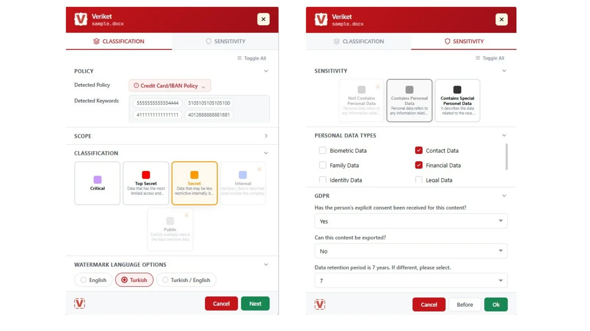
PRODUCT · DATA CLASSIFICATION
Veriket Data Classification — Label It Once, Protect It Everywhere
Veriket classifies documents, files and emails with manual, policy-based and AI-assisted methods, embedding persistent metadata that stays with the file — so every downstream control, including DLP, knows exactly what it is handling.
Every classification style
User-driven, policy/content-based and AI-assisted classification with pre-send email labeling.
Visible + invisible labels
Headers, footers and watermarks for people; persistent metadata for systems.
Screen watermarking
Deters screenshots and phone photos by marking the screen itself.
Beyond Microsoft
Office, Microsoft 365, Outlook and OWA — plus Google Workspace and Zimbra.
Veriket Data Classification — management console
siberson.com · info@siberson.com
1 / 30

Slide 2
VERIKET DATA CLASSIFICATION · WHY
Why Classification Comes First
Every downstream control — DLP, discovery, audit — is only as good as its understanding of the data. These are the five problems classification solves at the root.
Data you can't see
Unlabeled files carry no signal; nobody knows what is sensitive until it is too late.
AI raises the stakes
GenAI tools consume whatever users feed them — unlabeled data cannot be protected at that boundary.
DLP needs context
Pattern-only DLP guesses; label-driven DLP knows. Classification is what makes DLP precise instead of noisy.
Manual-only labelling fails
People forget and mislabel; policy and AI assistance keep classification consistent at scale.
Regulation demands it
KVKK, GDPR and ISO 27001 all expect data to be classified and handled by sensitivity.
siberson.com · info@siberson.com
2 / 30

Slide 3
VERIKET DATA CLASSIFICATION · PRODUCT ARCHITECTURE
Seven Classifiers, One Platform
Veriket is not a single add-in — it is a family of classifier modules that meet data wherever it is created, all reporting into one management console with one policy model.
Office Classifier
Labels inside Word, Excel and PowerPoint as documents are created and edited.
Desktop Classifier
Automatic classification at creation, copy and download on the endpoint.
File Classifier
Classifies every file type on servers and shares — including bulk, folder-level operations.
SharePoint Classifier
Covers SharePoint and OneDrive repositories at rest.
Mobile Classifier
Extends the same labels and policy to mobile platforms.
Email Classifier
Outlook and OWA labeling before send, with attachment content scanning.
CAD Classifier
Labels technical drawings — AutoCAD and engineering formats.
siberson.com · info@siberson.com
3 / 30

Slide 4
VERIKET DATA CLASSIFICATION · VALUE
What This Buys the Business
Lower leak risk
Data leaves less often, and never unnoticed.
User awareness
Employees engage with data protection instead of bypassing it.
More effective DLP
Labels sharpen every downstream security control.
Regulatory alignment
Supports KVKK, ISO 27001 and PCI DSS classification requirements.
Lower storage cost
Knowing what data is lets you govern and prune it.
Violation reporting
Detailed logging turns incidents into reportable evidence.
siberson.com · info@siberson.com
4 / 30

Slide 5
VERIKET DATA CLASSIFICATION · COMPLIANCE
Regulations Don't Ask If — They Ask How
Classification is not a nice-to-have: KVKK, GDPR and ISO 27001 all expect data to be known, labelled and protected — and sector rules from banking and capital-markets regulators ask for it explicitly. Veriket produces the evidence auditors ask for: label, log and report.
KVKK
Art. 4 · Art. 6 · Art. 7 · Art. 12
The two-axis label makes personal and special-category data visible; the retention parameter feeds erasure processes; label-driven DLP is documented evidence of the technical measures Art. 12 requires.
GDPR
Art. 5 · Art. 25 · Art. 30 · Art. 32
Consent, transfer and retention metadata document privacy by design; inventory output feeds Art. 30 records of processing; label-driven controls support Art. 32 security of processing.
ISO 27001:2022
A.5.12 · A.5.13 · A.8.12
Meets A.5.12 (classification of information) and A.5.13 (labelling) directly — and A.8.12 (data leakage prevention) through label-triggered actions.
NIST CSF 2.0
Identify · Protect · Detect
The data inventory feeds Identify, label-driven protection feeds Protect, and event logs feed Detect — traceable evidence at audit time.
siberson.com · info@siberson.com
5 / 30

Slide 6
VERIKET DATA CLASSIFICATION · TAXONOMY
A Label Model People Actually Understand
What matters is not how many labels you have — it is that they are consistent, understandable and actionable across the organization. A typical four-level scheme, and what each level implies for sharing:
Public
Information whose external sharing poses no concern — public documents, press releases, brochures.
Internal
Limited to employees — process documents, operational reports, internal correspondence.
Confidential
Unauthorized sharing creates corporate risk — reports containing personal data, financial documents, contracts.
Top Secret
Strategic, critical or highly sensitive — security architectures, critical infrastructure documents.
siberson.com · info@siberson.com
6 / 30

Slide 7
VERIKET DATA CLASSIFICATION · TAXONOMY
Two Axes, Not One
Veriket separates security sensitivity from personal-data sensitivity , because KVKK and GDPR obligations do not map neatly onto a single confidentiality ladder. A document can be “Internal” for security purposes and still carry special-category personal data.
siberson.com · info@siberson.com
7 / 30

Slide 8
VERIKET DATA CLASSIFICATION · EXPERIENCE
The User Becomes Part of the Control
Classification changes behaviour, not just metadata. The moment of labelling is the moment a user notices what they are handling — which is why mis-sharing drops even before a single DLP rule fires.
Sees the sensitivity
The label and visual mark appear the moment the document is opened.
Selects the right label
Veriket suggests from policy and content; the user confirms — conscious classification.
Shares consciously
Sensitivity awareness kicks in at send time, before the message leaves.
Mis-sharing decreases
Human and system work in the same context — a sustainable control, not a fight.
siberson.com · info@siberson.com
8 / 30

Slide 9
VERIKET DATA CLASSIFICATION · EXPERIENCE
The Guidance Menu
Rather than asking “pick a label”, Veriket presents a customisable guidance menu that collects everything the policy and the regulation need — in one dialog, at the moment of saving or sending.
Detected automatically
Matching policy and detected content are shown to the user, so the suggestion is explainable.
Chosen by the user
Classification level, personal-data level and types, consent, sharing permission and retention.
siberson.com · info@siberson.com
9 / 30

Slide 10
VERIKET DATA CLASSIFICATION · CAPABILITIES
Capabilities in Depth
From right-click labeling to AI auto-classification — every capability below is on the product page and in the documentation.
Manual & email classification
Right-click labeling in Office, PDF and files, and pre-send labeling in Outlook — from the Go edition.
Automated protection
Masking, encryption (RMS-aware and RMS-less), auto-encryption on policy hits and Kryptos integration.
Visual labels & metadata
Headers, footers, watermarks and persistent metadata (label + GUID) readable by DLP, SIEM and Discovery.
★ Screen watermark
Dynamic on-screen watermark deters photo and screenshot exfiltration — a Siberson signature capability.
OCR & fingerprinting
Read text inside images and scanned PDFs, and detect proprietary content by exact or partial match.
★ AI auto-classification
Content-aware AI suggests and applies labels automatically — Veriket's signature classification engine.
siberson.com · info@siberson.com
10 / 30

Slide 11
VERIKET DATA CLASSIFICATION · COVERAGE
When It Labels — and What It Can Read
On first installation
An initial estate-wide scan brings existing files into the scheme instead of starting from zero.
At send time
Outlook labelling before the message leaves, with attachment content scanned too.
As users work
Automatic classification on file creation, copy and download — the label follows the moment of creation.
Watermarks with exceptions
Document and screen watermarks, governed by detailed exception rules so they never disrupt the wrong workflow.
In bulk
Whole folders classified in one operation for legacy shares and migrations.
Encrypted files
Automatic classification of encrypted files keeps protected content inside the scheme.
Word · Excel · PowerPoint · PDF · UDF · TXT · LibreOffice · OpenOffice · AutoCAD · Photoshop · Images (OCR) · Audio · Video · RAR · ZIP · 7z contents · EXE · BAT · DLL · .msg e-mai
siberson.com · info@siberson.com
11 / 30

Slide 12
VERIKET DATA CLASSIFICATION · E-MAIL
E-mail Control, End to End
E-mail is where classification earns its keep. Veriket classifies messages by sensitivity, marks them visually and in metadata — then controls that labeled mail actually goes only where it should .
Right recipients only
Labeled e-mail and attachments are checked so they reach only the intended recipients.
Attachments included
Attachment content is scanned — a clean message cannot smuggle a sensitive file.
Block or control the send
A file containing TCKN, payroll, credit-card or IBAN data is blocked or sent under control, per policy and KVKK.
Admin oversight
Security admins monitor attempted violations, analyse the full audit log and report to management.
siberson.com · info@siberson.com
12 / 30

Slide 13
VERIKET DATA CLASSIFICATION · POLICY ENGINE
Policies That Match How Your Organization Is Actually Shaped
A rule is rarely just “find this pattern”. Veriket lets you combine content, identity, location and time — so the same file can be treated differently depending on who holds it and where it lives.
Unlimited dictionaries
Build keyword lists per business domain — contract terms, project code names, product identifiers.
Regex where you need precision
Structured identifiers such as TCKN, VKN, IBAN and card numbers, matched exactly.
Ready-made templates
Start from the most commonly used policies, then save your own back into the template library.
Scope per policy
Each policy can cover classification only, discovery only, or both — one console, two disciplines.
siberson.com · info@siberson.com
13 / 30

Slide 14
VERIKET DATA CLASSIFICATION · PLATFORMS
The Widest Local Platform Reach
One policy, every OS and suite: Veriket labels where your users actually work — including Pardus and Zimbra , which most global vendors do not cover.
siberson.com · info@siberson.com
14 / 30

Slide 15
VERIKET DATA CLASSIFICATION · INTEGRATION
Plugs Into Your Ecosystem
A well-behaved agent
Hard CPU ceiling, tunable communication, works offline, encrypted sync with the console.
Web service API
Automate labelling and pull classification state into your own workflows.
Metadata hand-off
Labels are written as persistent metadata that Verikor DLP, SIEM and Discovery read and act on.
Directory & identity
AD-integrated policy targeting and authorization by user, group and department.
Ecosystem integration
Designed to feed DLP, enterprise rights management (ERM), CASB and next-generation firewalls with the same label.
Recipient-aware
Automatic labelling based on the e-mail recipient's domain — internal and external treated differently.
siberson.com · info@siberson.com
15 / 30

Slide 16
VERIKET DATA CLASSIFICATION · DIFFERENTIATION
What Sets Veriket Apart
Six differences that decide real projects — each one verifiable in a PoC.
Pardus and Zimbra included
The same experience on local platforms global vendors don't cover — critical for public sector and defense.
A Türkiye-based vendor
Product management and support are local; your needs enter the roadmap directly.
The two-axis model
Confidentiality plus the KVKK personal-data axis in one dialog; compliance metadata lives with the label.
Open metadata
Labels are written to standard metadata fields; DLP, ERM, CASB and other tools can read them — no vendor lock-in.
A true on-premises option
Every component can run inside your network; content never leaves.
An end-to-end portfolio
Discovery + Classification + DLP from one vendor, speaking one policy language.
siberson.com · info@siberson.com
16 / 30

Slide 17
VERIKET DATA CLASSIFICATION · WITH DLP
One Rule, Four Different — Correct — Outcomes
This is the single most important slide for a security team. Without labels, DLP can only match patterns and every decision looks the same. With labels, the same policy produces a different, appropriate action at each sensitivity level .
Label | E-mail · external domain | E-mail · personal account | USB & removable | Web upload | Print
Public | Allow | Allow | Allow | Allow | Allow
Internal | Warn | Justify | Allow + log | Justify | Allow + log
Confidential | Justify | Block | Justify | Block | Warn
Top Secret | Block | Block + incident | Block + incident | Block + incident | Block
siberson.com · info@siberson.com
17 / 30

Slide 18
VERIKET DATA CLASSIFICATION · SCENARIO
A Concrete Walk-through
A Confidential -labeled document is e-mailed to a personal address — here is the whole story, end to end:
Veriket assigned the label
The document was classified Confidential earlier; the label lives in its metadata.
Incident recorded
A full audit trail is created for security review and compliance reporting.
User hits send
The recipient is a personal e-mail account outside the organization.
Fewer false positives
Pattern-only DLP blocks a lunch menu that happens to contain digits; label-driven DLP does not.
Policy evaluates
Label: Confidential + channel: personal e-mail → the matrix says block.
Correct blocking
The genuinely sensitive document is stopped even when its content does not match a regex.
Send is stopped
The user is informed and pointed to the corporate channel instead.
Explainable to auditors
Every decision references a label, a channel and a policy — not an opaque score.
siberson.com · info@siberson.com
18 / 30

Slide 19
VERIKET DATA CLASSIFICATION · EVIDENCE
Protection You Can Prove
Auditors do not accept “we have a control” — they ask for evidence. Every classification action is logged in detail, and the console turns those logs into reports management and regulators can read.
siberson.com · info@siberson.com
19 / 30

Slide 20
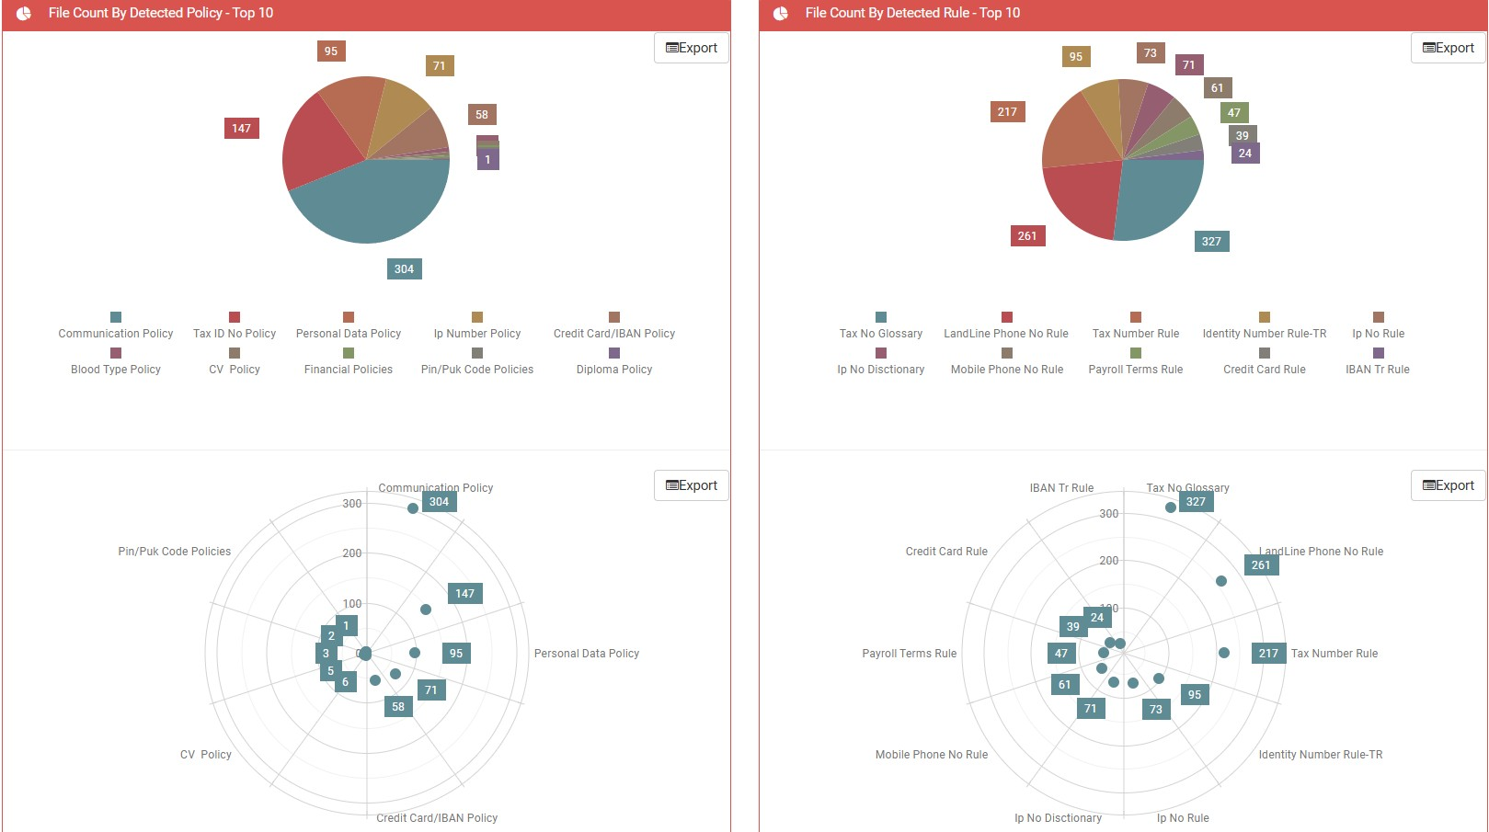
VERIKET DATA CLASSIFICATION · CONSOLE
One Console, Audit-ready
Filter and group instantly
Every logged field is filterable and groupable live in the console — no export-then-analyse cycle.
Export anywhere
PNG, JPG, PDF, SVG, GIF and Excel output for boards, auditors and evidence packs.
Trend analysis
Classification trends and detailed statistics show whether the programme is actually improving.
Delegated administration
Distinct authorization groups with admin accounts at every level, AD-integrated.
Console analytics — detections by policy and rule
siberson.com · info@siberson.com
20 / 30

Slide 21
VERIKET DATA CLASSIFICATION · ARCHITECTURE
Product Architecture — Three Layers, One Policy
The web console distributes policy; agents and add-ins label where the user actually works ; every decision returns to the centre as a log.
MANAGEMENT PLANE
Management Console
Web-based — on-prem, SaaS or multi-tenant in a data centre
AD / Entra ID
User, group and policy targeting
Database
Policy store + classification logs and reports
↓ CLIENT LAYER — LABELLING HAPPENS HERE
Endpoint agent
Windows · macOS · Linux · Pardus — right-click, bulk labelling, encryption
Office add-ins
Word · Excel · PowerPoint · LibreOffice · OpenOffice ribbon
E-mail add-ins
Outlook · OWA · Gmail / Workspace · Zimbra
↓ OUTPUTS — EVIDENCE AND INTEGRATION
Open metadata
Readable by DLP · ERM · CASB — no vendor lock-in
Syslog / SIEM
Events and logs flow to central monitoring
API
Automation and integration endpoints
siberson.com · info@siberson.com
21 / 30

Slide 22
VERIKET DATA CLASSIFICATION · ROLLOUT
How a Classification Project Actually Succeeds
Classification fails when it is switched on everywhere at once. It succeeds as a staged programme — inventory first, blocking last.
siberson.com · info@siberson.com
22 / 30

Slide 23
VERIKET DATA CLASSIFICATION · DEPLOYMENT
Deployment Models
On-premises
Everything inside your boundary — the default for regulated and sovereign environments.
Channel roles
Tenants can be created as owner, distributor, reseller or customer — a distributor can build and license its own network.
SaaS
The management console hosted for you: no server, storage, OS or database licences to buy, faster to start, automatic updates.
Central agent rollout
Via SCCM, Intune or GPO in minutes; silent install.
Data-centre / multi-tenant
Unlimited tenants with fully isolated data and configuration under one platform.
Managed from the browser
The console is web-based — no client install for administrators.
siberson.com · info@siberson.com
23 / 30

Slide 24
VERIKET DATA CLASSIFICATION · METRICS
What to Measure
Classified ratio
Share of discovered sensitive data that carries a label.
User response rate
How often users justify or cancel after a warning.
False-positive rate
Should fall steadily through the tuning phase.
Policy improvements
Number of tunings after the pilot — evidence the programme is alive.
Blocked risky operations
Volume and trend of prevented actions per period.
Audit reportability
Share of incidents with a complete audit trail.
siberson.com · info@siberson.com
24 / 30

Slide 25
VERIKET DATA CLASSIFICATION · EDITIONS
Editions & Licensing
Licensed per user, per year — on-premises or SaaS, with volume discounts. Editions are cumulative.
Capability | Go | Pro | Enterprise
Core capabilities
Manual classification (Office, PDF, files) | ✓ | ✓ | ✓
Visual labeling — headers, footers, watermarks | ✓ | ✓ | ✓
Email classification (Outlook) | ✓ | ✓ | ✓
Persistent metadata (label + GUID) | ✓ | ✓ | ✓
Central web console & AD integration | ✓ | ✓ | ✓
Policy templates + Resource Library (GDPR/ISO/KVKK) | ✓ | ✓ | ✓
Automation & platform
OCR — image & scanned PDF | – | ✓ | ✓
Fingerprinting + policy auto-classification | – | ✓ | ✓
Automated actions — masking, encryption, RMS | – | ✓ | ✓
Microsoft 365 + macOS + SIEM forwarding | – | ✓ | ✓
Enterprise & differentiators
siberson.com · info@siberson.com
25 / 30

Slide 26
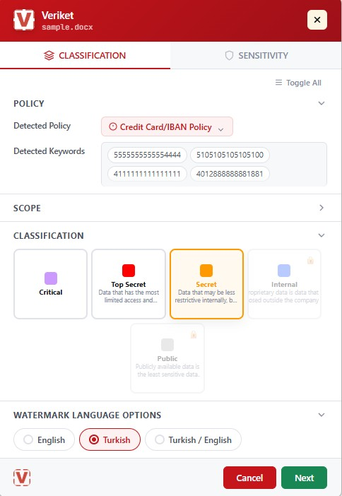
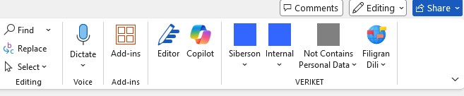
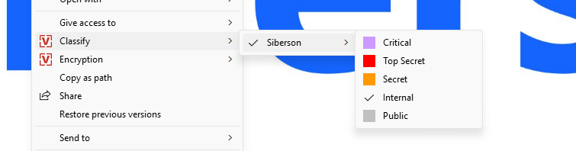
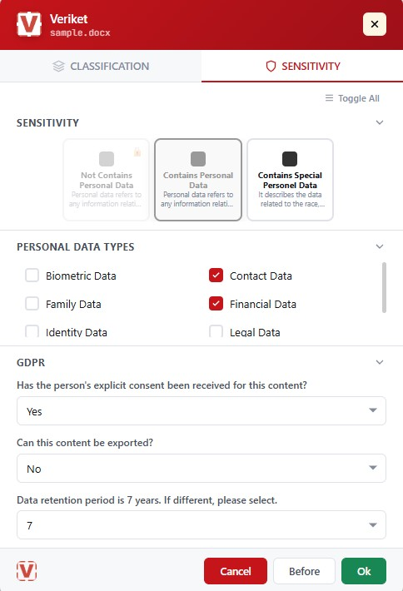
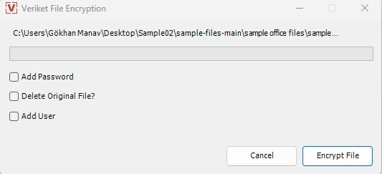
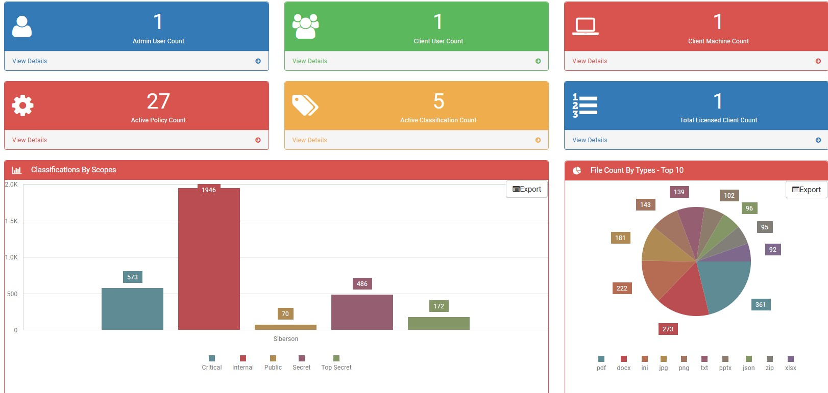
VERIKET DATA CLASSIFICATION · SCREENS
Straight from the Product
Real screens, not mockups — from the user's first right-click to the admin console.
Veriket lives in the Word ribbon — labelling happens inside the docume
Two clicks in Explorer — right-click, classify
The classification dialog — detected policy and content, level selecti
The sensitivity tab — personal-data types, consent, retention (KVKK/GD
One-step file encryption from the same menu
Admin dashboard — classification posture at a glance
siberson.com · info@siberson.com
26 / 30

Slide 27
VERIKET DATA CLASSIFICATION · FAQ
Frequently Asked, Answered
How does licensing work?
Veriket Data Classification is licensed per user; Veriket Data Discovery by scanned data volume (per terabyte). Editions (Go, Pro, Enterprise) set the module scope — see the editions slide.
How long does installation take?
Server components are typically installed within a single business day; agents are deployed centrally via SCCM, Intune or GPO. A typical PoC produces results in two weeks.
Does it affect performance?
The agent is resource-friendly: labelling runs locally and is designed not to introduce noticeable delay in daily office work.
What happens when the license expires?
Labels live in file metadata — independent of the product. When the license ends, new labelling and console management stop; existing labels, watermarks and logged evidence are not lost.
Does our content leave the network?
No. Classification analyses content in place; in an on-premises deployment every component stays inside your network.
Which Office versions are supported?
Microsoft Office 2010 and later, Microsoft 365, LibreOffice and OpenOffice. For e-mail: Outlook, OWA, Gmail / Google Workspace and Zimbra.
Can we bulk-label existing (legacy) files?
Yes — the post-install initial scan and folder-level bulk classification label historical data; for large stores it teams up with Veriket Data Discovery for prioritisation.
Can the label scheme be customised for us?
Yes — level names (TR/EN), colours, defaults, level locking and block-lower-level rules are defined in the console; multiple classification scopes are supported.
How flexible are the watermarks?
Per-format settings for Word, Excel, PowerPoint, PDF and e-mail. Dynamic fields such as [username], [date] and [classification]; headers/footers and screen watermarks included.
Are e-mail attachments controlled too?
Yes — attachments are checked against policy and can be labelled at send time; mandatory labelling is configured separately for external and internal sending.
Is there file encryption?
Yes — Veriket File Encryption from the right-click menu: password protection, adding users and optionally deleting the original.
Does it work with labels from other tools?
Yes — labels are written to open metadata fields, and the console can map other tools' metadata fields; DLP, ERM and CASB products can read the labels.
Is Pardus and Zimbra support built in?
Yes — the agent on Pardus desktops and e-mail classification on Zimbra are built in; both are in production use in public-sector and defense projects.
How does a PoC run?
A typical two-week PoC: scope and policy selection, agent rollout to a pilot group, labelling on sample data, and a joint review of the report output.
siberson.com · info@siberson.com
27 / 30

Slide 28
USE CASES
Real Scenarios, Mapped to the Platform
Pick the scenario closest to the room you are in — each links to the matching product section and the full write-up.
siberson.com · info@siberson.com
28 / 30

Slide 29
POC & NEXT STEPS
From Meeting to Measurable Proof
The strongest close is a concrete next step. A typical path: a scoped proof of concept on your data and policies, a technical evaluation meeting, or a hands-on start with the free self-service tools.
Proof of concept
Scoped to your channels, data types and success criteria — request via the contact page.
Technical meeting
Architecture, requirements and integration questions with Siberson engineers.
Free tools today
Run the vendor-neutral DLP Test or get a Data Risk Score before any commitment.
Partnership
MSSPs and resellers: multi-tenant management and a partner program built for the channel.
siberson.com · info@siberson.com
29 / 30

Slide 30
FREE TOOLS
Measure Your Risk Today
The presentation is over — now look at your own environment. Two free tools produce a concrete picture in your browser within minutes.
siberson.com · info@siberson.com
30 / 30

