Slide 1
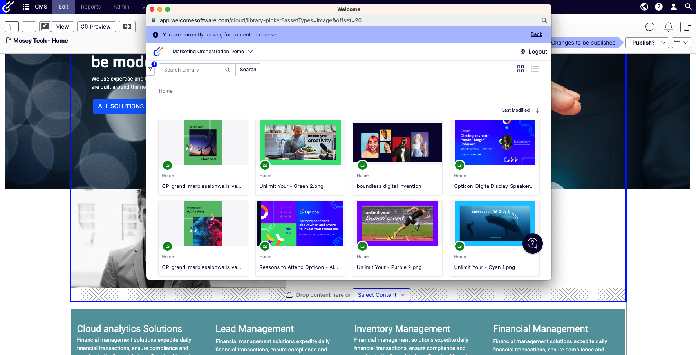

Plan, create and
publish exceptional
digital experiences
Beautiful websites start here...

Slide 2
90%
Marketers include content
in their marketing strategies
- Forbes
Content is the heart of digital experiences
49%
Marketers report almost
half of their budget is spent on content
- Forbes
70%
Consumers feel closer to a brand because of content marketing
- Demand Metrics
Source: Forbes Content Marketing Statistics ; Demand Metrics
Notes:
https://www.forbes.com/advisor/business/software/content-marketing-statistics/
https://www.demandmetric.com/content/content-marketing-infographic
Every interaction a user has with your brand online is shaped by content.
The words, images, and videos on your website tell your brand's story and guide users through their journey. Your social media posts, stories, and live videos engage your audience and create a sense of community. Your email newsletters, promotional offers, and transactional messages keep your audience informed and connected to your brand.
Content marketing and a solid content strategy are non-negotiable for any brand that wants to thrive in the digital age. By investing in high-quality content and delivering it through the right channels, you can build trust, attract leads, drive conversions, and create memorable digital experiences that keep your audience coming back for more.

Slide 3
69%
Of marketers say they don't have the right technology
- CMI
But scaling content is a major challenge
48%
Of marketers say the biggest challenge is repurposing content
- CMI
68%
Of content is wasted due to being unfindable or unusable due to lack of quality
- CMI
Source: Forbes Content Marketing Statistics ; Demand Metrics
Notes:
https://www.forbes.com/advisor/business/software/content-marketing-statistics/
https://www.demandmetric.com/content/content-marketing-infographic
Every interaction a user has with your brand online is shaped by content.
The words, images, and videos on your website tell your brand's story and guide users through their journey. Your social media posts, stories, and live videos engage your audience and create a sense of community. Your email newsletters, promotional offers, and transactional messages keep your audience informed and connected to your brand.
Content marketing and a solid content strategy are non-negotiable for any brand that wants to thrive in the digital age. By investing in high-quality content and delivering it through the right channels, you can build trust, attract leads, drive conversions, and create memorable digital experiences that keep your audience coming back for more.

Slide 4
Great content marketing tools are a revolutionary move for businesses. Companies that use them are 20% more productive than those that don’t.
- Digital Marketing Institute
But it’s
worth it
58% of B2B marketers reported increased sales and revenue in 2023 thanks to content marketing.
- CMI
Content marketing costs 62% less than most other types of marketing while delivering 3 times the number of actual leads on average.
- CMI
Source: Forbes Content Marketing Statistics ; Demand Metrics
Notes:
https://www.forbes.com/advisor/business/software/content-marketing-statistics/
https://www.demandmetric.com/content/content-marketing-infographic
Every interaction a user has with your brand online is shaped by content.
The words, images, and videos on your website tell your brand's story and guide users through their journey. Your social media posts, stories, and live videos engage your audience and create a sense of community. Your email newsletters, promotional offers, and transactional messages keep your audience informed and connected to your brand.
Content marketing and a solid content strategy are non-negotiable for any brand that wants to thrive in the digital age. By investing in high-quality content and delivering it through the right channels, you can build trust, attract leads, drive conversions, and create memorable digital experiences that keep your audience coming back for more.

Slide 5



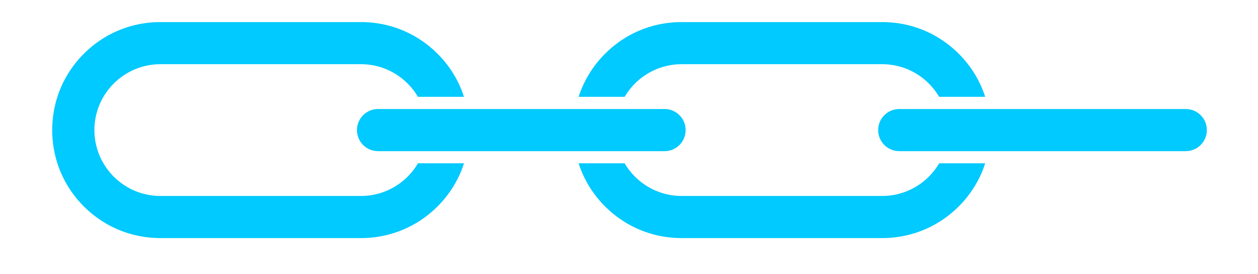
The content supply chain is broken
Marketing teams
are using too
many different, disconnected tools.
Lack of resources and repeatable processes.
Content is used once or completely wasted.
Stale digital experiences due
to technical dependencies.
Notes:
So, why is it so hard to do personalization well? There are a lot of factors that make it challenging.
Many businesses don’t have user-friendly tools to create personalization campaigns.
Additionally, it’s a common struggle to personalize websites in real-time, when it matters most.
A big reason for this is that customer data is usually stored in multiple locations, making it hard to get a unified view of their customers, manage audiences, and scale programs.
Another challenge is a lack of tools or the processes to test and measure the impact of their personalization efforts, making it hard to optimize and improve.
And finally, many businesses have disjointed teams and tools that make collaboration and alignment difficult. This is a defining challenge why a lot of programs struggle to scale.
Does any of this sound familiar to you? How are you currently dealing with these challenges?

Slide 6




Analyze
Plan
Plan
Empower marketers to streamline the entire content supply chain, from initial concept to global delivery.
Experiment
Create
Create
Personalize
Store
Store
Orchestrate the content supply chain
Publish
Globalize
Publish
Globalize
Layout
Supercharge your marketing efforts.
Layout
Notes:
Our comprehensive solution is comprised of industry-leading, best-in-class tools including a CMP, DAM, and CDP—fully integrated with our CMS to support the entire content lifecycle.
Together, these products provide critical capabilities for modern marketing teams, enabling:
Better collaboration through shared calendars, workflows, and intuitive Editors
Delivery of personalized content that’s relevant to each individual through AI-powered content recommendations
Data-driven decision-making with rich customer data and content analytics
Data protection & regulatory compliance with modern content governance capabilities and enterprise-grade support & security certifications

Slide 7
The solution
Planning & Creation
Publishing & Personalization
Content Marketing Platform
Content Management System
Collaboratively plan and create exceptional content and campaigns with a 7x Leader in the Gartner Magic Quadrant for Content Marketing Platforms.
Deliver incredible content experiences with marketer-friendly tools—via a headless or coupled approach.
Content reuse
Digital Asset Management
Shared collaboration
Shared Calendars
Intelligent Workflows
Easy-to-Use Editors
Data & insights
Content Analytics
Efficiency Reporting
Content Recommendations
Enterprise scale
Governance
Security
Integrations & Open APIs
Enablement Services
Ongoing Support
Training & Documentation
Notes:
Our comprehensive solution is comprised of industry-leading, best-in-class tools including a CMP, DAM, and CDP—fully integrated with our CMS to support the entire content lifecycle.
Together, these products provide critical capabilities for modern marketing teams, enabling:
Better collaboration through shared calendars, workflows, and intuitive Editors
Delivery of personalized content that’s relevant to each individual through AI-powered content recommendations
Data-driven decision-making with rich customer data and content analytics
Data protection & regulatory compliance with modern content governance capabilities and enterprise-grade support & security certifications

Slide 8
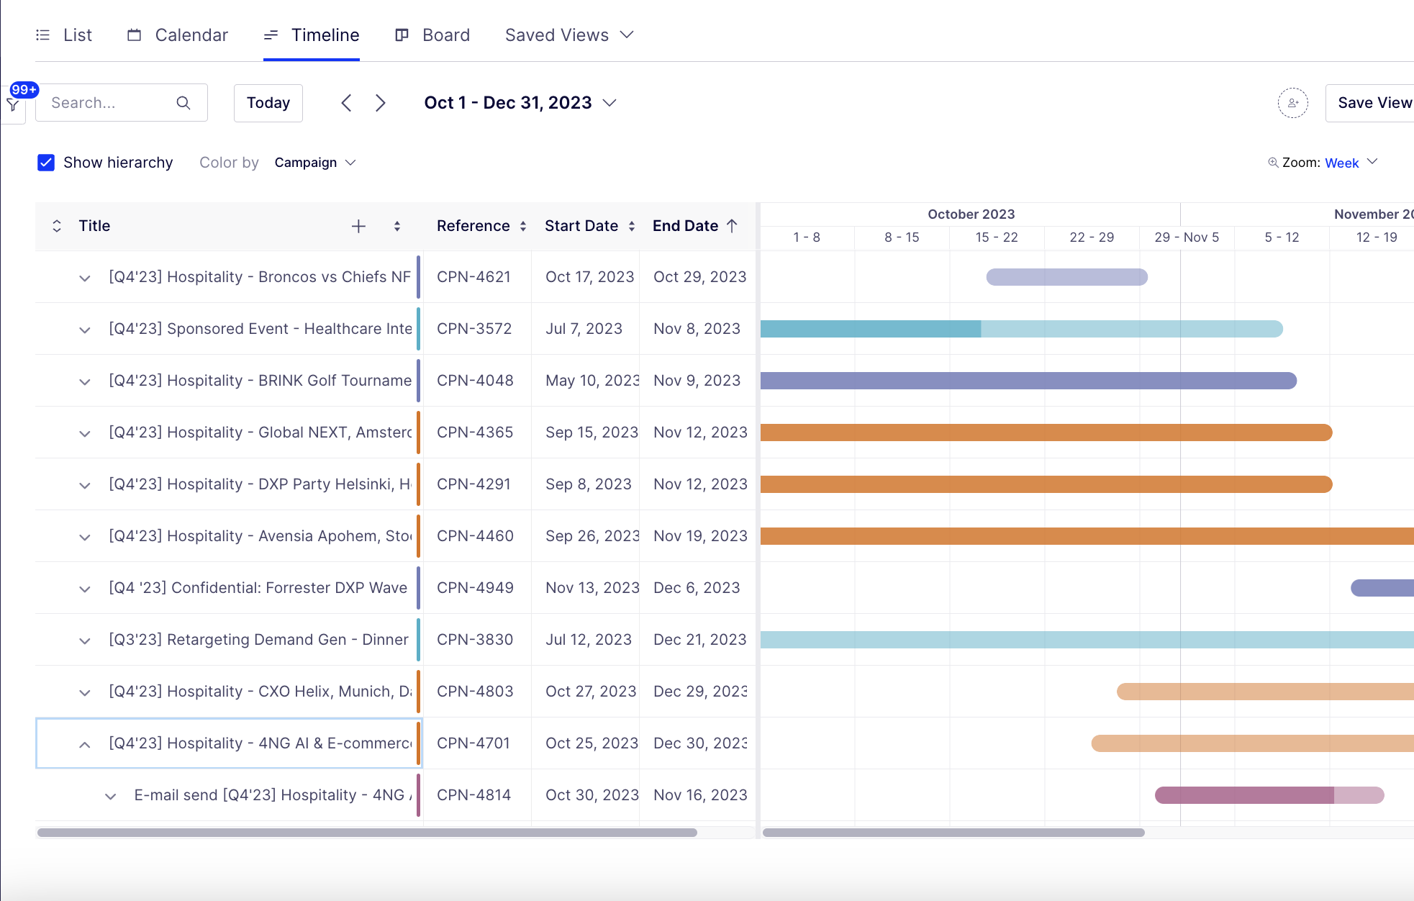
Plan
Create
Store
Globalize
Layout
Publish
Enabling marketers to plan collaboratively
Multi-view calendars and shared workspaces give full visibility into what's happening, when
Flexible workflows ensure content is moved swiftly through the creation and approval process
Dynamic intake request forms ensure requestors provide all the relevant information
Notes:
Our comprehensive solution is comprised of industry-leading, best-in-class tools including a CMP, DAM, and CDP—fully integrated with our CMS to support the entire content lifecycle.
Together, these products provide critical capabilities for modern marketing teams, enabling:
Better collaboration through shared calendars, workflows, and intuitive Editors
Delivery of personalized content that’s relevant to each individual through AI-powered content recommendations
Data-driven decision-making with rich customer data and content analytics
Data protection & regulatory compliance with modern content governance capabilities and enterprise-grade support & security certifications

Slide 9
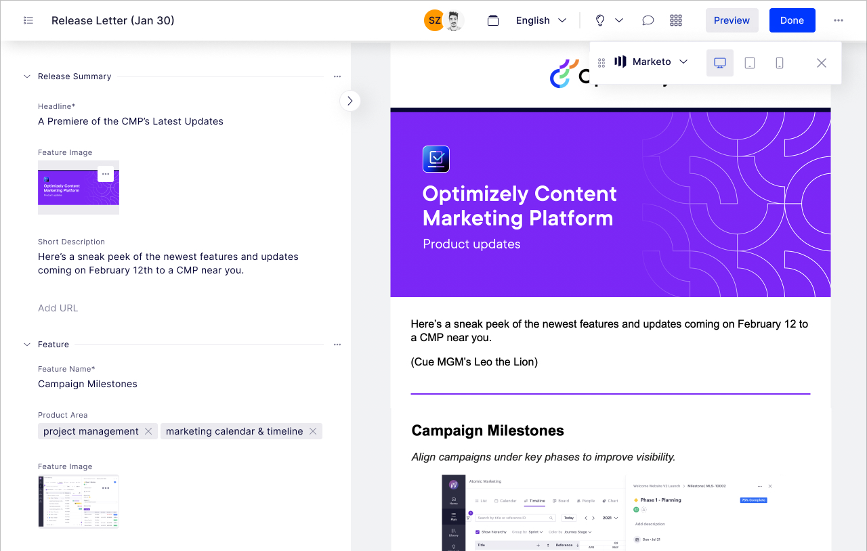
Plan
Create
Store
Globalize
Layout
Publish
Scale campaign & content production
Build content in any format
Use flexible workflows to make sure content is swiftly reviewed and approved
Provide feedback easily through comments, markups and annotations
Supplement with AI to accelerate content production
Get a side-by-side preview of how content will look before publishing
Notes:
Our comprehensive solution is comprised of industry-leading, best-in-class tools including a CMP, DAM, and CDP—fully integrated with our CMS to support the entire content lifecycle.
Together, these products provide critical capabilities for modern marketing teams, enabling:
Better collaboration through shared calendars, workflows, and intuitive Editors
Delivery of personalized content that’s relevant to each individual through AI-powered content recommendations
Data-driven decision-making with rich customer data and content analytics
Data protection & regulatory compliance with modern content governance capabilities and enterprise-grade support & security certifications

Slide 10
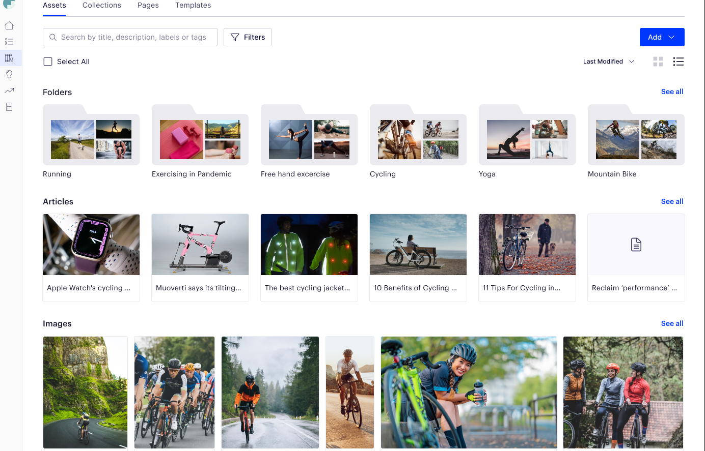
Plan
Create
Store
Globalize
Layout
Publish
Get the most out of content
Manage and store all brand-approved assets in one single place
Increase reuse of content with integrated creation and publishing workflows (or pull assets directly into Optimizely CMS!)
Control your brand with shareable collections, asset expiration, and brand portals and templates
Notes:
Our comprehensive solution is comprised of industry-leading, best-in-class tools including a CMP, DAM, and CDP—fully integrated with our CMS to support the entire content lifecycle.
Together, these products provide critical capabilities for modern marketing teams, enabling:
Better collaboration through shared calendars, workflows, and intuitive Editors
Delivery of personalized content that’s relevant to each individual through AI-powered content recommendations
Data-driven decision-making with rich customer data and content analytics
Data protection & regulatory compliance with modern content governance capabilities and enterprise-grade support & security certifications

Slide 11
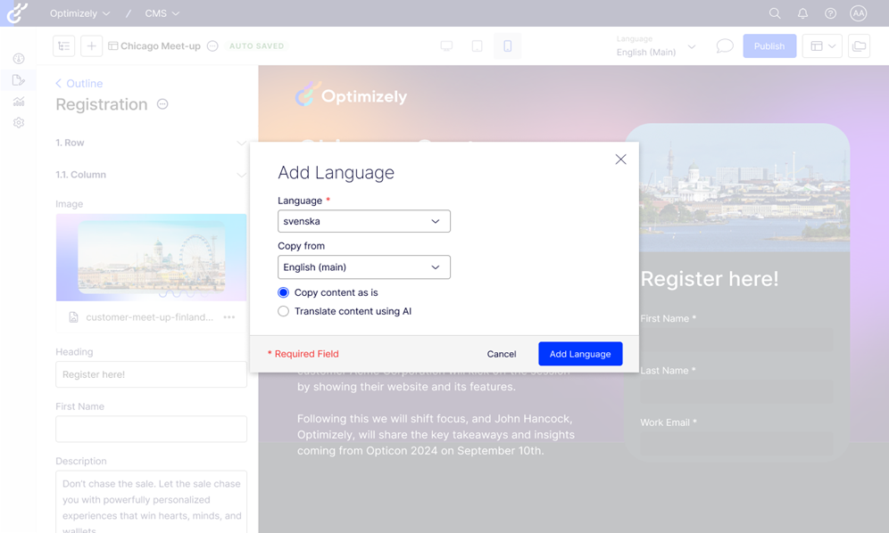
Plan
Create
Store
Globalize
Layout
Publish
Optimize the experience for global teams and audiences
  Translate content into 350+ supported languages and define fallback languages for non-translated content
  Switch the language for the editorial user interface so your teams can work in their preferred language and still translate the content into another language
  Control how users are directed to the appropriate language version of your website based on their preferences or browser settings
Notes:
Our comprehensive solution is comprised of industry-leading, best-in-class tools including a CMP, DAM, and CDP—fully integrated with our CMS to support the entire content lifecycle.
Together, these products provide critical capabilities for modern marketing teams, enabling:
Better collaboration through shared calendars, workflows, and intuitive Editors
Delivery of personalized content that’s relevant to each individual through AI-powered content recommendations
Data-driven decision-making with rich customer data and content analytics
Data protection & regulatory compliance with modern content governance capabilities and enterprise-grade support & security certifications

Slide 12
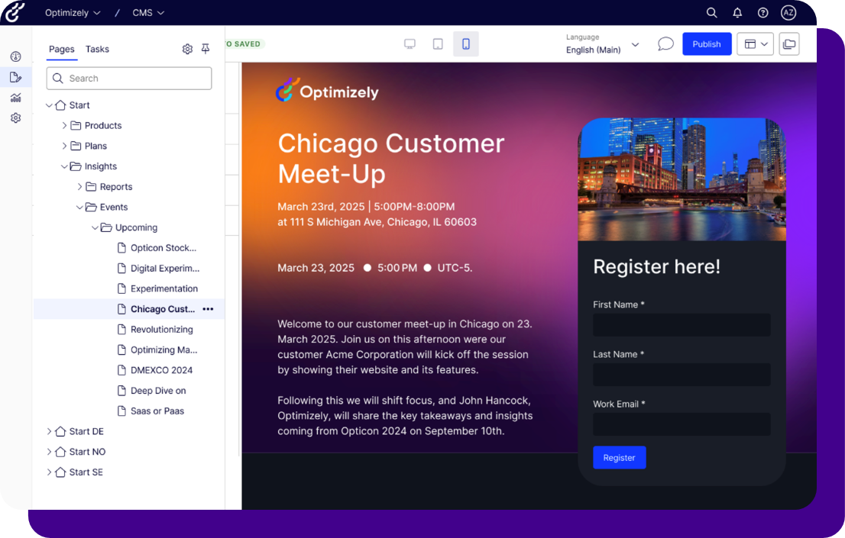
Plan
Create
Store
Globalize
Layout
Publish
Create a kick-a** digital experience
Built for the marketer, drag-and-drop visual interface to create, edit and publish
  Make changes directly on the page in a state-of-the-art side-by-side editing experience
  Users can easily create templates and custom components by dragging and dropping elements onto a page, making it simple to create custom pages and experiences
  No coding expertise is needed
Notes:
Our comprehensive solution is comprised of industry-leading, best-in-class tools including a CMP, DAM, and CDP—fully integrated with our CMS to support the entire content lifecycle.
Together, these products provide critical capabilities for modern marketing teams, enabling:
Better collaboration through shared calendars, workflows, and intuitive Editors
Delivery of personalized content that’s relevant to each individual through AI-powered content recommendations
Data-driven decision-making with rich customer data and content analytics
Data protection & regulatory compliance with modern content governance capabilities and enterprise-grade support & security certifications

Slide 13
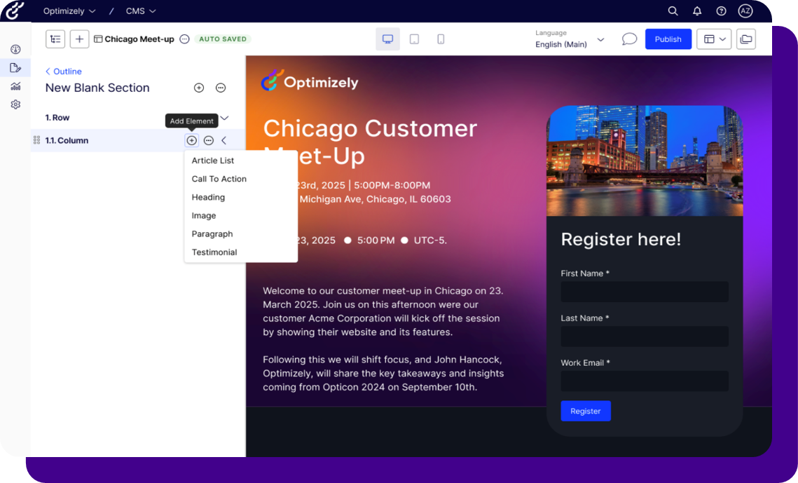
Plan
Create
Store
Globalize
Layout
Publish
Deliver content across all channels and platforms at lightning speed
  AI-driven content recommendations that provide a personalized journey across the web
  Seamless content delivery across all channels, web, apps, social media, email and more
  High performance and availability, even under heavy traffic loads while protecting your valuable content and customer data
Notes:
Our comprehensive solution is comprised of industry-leading, best-in-class tools including a CMP, DAM, and CDP—fully integrated with our CMS to support the entire content lifecycle.
Together, these products provide critical capabilities for modern marketing teams, enabling:
Better collaboration through shared calendars, workflows, and intuitive Editors
Delivery of personalized content that’s relevant to each individual through AI-powered content recommendations
Data-driven decision-making with rich customer data and content analytics
Data protection & regulatory compliance with modern content governance capabilities and enterprise-grade support & security certifications

Slide 14
Create better content & digital experiences, faster
Lower TCO
Do more
with less
Maximize content ROI
Increase conversions
Adopt an integrated suite of tools that connect the entire content supply chain.
Leverage AI, automate and create repeatable and collaborative processes.
Get the most out of your content by repurposing and delivering to any channel.
Deliver engaging content to market fast with tools that are purpose-built for marketers.
Notes:
In today's fast-paced digital landscape, marketers are constantly seeking ways to streamline operations, maximize efficiency, and drive better results. Optimizely One emerges as a game-changing solution that addresses these challenges head-on.
Key Benefits for Marketers:
Lower Total Cost of Ownership (TCO):
Consolidated Platform: Optimizely One eliminates the need for multiple disparate tools, consolidating essential marketing functions into a single unified platform. This consolidation reduces licensing fees, integration costs, and maintenance overhead, leading to significant cost savings.
Streamlined Workflows: By centralizing content creation, experimentation, personalization, and analytics, Optimizely One streamlines workflows, reducing the time and resources required to execute campaigns. This efficiency translates to lower operational costs and improved team productivity.
Do More with Less Tools:
All-in-One Solution: Optimizely One provides a comprehensive suite of tools that cover the entire marketing lifecycle. From content management and experimentation to personalization and analytics, marketers have everything they need in one place. This eliminates the need to juggle multiple tools, simplifying processes and improving collaboration.
Seamless Integrations: While consolidating core functions, Optimizely One also offers seamless integrations with popular third-party tools. This flexibility allows marketers to leverage their existing investments while benefiting from the unified platform's capabilities.
Maximize Content ROI:
Data-Driven Optimization: The platform's robust analytics capabilities provide marketers with deep insights into content performance. By understanding what resonates with different audiences, marketers can continuously optimize content strategies to drive better results.
Increase Conversions:
Content testing: Optimizely Oneenable marketers to test different variations of content, landing pages, and campaigns to identify the most effective approaches. This data-driven experimentation leads to continuous improvement and increased conversion rates.
By combining content testing and analytics, Optimizely One empowers marketers to optimize every step of the customer journey. This holistic approach drives higher engagement, reduces friction, and ultimately leads to more conversions.

Slide 15









Trusted by the biggest and best brands across the globe
Notes:
In today's fast-paced digital landscape, marketers are constantly seeking ways to streamline operations, maximize efficiency, and drive better results. Optimizely One emerges as a game-changing solution that addresses these challenges head-on.
Key Benefits for Marketers:
Lower Total Cost of Ownership (TCO):
Consolidated Platform: Optimizely One eliminates the need for multiple disparate tools, consolidating essential marketing functions into a single unified platform. This consolidation reduces licensing fees, integration costs, and maintenance overhead, leading to significant cost savings.
Streamlined Workflows: By centralizing content creation, experimentation, personalization, and analytics, Optimizely One streamlines workflows, reducing the time and resources required to execute campaigns. This efficiency translates to lower operational costs and improved team productivity.
Do More with Less Tools:
All-in-One Solution: Optimizely One provides a comprehensive suite of tools that cover the entire marketing lifecycle. From content management and experimentation to personalization and analytics, marketers have everything they need in one place. This eliminates the need to juggle multiple tools, simplifying processes and improving collaboration.
Seamless Integrations: While consolidating core functions, Optimizely One also offers seamless integrations with popular third-party tools. This flexibility allows marketers to leverage their existing investments while benefiting from the unified platform's capabilities.
Maximize Content ROI:
Data-Driven Optimization: The platform's robust analytics capabilities provide marketers with deep insights into content performance. By understanding what resonates with different audiences, marketers can continuously optimize content strategies to drive better results.
Increase Conversions:
Content testing: Optimizely Oneenable marketers to test different variations of content, landing pages, and campaigns to identify the most effective approaches. This data-driven experimentation leads to continuous improvement and increased conversion rates.
By combining content testing and analytics, Optimizely One empowers marketers to optimize every step of the customer journey. This holistic approach drives higher engagement, reduces friction, and ultimately leads to more conversions.

Slide 16



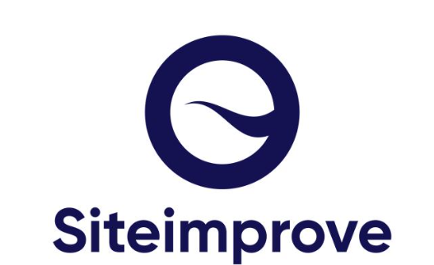
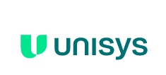

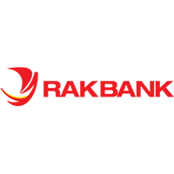

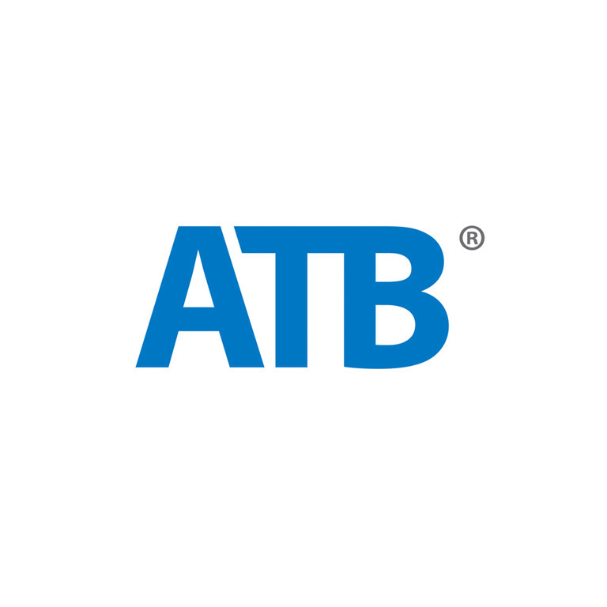
Trusted by the biggest and best brands across the globe

Slide 17




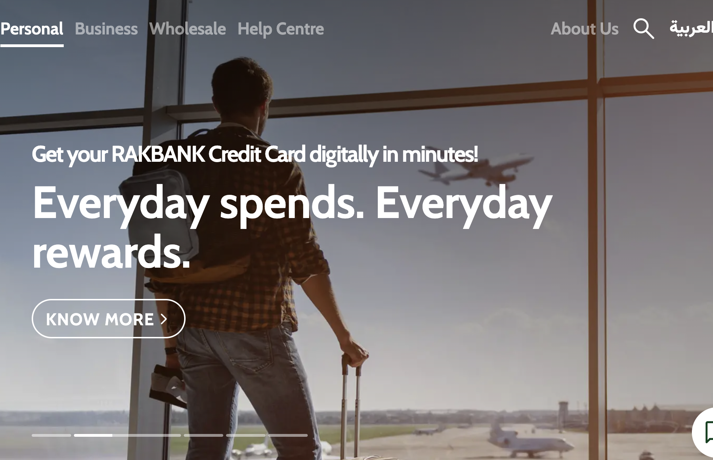
CUSTOMER SPOTLIGHT
RAKBANK transformed their digital presence with Optimizely One, supercharging efficiency, boosting website engagemen and increasing conversions.
37%
Increase in website engagement
9 hours
saved per week on manual tasks
Notes:
We have customers across various industries, but here are a few examples of marketing organizations that have completely transformed the way the marketing organizations work (and increased their performance) with Optimizely.
Here's a quick look at RAKBANK, a leading bank in the UAE. They were facing challenges with revamping their website and digital and content marketing operations, Specifically:
Teams were working in silos: Without a single place to manage and execute projects and campaigns, RAKBANK was faced with operational inefficiencies and a lack of visibility across what each team was working on.
Outdated technology: RAKBANK was relying on a legacy CMS that they had used for over 10 years, which required developer assistance and made it difficult for marketing to update content. They also lacked the functionality to run experiments and personalize their website.
Disconnected tech stack: RAKBANK lacked an integrated tool to store their marketing assets for easy reuse and was unable to seamlessly create and deliver content in a headless fashion due to the limitations of their legacy CMS.
RAKBANK chose Optimizely One for its suite of integrated products to transform their digital presence and the way their marketing team worked.
Content Marketing Platform (CMP): To more effectively manage their campaigns, tasks, workflows, and assets, RAKBANK implemented Optimizely CMP.
Content Management System (CMS): The bank migrated its website from HCL to Optimizely CMS, which offered faster load times, easier content updates, and more flexibility.
Digital Asset Management (DAM): RAKBANK utilizes Optimizely’s integrated DAM to organize and manage their brand-approved marketing assets, which can now be easily discovered, reused and repurposed through its integration with Optimizely CMS.

Slide 18
CUSTOMER SPOTLIGHT
Challenge
Solution
Outcomes
Lacked a centralized place to intake requests, strategically plan, and collaborate on
campaigns and content that would seamlessly connect to the rest of the Optimizely One suite.
Operating in silos: Their generic project management tool was disconnected from the actual creation and execution of their work, resulting in a lack of visibility and efficient collaboration.
Duplicated and wasted efforts: Content lived in separate spreadsheets, documents, and drives, making it difficult to find brand-approved assets and easily repurpose them, particularly to Optimizely CMS.
Disconnected tech stack: Without a tool for planning, creation and collaboration, that connected to Optimizely CMS, data platform and experimentation tools, they were missing a vital piece of the marketing lifecycle.
Optimizely migrated from Asana to their Content Marketing Platform, which kickstarted their marketing transformation and became the thread of their suite of Optimizely One products.
Content Marketing Platform: Allowed Optimizely to simplify their marketing processes, and enabled them to intake, collaboratively plan and create, and reuse content across various channels.
Content Management System: CMS12 and SaaS Core provided more flexibility, so Optimizely's marketing team could choose the implementation based on each site’s specific need. Data Platform and Content Recommendations helped ensure tailored digital experiences.
Experiment Collaboration: Enabled Optimizely's marketing team to adopt a “culture of experimentation” and democratize the ideation and creation of experiments.
Leveraging a suite of integrated Optimizely One products enabled Optimizely to make a complete marketing transformation.
Increased efficiency: Optimizely’s marketing team can now run hundreds of campaigns as well as 50+ concurrent experiments at any given time.
Lower marketing spend: More collaboration, better visibility and less duplicated efforts allowed Optimizely to reduce their marketing spend by 31%.
Improved cost per MQL: With a more streamlined approach to planning and executing campaigns and experiments, Optimizely reduced their average cost per MQL by 50%.
Notes:
Outcomes: Leveraging a suite of integrated Optimizely One products enabled Optimizely to make a complete marketing transformation.
Increased efficiency: Optimizely’s marketing team can now run hundreds of campaigns as well as 50+ concurrent experiments at any given time.
Lower marketing spend: More collaboration, better visibility and less duplicated efforts allowed Optimizely to reduce their marketing spend by 31%.
Improved cost per MQL: With a more streamlined approach to planning and executing campaigns and experiments, Optimizely reduced their average cost per MQL by 50%.

Slide 19




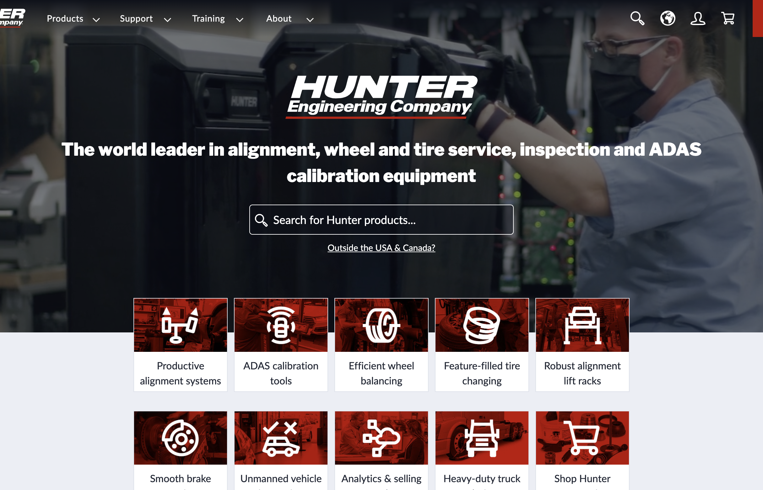
CUSTOMER SPOTLIGHT
How Hunter Engineering transformed content production, delivery, and digital commerce with a trusted software partner.
+88%
Lead generation
+72%
Traffic increase
Multiplied content output
Notes:
Challenge: Hunter Engineering wanted to accelerate their digital presence due to COVID-related restrictions and streamline content production needed to launch high quality content.
Limited commerce platform: Hunter Engineering found it difficult to manage multiple users on their CMS, leading to stagnant adoption and usage.
Outdated content production process: Manual content editing using pen and paper slowed approvals and delayed production.
Need for intuitive technology: Platform onboarding was time consuming and stifled collaboration and site fixes.
Solution: Optimizely One enabled Hunter Engineering to fast-track content production and scale their business globally.
Content Management System: Hunter launched personalized content experiences and streamlined product catalog management for their e-commerce site.
Customized Commerce: Hunter’s partner team crafted an engaging site experience that could extend their brand globally and empowered non-technical users to curate engaging buying experiences.
Content Marketing Platform: Hunter Engineering ditched outdated content production methods to centralize content with a cloud-based solution where employees can create, collaborate, and manage content and approvals.

Slide 20
CUSTOMER SPOTLIGHT
Challenge
Solution
Outcomes
Hunter Engineering wanted to accelerate their digital presence due to COVID-related restrictions and streamline content production needed to launch high quality content.
Limited commerce platform: Hunter Engineering found it difficult to manage multiple users on their CMS, leading to stagnant adoption and usage.
Outdated content production process: Manual content editing using pen and paper slowed approvals and delayed production.
Need for intuitive technology: Platform onboarding was time consuming and stifled collaboration and site fixes.
Optimizely One enabled Hunter Engineering to fast-track content production and scale their business globally.
Content Management System: Hunter launched personalized content experiences and streamlined product catalog management for their e-commerce site.
Customized Commerce: Hunter’s partner team crafted an engaging site experience that could extend their brand globally and empowered non-technical users to curate engaging buying experiences.
Content Marketing Platform: Hunter Engineering ditched outdated content production methods to centralize content with a cloud-based solution where employees can create, collaborate, and manage content and approvals.
With Optimizely One, Hunter Engineering created a personalized e-commerce site while digitally empowering their workforce to improve content production.
Increased revenue and engagement: Hunter achieved an 88% increase in digital leads year-over-year (YoY), saw a 20% average month-over-month (MoM) increase in order volume, and a 72% increase in site traffic.
Marketing and content transformation: Hunter enabled employees to collaborate on content production through a cloud-native solution that significantly increased production and boosted employee morale.
Improving the customer experience: With Customized Commerce’s PaaS foundation, Hunter Engineering’s team can create bespoke commerce experiences that delight customers.
Notes:
Outcomes: With Optimizely One, Hunter Engineering created a personalized e-commerce site while digitally empowering their workforce to improve content production.
Increased revenue and engagement: Hunter achieved an 88% increase in digital leads year-over-year (YoY), saw a 20% average month-over-month (MoM) increase in order volume, and a 72% increase in site traffic.
Marketing and content transformation: Hunter enabled employees to collaborate on content production through a cloud-native solution that significantly increased production and boosted employee morale.
Improving the customer experience: With Customized Commerce’s PaaS foundation, Hunter Engineering’s team can create bespoke commerce experiences that delight customers.

Slide 21
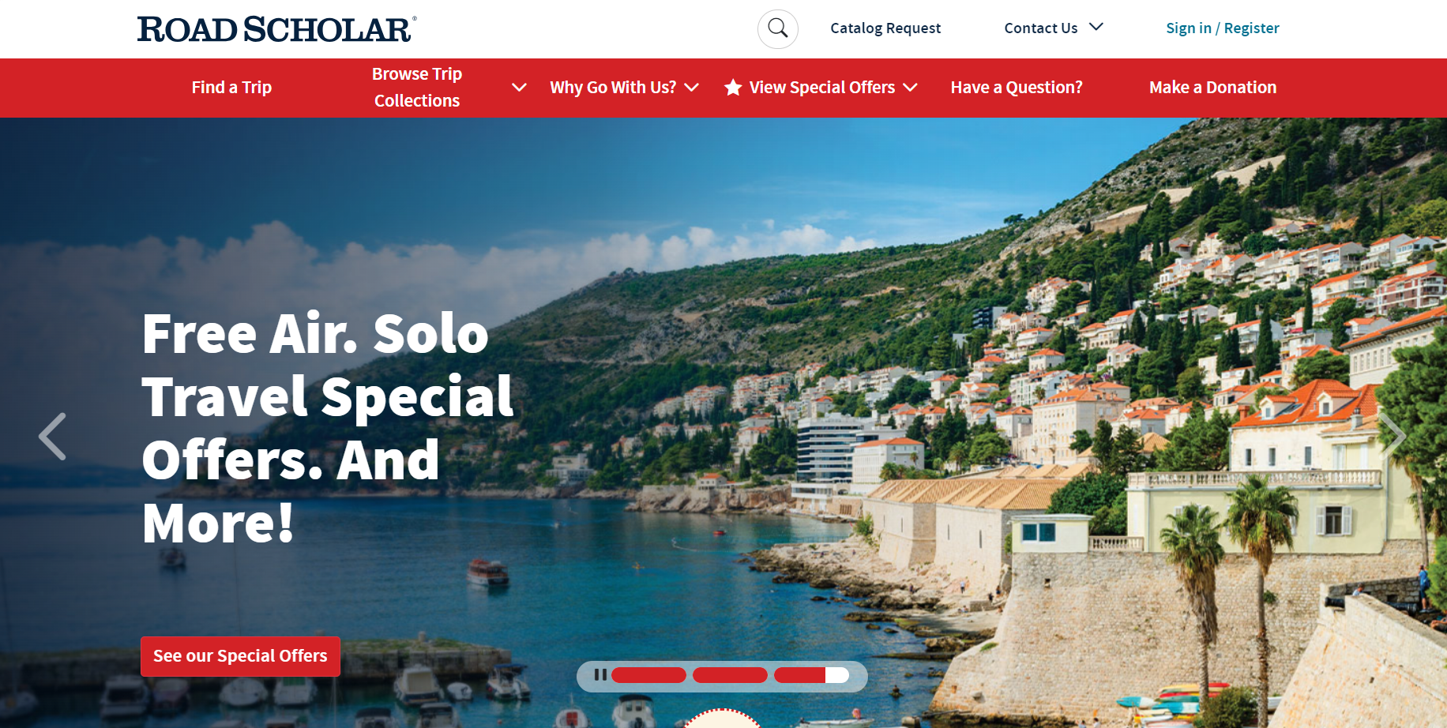
CUSTOMER SPOTLIGHT
How Road Scholar leverages Optimizely One to revitalize its online digital presence, increase conversion rates and transform internal workflow management
+30%
Conversion Rates
+38%
Page Load Speed
Dramatically scaled content creation
Notes:
Top challenges before Optimizely One:
Low conversion rates
Despite having a loyal customer base and a unique value proposition, Road Scholar faced low conversion rates on its website, especially among new visitors who were not familiar with the brand or the concept of educational travel.
Manual and inefficient processes
Road Scholar relied on manual processes and third-party tools to create and update content on its website, which resulted in delays, errors, and inconsistencies.
Facing these multifaceted challenges, Road Scholar realized the need for a comprehensive and integrated solution that could streamline their content management, enhance workflow efficiency, and provide a robust platform. This need for an adaptable, scalable, and integrated digital experience platform led them to choose Optimizely.

Slide 22
CUSTOMER SPOTLIGHT
Challenge
Solution
Outcomes
Road Scholar encountered several critical challenges. The outdated system significantly lacked the modern look and feel needed to attract and retain users, and making any changes to the website was a complex process.
Low Conversion Rates: Despite having a loyal customer base and a unique value proposition, Road Scholar faced low conversion rates on its website, especially among new visitors who were not familiar with the brand or the concept of education travel.
Manual and inefficient processes: Road Scholar relied on manual processes and third-party tools to create and update content on its website, which resulted in delays, errors, and inconsistencies.
Need for modern scalable technology: System lacked the flexibility and customizability required to grow with the organization. It was not scalable, posing a barrier to future development and adaptation.
Optimizely One allowed Road Scholar to experience transformative improvements in their digital capabilities and operational efficiency, creating a more dynamic and engaging digital experience for its users.
Content Management System: The fully supported and customizable nature of the CMS has enabled Road Scholar to set specific usage rules and manage content more efficiently. CMS offered faster load times, easier content updates, and more options to deliver content.
Content Marketing Platform: With around 75 users on CMP, including 20-25 core content creators and the rest involved in approvals and editing, the platform has significantly enhanced collaboration. The shared editing capabilities and visibility into the entire content creation process ensure everyone stays aligned
Digital Asset Management: (DAM) integration allows Road Scholar to manage over 50,000 assets, including images and, soon, videos. The integration between CMP and DAM allows for seamless access and deployment of these assets, improving the speed and efficiency of content creation and publication.
The true power of Optimizely One lies in its ability to integrate multiple products into a single, cohesive platform. This interconnected suite provides a holistic solution that enhances every aspect of Road Scholar's digital presence.
Higher Conversion Rates and Revenue: Road Scholar increased its conversion rates by 30% from March 2023 to March 2024 (including mobile).
Improved website performance: Road Scholar improved its website page load speed by 38%, which has improved the user experience and reduced bounce rates .
Increased Efficiency: Road Scholar has dramatically reduced its content creation and deployment time thanks to the user-friendly and streamlined capabilities of Optimizely CMP and CMS.
Notes:
The true power of Optimizely One lies in its ability to integrate multiple products into a single, cohesive platform. This interconnected suite ensures that CMP, CMS, DAM work seamlessly together, providing a holistic solution that enhances every aspect of Road Scholar's digital presence.
Since adopting Optimizely's integrated suite of products, Road Scholar has experienced transformative improvements in their digital capabilities and operational efficiency. Leveraging the comprehensive tools provided by Optimizely, Road Scholar has created a more dynamic and engaging digital experience for its users.

Slide 23
Thank you!

