Slide 1






Low-сode platform to transform your business
№1 BPMS
in Russia
10 000 000 users
working in our system
2000 customers
in 30 countries

Slide 2


2000
clients
10М
users
30
countries
operates on
8 languages
2000+ implementations, more than
45000 ELMA Community Edition activations
#1 BPM
implementing company in Russia and the CIS
Our 5 own Digital transformation laboratories in universities: BP, AI & ML, MV, Robotics
"Business Automation" and "Business Processes" courses are taught according to the ELMA methodology in 113 universities in 6 countries.
8500 graduates completed these university courses.
5700 people received EVA certificates.
Our own digital transformation certification system
Skolkovo Innovation Centre resident; Included in the Russian Unified Software Register of the Ministry of Digital Development, Communications and Mass Communications of the Russian Federation

Slide 3

























Our customers

Slide 4
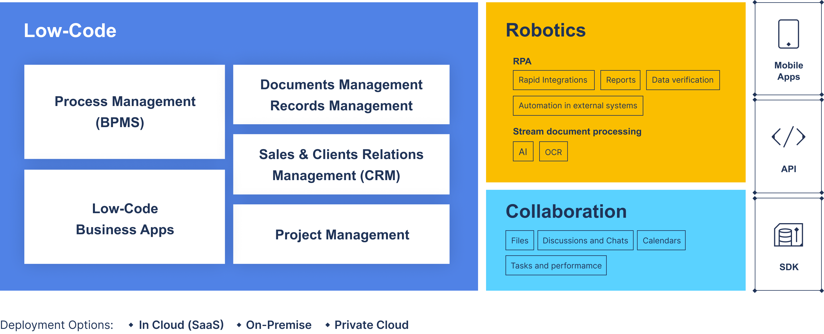
Our Digital Transformation Products

Slide 6
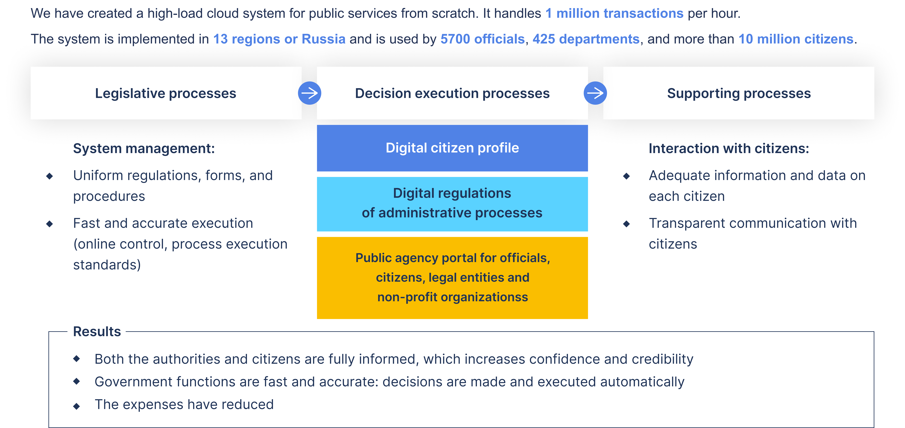
ELMA for Public Sector

Slide 7
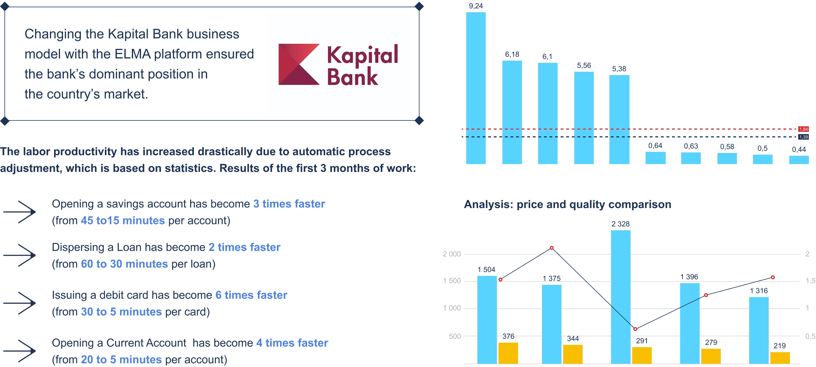
ELMA for Business

Slide 8





Technology
Microservice architecture
Fault tolerance
Easily scalable
Easy to maintain in the enterprise (DevOps, low maintenance, independent environment)
Easy access distribution for mobile, web, and system interaction
Private Cloud mode
Creating streamlined processes that include several companies
Database of reference processes and configurations
Shared libraries and best practices
Connecting new companies to the cloud takes minimum time
Multitenancy
Isolated tenants for set up configurations and data
Multi-tenant resource balance
Advanced technology stacks that are sufficient right now and have a potential for the future growth

Slide 9


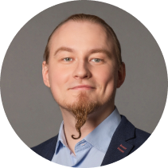
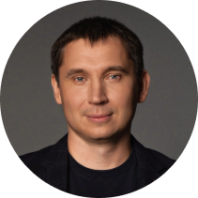
Change with Ease
Luxembourg
50, Rue de la Gare, L-6440, Echternach, Luxembourg,
Phone: + 352 (2) 030 1140
Moscow
117587 Varshavskoje Shosse, 125/1, Russian Federation
Phone: +7 (499) 921-02-87
Izhevsk
426033, 30 Let Pobedy st., 2 Izhevsk, Russian Federation
Phone: +7 (3412) 93-66-93
Kazan
Salimjanova st., 25/501, Russian Federation
Phone: +7 (3412) 93-66-93
Aleksey Trefilov
CEO
trefilov@elewise.com
Kiev
02000, Rusanovskaja Naberezhnaja, 4, Ukraine
Phone: +7 (909) 050-10-06
Almaty
050008, Prospekt Abaja, 68/74, Kazakhstan
Phone: +7 (727) 313-15-04
Vitaly Ponomarev
VP
ponomarev@elewise.com

