Slide 1


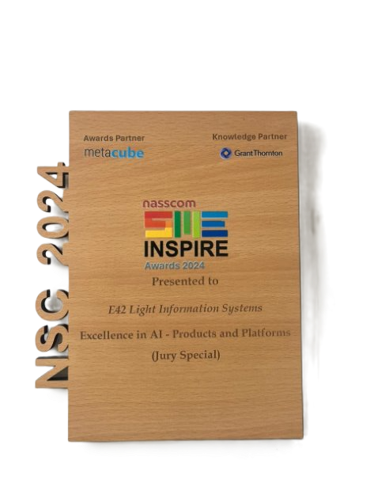






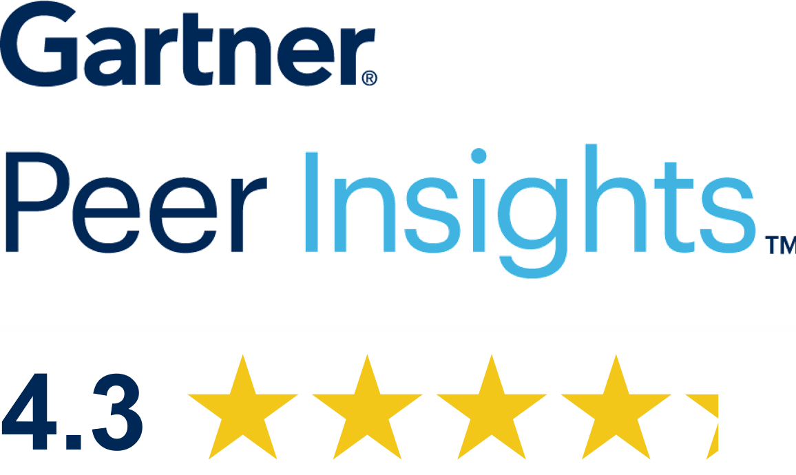


End-to-end Accounts Payable automation with AI Agents
Notes:
Bringing Human Level cognition to Automate AP Process End to End
50+ Large Orns worldwide

Slide 2

Accounts Payable Process
Current Challenges
Manual processing
Brittle existing technology
Lack of Real-Time Visibility & Reporting
Brittle existing technology
High Team workload & TAT
Potential fraud and Anomalies
Prone to errors (e.g., duplicate invoices, missing PO/GRN, contract rate and other data mismatches)
Payment delays
Compromised stakeholder experiences
Inability of RPA solutions process complex data and adapt to changes
Difficulty in adopting new templates
Low accuracy
Exceptions, decisions, communications left to manual handling
Lack of real-time insights - performance tracking, compliance & control
Bottlenecks, exceptions, and SLA breaches go unnoticed
Cash flow predictability
Impact:
High TCO, Scalability
Impact:
Missed deadlines, Poor decision-making, Reduced accountability.
Impact:
Manual work overload, Missed
Discounts, Discrepancies, Irate vendors

Slide 3
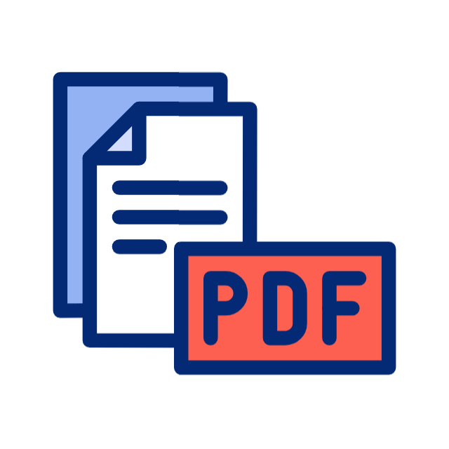


















Meet Neil
Neil - A thinking partner built on intelligence, logic, and purpose. Neil work with a team of specialized AI agents to handle your Accounts Payable end to end, accurately, securely, and without any human touch.
Ingestion
Work bench and AI agents with Neil
PDF
Gmail/Outlook
Paper
Omnichannel
Agent
Exception Handling
Agent
Entry into
ERP
SFTP/Shared folder
Email
File
FAX
Supplier
Async API
Query
Authentication
EDI
SBN
Vendor Portal
Vendor Communication
Dashboard & Reports
Intelligent Document Processing Agent
Validation
Agent
E- Invoices
E-Invoices
PO & GRN Data
Validated & extracted Data
Note: The platform is configured to meet your AP and reconciliation needs

Slide 4



End-to-End AP Automation With Neil the AI Co-Worker for AP
Using Generative AI to bring human on top and communicate with Vendors as and When needed
Neil:
AI Co Worker for AP
Handling Vendor/Supplier
Communication
----
Answering Vendor Emails and Queries, 24x7 support​
Extraction
----
Auto extracting all relevant information from Invoices and other supporting documentation in any format
Approvals
----
Auto approvals for Straight Through Processing (STP) as well as Single/multi-level approvals with time tracking and approval workflows
Storage & Reporting
----
Pushing the invoice pdf into DMS, generating reports, role specific dashboards
Handling Invoices, Supporting Documentation
----
Identifying invoice and other supporting documentation across multiple channels—email, portal, SharePoint
Authentication
----
Authenticating the source of the information and checking against blocked lists
Validation
----
Conducting 2-way, N-way matches, checking against contracts, Govt. Portals and other sources
Entry into ERP
----
Ledger entry into ERP, along with GL Code, Cost Center, etc. Ready to pay status through STP
Notes:
Expand channels – email, chat, portal,

Slide 6
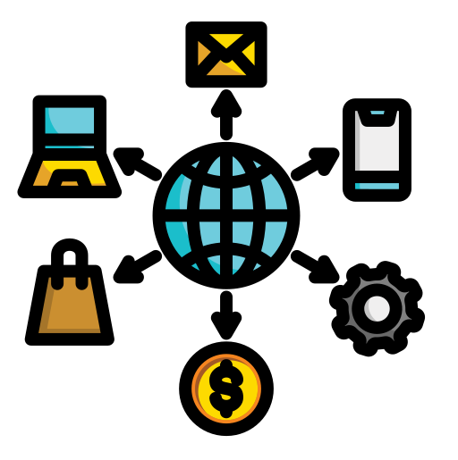









Multilingual AI Agents working in tandem with Neil
Omnichannel Agent
Intelligent Document Processing Agent
Insights Agent
Validation Agent
Exception Handling Agent
Uses GENAI and Communicates across channels (Emails, Portals, APIs, Folders etc.), Collects Invoices and supporting documentation
Uses ICR & LMM models to extract data from PDFs, Images, Scans
Aging reports, AI and Team efficiency reports, Payable prediction.. Role specific insights
Performs 2/3/N-Way matches between invoice, PO, GRN, GSTIN, Contracts, Insurance etc.. Validates against govt portals, country specific taxation and statutory rules.
Resolves issues in real time or brings a stakeholder in the loop for decision
ERP Agent
Support Agent
Risk Detection Agent
Payable Optimization Agent
Approver Agent
Posts clean, validated and approved entries directly into ERP systems.
Uses GENAI to support Vendors, AP Team and CFO – 24x7 – Can converse and plot graphs on demand
Looks for duplicates,
frauds, anomalies , vendor blacklist & risk scoring
Auto approves ready to pay/runs through a workflow to gather required approvals from various stakeholders
Manages Payment optimization for discounts, DPO and conserving cashflow. Provides aging reports.

Slide 7
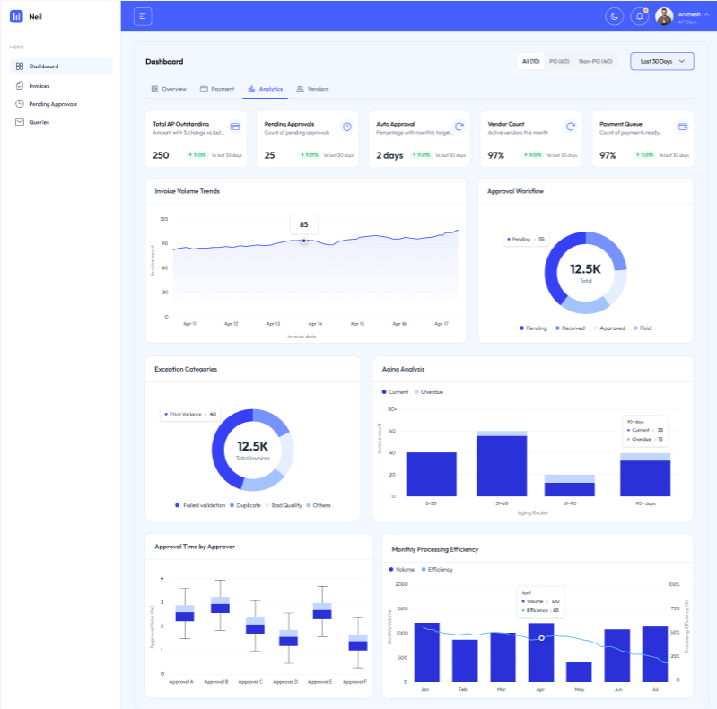
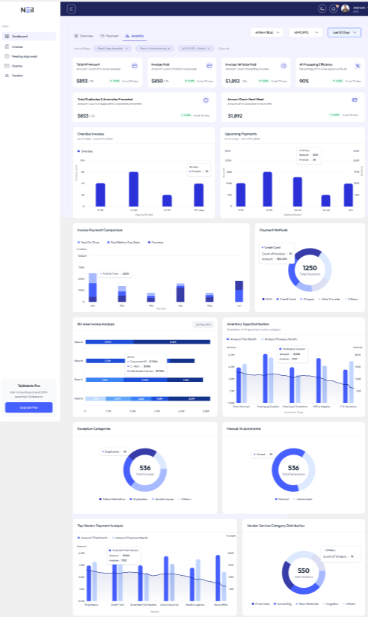
Glimpses (Dashboard analytics)

Slide 8
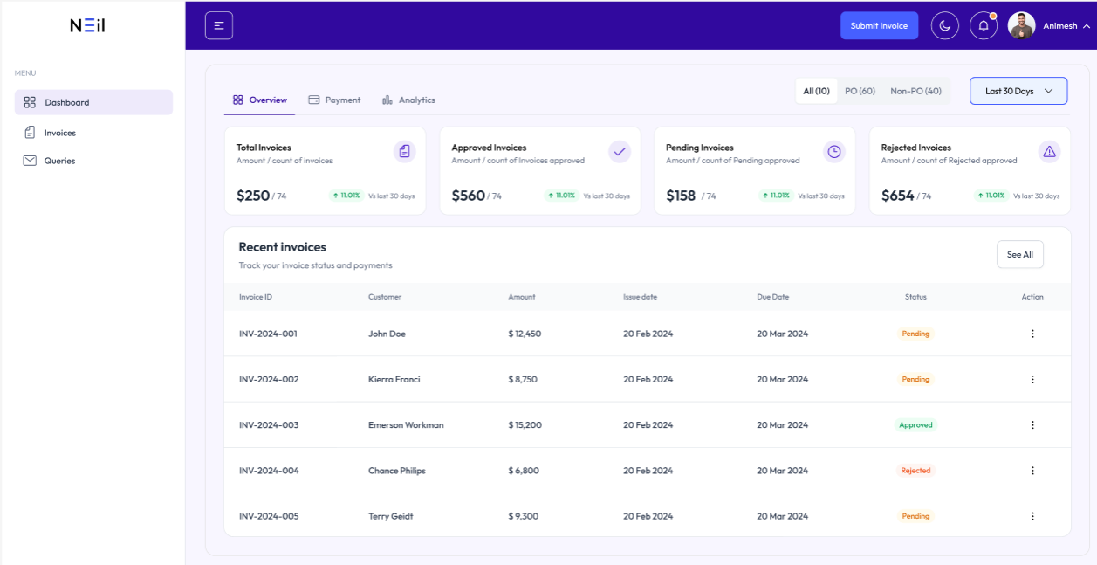
Glimpses (Dashboard analytics)

Slide 9





Business outcomes with Neil (for CFO/Controller)
AP cost reduction: 70–90% lower cost per invoice,
Targeting < 1$ /invoice in steady state.
Working-capital uplift: capture 90–99% of eligible early‑payment discounts,
Measurable DPO optimization with policy-driven scheduling.
Cash‑flow predictability: real‑time liability forecast by due‑date buckets,
Variance to plan reduced by 30–50% (benchmarking against touchless & approval-cyclegains).
Fraud/risk impact: Payment loss avoidance, duplicate & anomaly detection and prevention,
Target >99.9% duplicate catch rate.
Procure-to-pay synergy: when AP + procurement policies run through Neil’s guardrails,
Total P2Psavings potential 20–50% (alignment benchmark).

Slide 10














Operational KPIs with Neil (for AP leadership)
Touchless processing rate: 90% + with agentic exception handlers pushing the upper bound.
Invoice cycle time (receipt→ready‑to‑pay): 10× faster, long tail compressed via agent escalation.
Approval cycle time: 30–60% faster through policy‑aware routing and nudges.
Extraction & validation accuracy: 99% + field‑level accuracy, audited duplicate‑detection before posting.
Exception rate: 60–80% reduction vs. baseline (drivers: N‑way match, vendor normalization).
Cost per invoice (Ops view): aligned to < $1
Supplier experience & SLA: ≥90% of vendor inquiries auto‑answered within seconds via Neil generative AI agents.
Discount capture rate: “available vs. realized,” matric, goal 90–99% with autonomous
scheduling & CFO guardrails.

Slide 11






Observability & governance metrics with Neil (for audits/IT)
AI observability: extraction accuracy by field/vendor; drift alerts; exception taxonomy trends (weekly trend lines)
Security posture: audit log coverage, SSO/MFA adoption, encryption attestations (ISO 27001/SOC 2/GDPR listing in security page).
Audit Trails: Captures the entire data flow and individual records and activities for Audit.
ESG and Responsible AI: E42's Governance board ensures our commitment extends beyond rhetoric, backed by a comprehensive and advanced framework.
Policy compliance: auto‑checks on Tax/GST schemas, 2/3/4‑way match pass rate, segregation‑of‑duties incidents.

Slide 12





Operational KPIs with Neil (for Vendors)
Supplier inquiry support cost drops by40–60% via self‑service status, remittance, and docs
On‑time payments goes up to 75–85% with clearer status, fewer exceptions, and proactive nudges to approvers/vendors
Early‑payment discounts captured goes up to 90-99% by surfacing offers in‑portal and auto‑‑portal and auto-orchestrating windows (discount capture is a highlighted lever).
Vendor satisfaction (CSAT) increase by 70-80% through transparency and faster resolutions

Slide 13




A Leading Manufacturing conglomerate Automates Their AP Process with Neil
Results Delivered
About:
A leading automotive manufacturing company that produces SUVs, EVs, pick-ups, large commercial vehicles, small commercial vehicles, and small utility vehicles.
Project Overview:
The company was facing challenges in its Accounts Payable (AP) process, which involved manual data entry, invoice processing, and vendor servicing across 6000+ suppliers. The process was time-consuming, error-prone, and inefficient, leading to poor vendor experiences and reduced productivity.
What we did:
  Enabled template-free invoice data extraction from multiple formats (PDF, JPEG).
  Built a consolidated view for vendors to validate extracted fields.
  Automated real-time process verification and validation of invoices.
  Implemented auto-entry of validated data into the ERP for ASN generation.
  Enabled automated status updates for vendors to track invoice progress.
  Added omnichannel integration (web and mobile) for approvals and process
  Capture Good Delivery Note and validate and input into ERP
96% accuracy in data extraction.
1000+ person-days saved per month.
100,000+ invoices processed monthly.
Live in 8 weeks
Enhanced vendor relationships with a more transparent, streamlined AP process.
Zero manual errors with real-time monitoring and automation.

Slide 14
Accelerating Accounts Payable for a Leading Pharma Enterprise Through Intelligent Document Processing
Results Delivered
About:
Project Overview:
What we did:
Automated data extraction from aged, noisy, discoloured invoices and legal documents.
Conducted multiple proof-of-concepts (PoCs) to validate high-accuracy extraction.
Handled complex layouts such as nested tables, variable formats, and noisy scans (less than 200 DPI, overexposed, small fonts, dot matrix prints, stamps/marks).
Delivered seamless invoice data processing and ERP readiness.
A leading global pharmaceutical company specializing in the development, manufacturing, and distribution of a wide range of medications and medical devices.
50,000 invoices processed per month (and growing).
82% reduction in processing time and manual effort.
63% faster invoice approval times.
50% backlog reduction within 3 months.
Improved efficiency and compliance, laying the foundation for enterprise-wide IDP adoption across QA, operations, production, and R&D.
The company faced significant challenges in managing a large volume of diverse documents—ranging from invoices and legal files to complex medical notes. Traditional OCR tools struggled with noisy, discoloured, multi-lingual, and legacy-format documents, resulting in inefficiencies, compliance risks, and poor visibility.
The client aimed to streamline their Intelligent Document Processing (IDP) workflows, starting with finance-related documents such as invoices, and later scaling across quality assurance, operations, production, and R&D.

Slide 15
Revolutionizing Accounts Payable for a Leading FMCG Enterprise with AI Automation
Results Delivered
About:
Project Overview:
What we did:
  Smarter Invoice Handling: Managed dot-matrix invoices via structured Excel and unified Gmail + web uploads.
  Automated Tax & Error Checks: Auto-split IGST, fixed errors, and allowed partial Excel processing.
  Seamless ERP Integration: Sent validated data directly to the company’s portal through APIs.
  AI Support & Training: Added AI assistant for FAQs and trained warehouse teams for adoption.
  Full Audit Control: Linked every data point back to its source document for compliance.
A leading Fast-Moving Consumer Goods (FMCG) enterprise, operating at scale with thousands of invoices processed every month across its nationwide supply chain.
3,000+ invoices processed monthly with minimal manual intervention.
60% reduction in manual processing time per invoice.
90%+ extraction accuracy even for low-quality data inputs.
30–40% reduction in AP operational costs.
Faster vendor payments and improved supplier relationships.
40% finance capacity redirected from transactional tasks to analytics.
The company’s Accounts Payable (AP) operations were under severe strain due to unreliable OCR performance on dot-matrix invoices, lack of audit trails, multi-channel chaos (email, Excel, web uploads), and frequent manual tax calculation errors. Vendor payment delays led to disputes, creating friction with suppliers and compliance risks.
To modernize operations, the company partnered with Neil – the AI Accounts Payable Executive to transform its AP process end-to-end.

Slide 16
















































Partners and Customers
Notes:
I feel should add more metric parameters here in stead of just 3.
Such as

Slide 17

Mission
To power enterprises worldwide with AI co-workers performing various roles alongside humans.
Vision
Making enterprises intelligent, one AI worker at a time, while elevating humans towards higher value contribution to society at large.
Contact: interact@e42.ai
Office
E42 Inc.
8, The Green STE 10547
Dover, DE 19901 USA
Marisoft – 1, 5th floor, Marigold Complex,
Behind Big Cinema, Kalyan Nagar,
Pune – 411014, India
https://apautomation.solutions/
This document contains confidential information of e42.ai. No use or disclosure shall be made without the written consent of e42.ai

