Slide 1
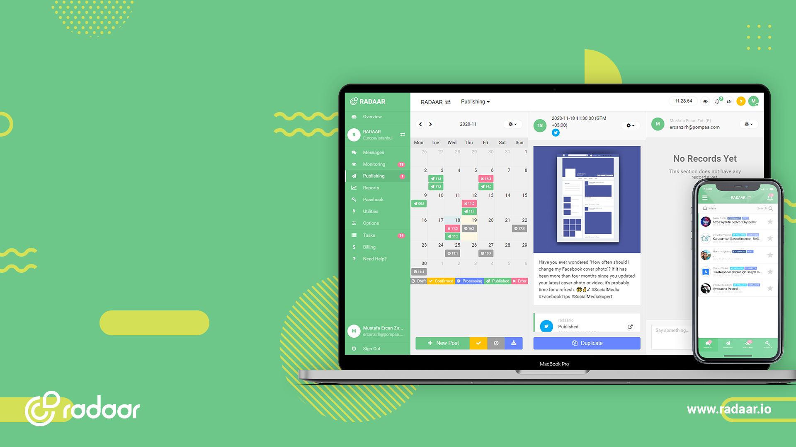
A BEST-IN-CLASS PLATFORM
Manage all your
social media
accounts
in one place!

Slide 2

A BEST-IN-CLASS PLATFORM
A stunning social media management and collaboration
platform designed for handling multiple brands.

Slide 3

WHY YOU SHOULD USE?
If you manage multiple social media accounts, serve multiple brands,
or work as a crowded team, you should definitely use RADAAR.

Slide 4

BUILT FOR MARKETERS
A platform for brands, agencies, and startups that wants to engage
followers, publish unique content, and measure performance.

Slide 5
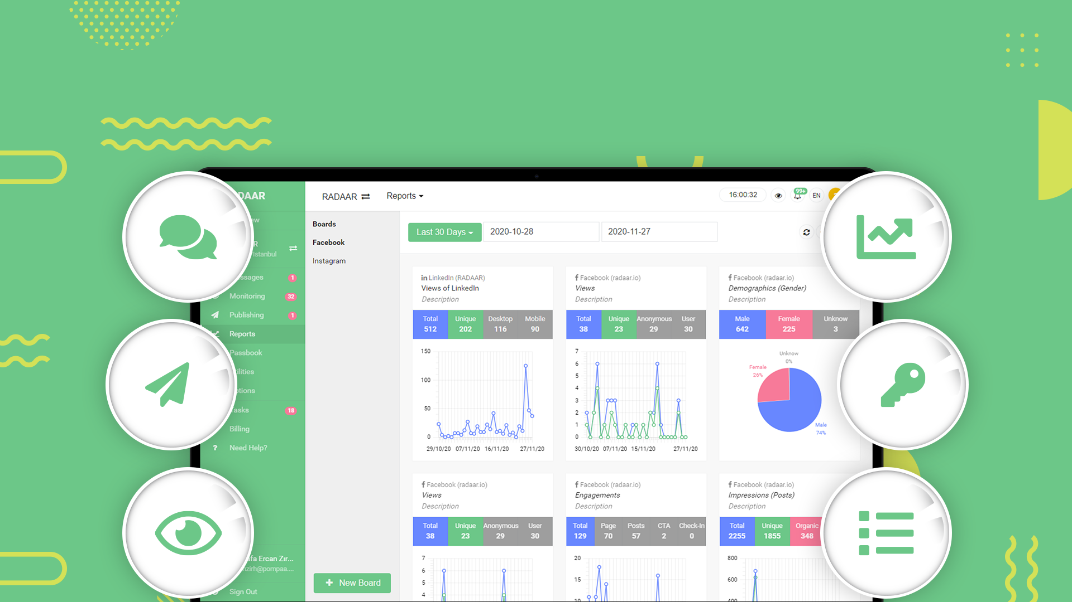
EXPLORE OUR KEY FEATURES
Visually plan your content, publish automatically, engage followers,
and get reports in collaboration with your team and clients.

Slide 6
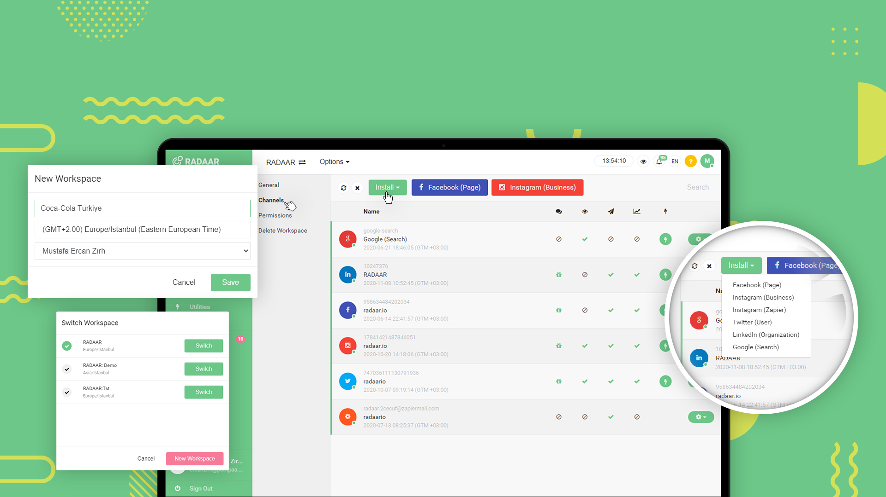
WORKSPACES
Stay organized by working in different workspaces
for multiple brands.

Slide 7
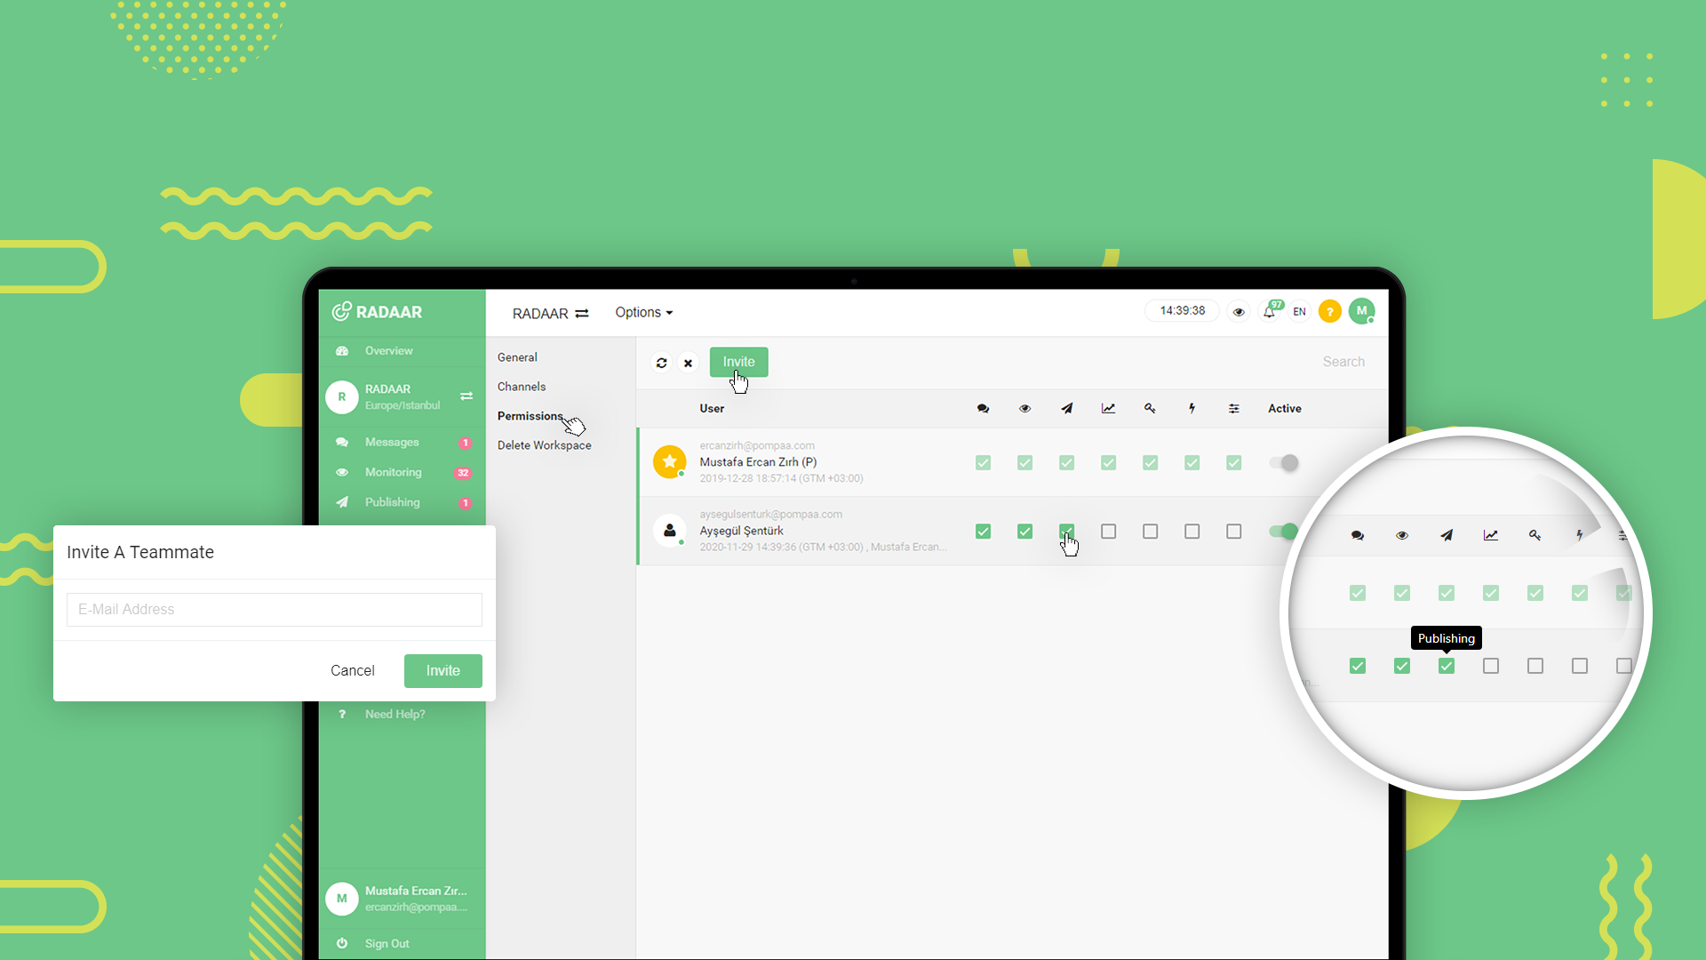
COLLABORATION
Easily manage workspaces while collaborating
with your colleagues.

Slide 8
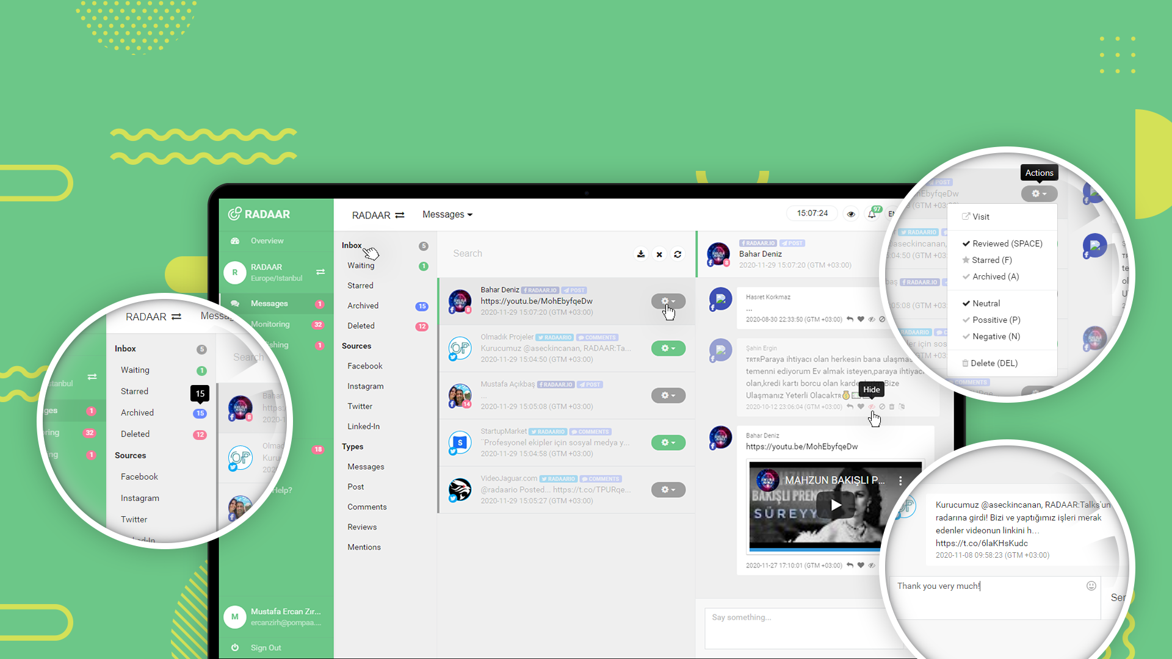
ENGAGEMENT
Build a close relation with your audience
with faster response times.

Slide 9
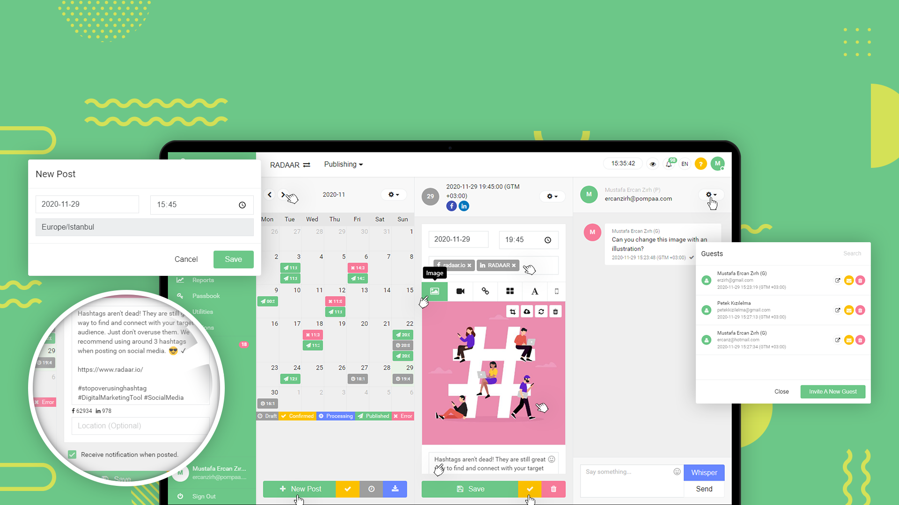
PUBLISHING
Simplify your social media publishing
and save time.

Slide 10
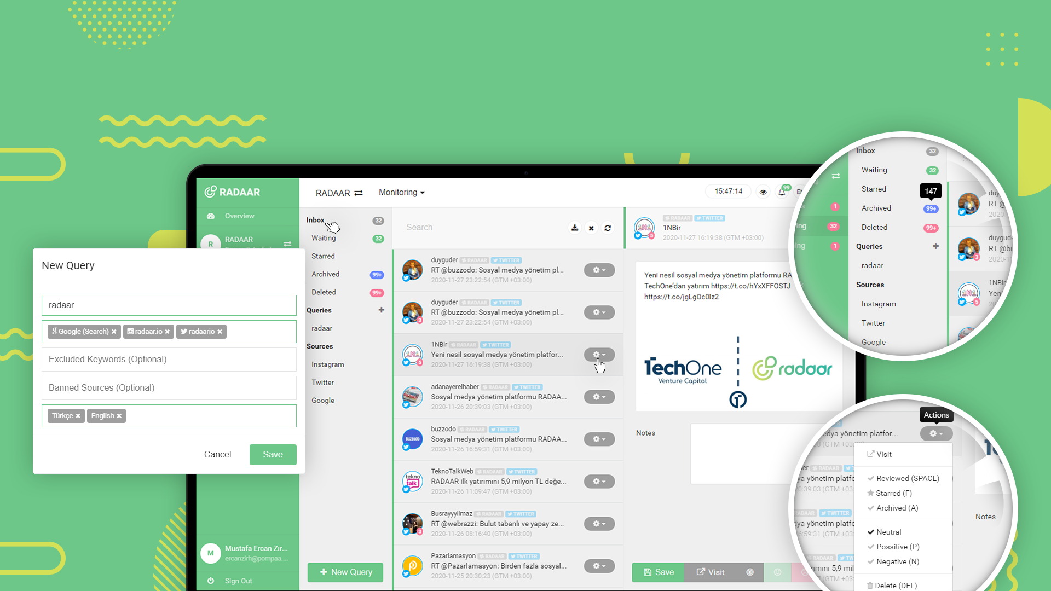
LISTENING
Track key industry terms and competitors
to improve your strategy.

Slide 11
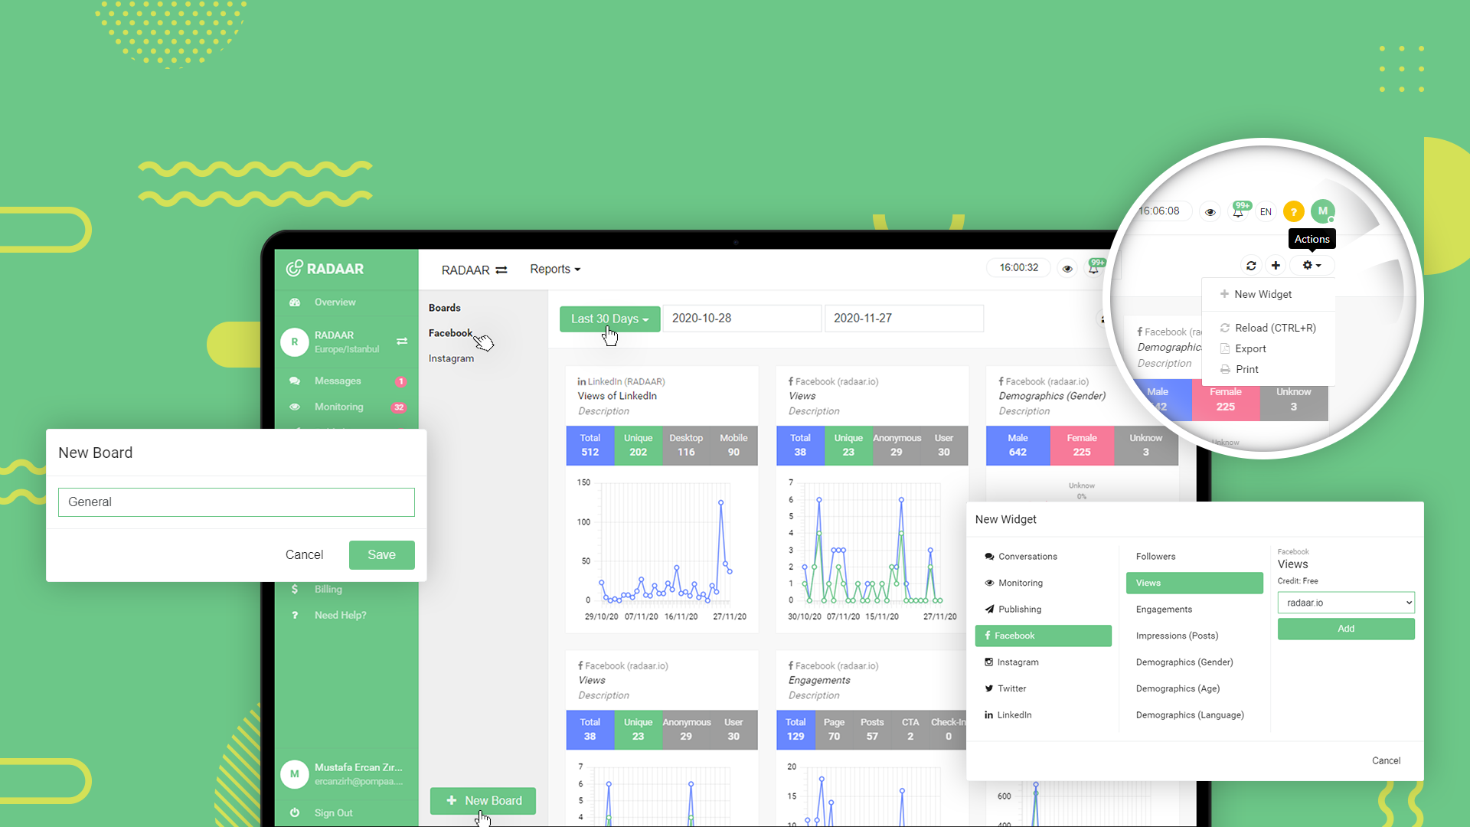
ANALYTICS
Create meaningful reports and
find out what's working.

Slide 12
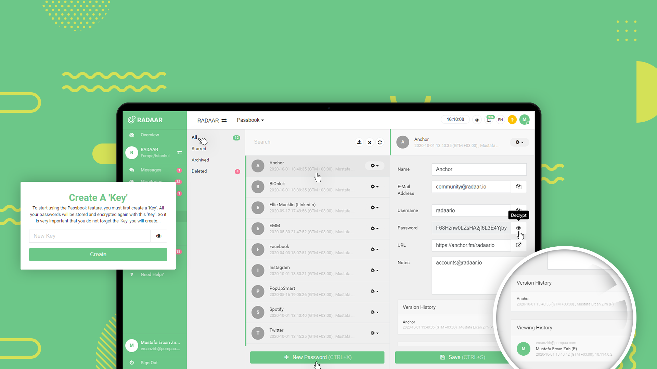
PASSWORD VAULT
Store your passwords in a single place and
share them across team members.

Slide 13
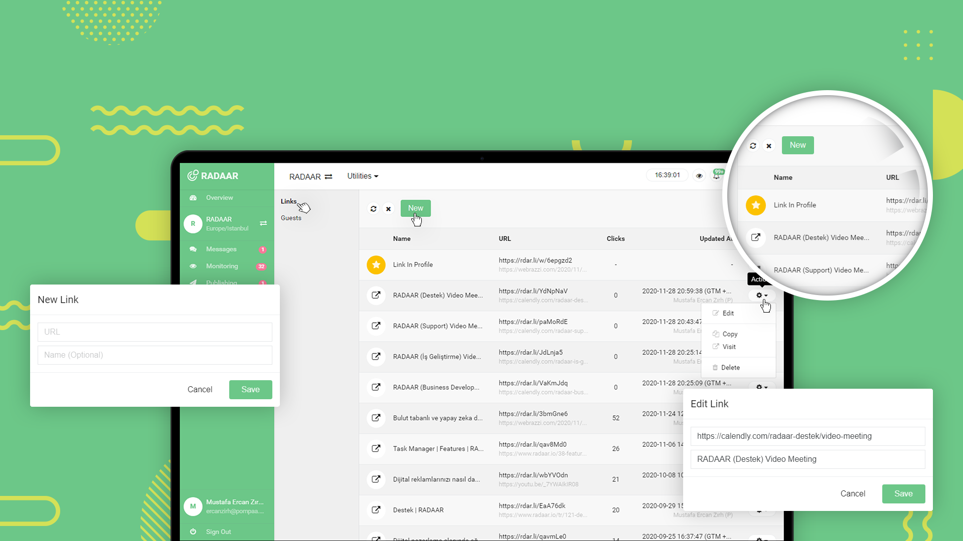
LINK MANAGER
Create, share, and track your links
to get more clicks.

Slide 14
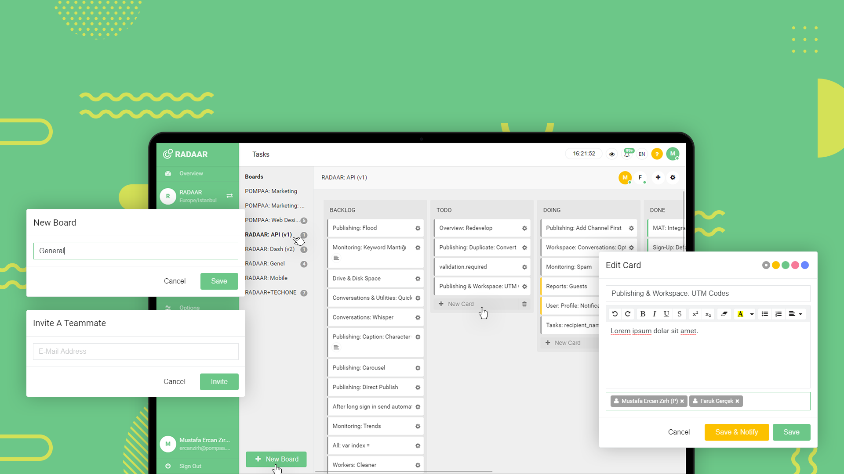
TASK MANAGER
Visualize your tasks, see how busy your colleagues
are, and reach your goals.

Slide 15

STAY PRODUCTIVE
Our best-in-class Android and iOS apps bring
the power of RADAAR to the palm of your hand.

Slide 16
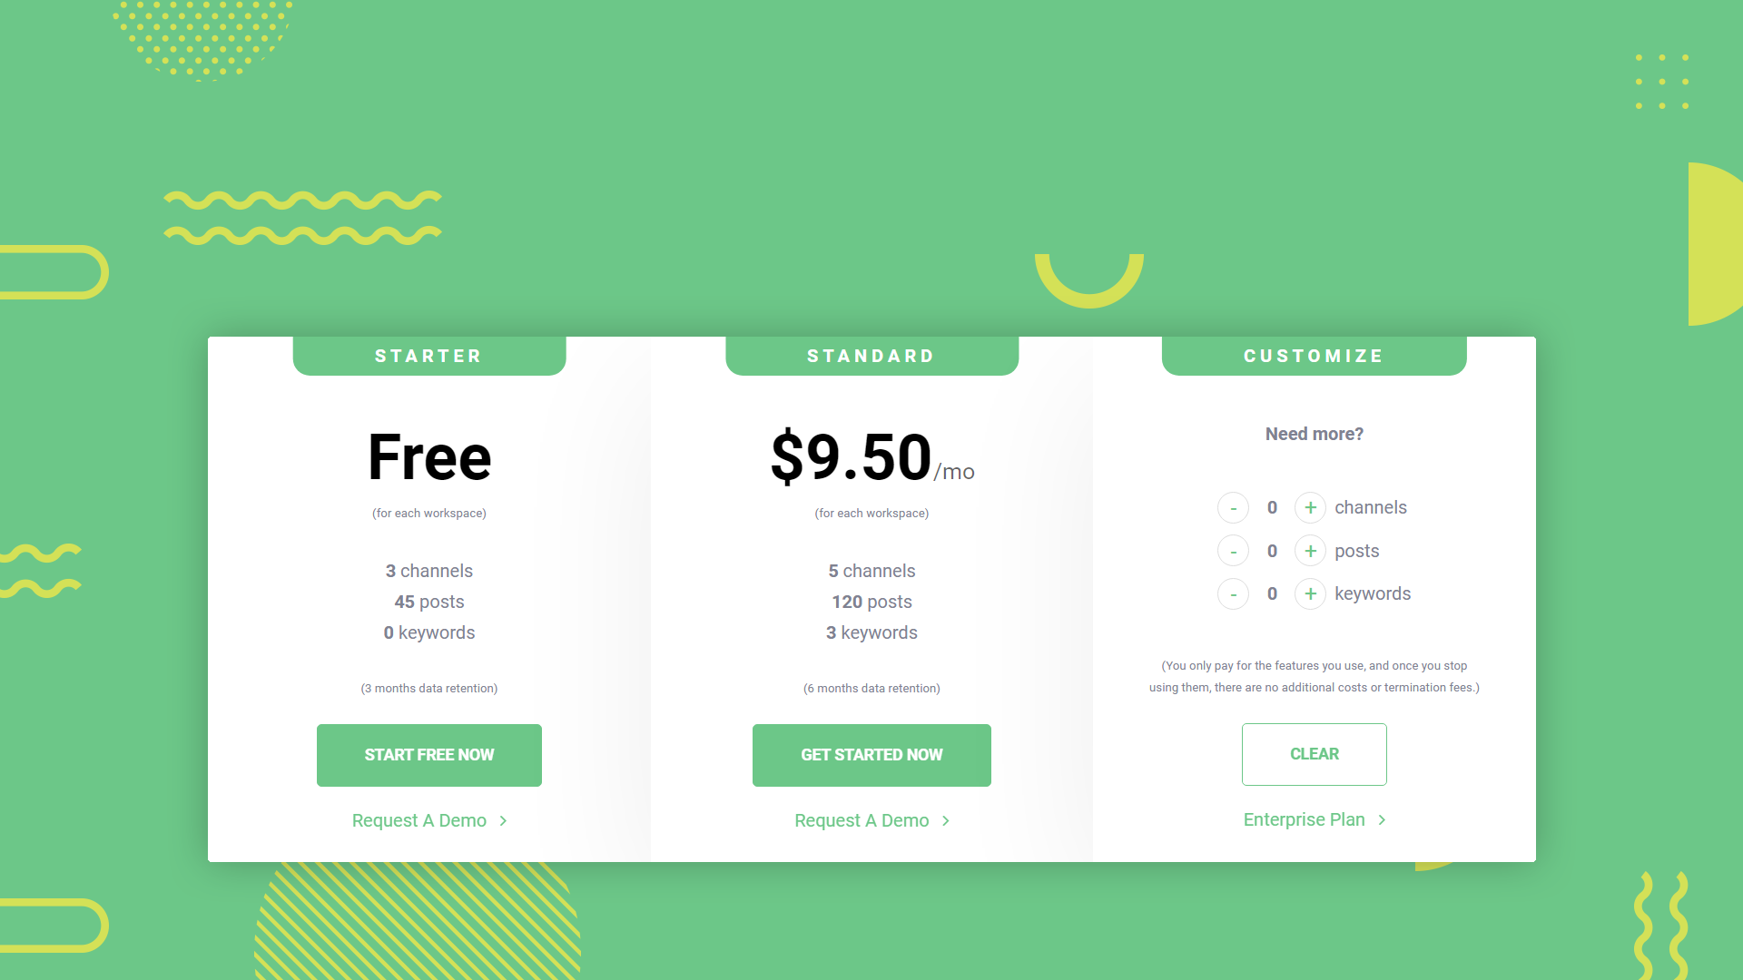
MOST AFFORDABLE PLATFORM
Discover the most powerful and flexible social media
management solution, built to scale.

Slide 17
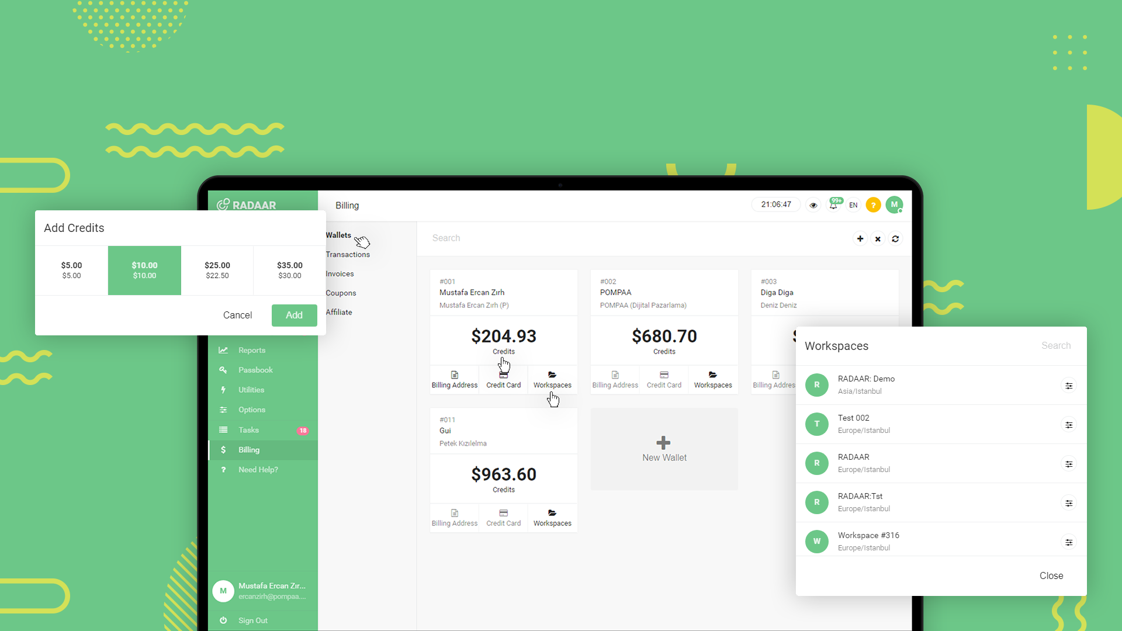
MOST AFFORDABLE PLATFORM
Perfect for any size of business. Upgrade as you grow
or cancel at any time.

Slide 18
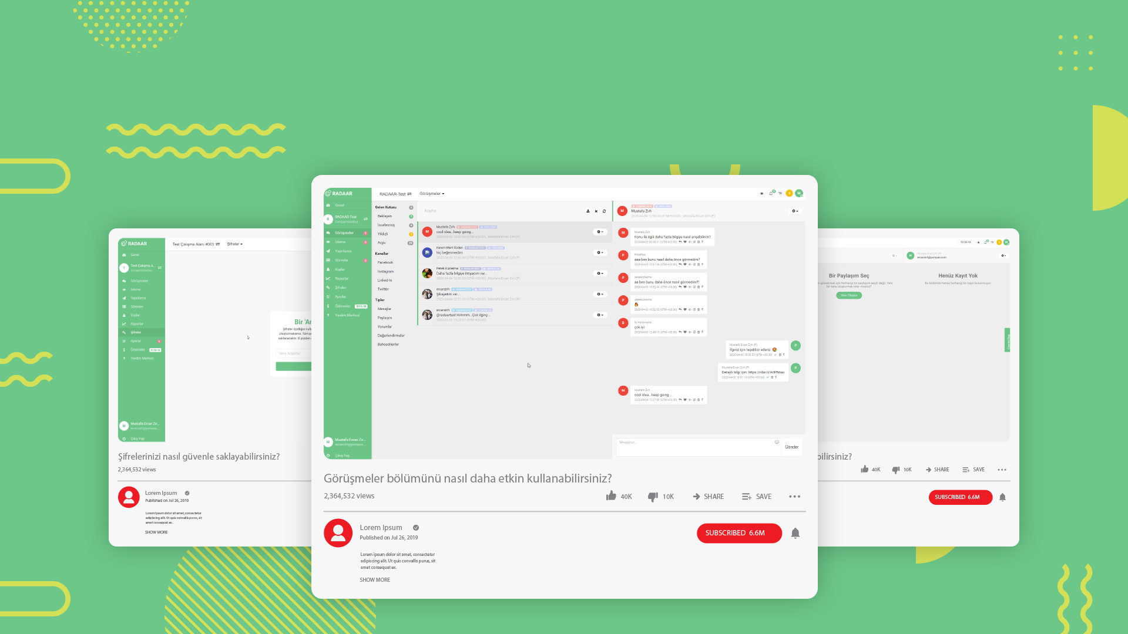
HOW CAN WE HELP?
Don't hesitate to get in touch
with our support team.

Slide 19

A BEST-IN-CLASS PLATFORM
Thank you for
listening! Any
Questions?
Ayşegül Şentürk
Business Development Specialist, RADAAR
satis@radaar.io

