Slide 1


Slide 2











As Used By…
(in the Amercias, Europe, Asia, Africa)

Slide 3
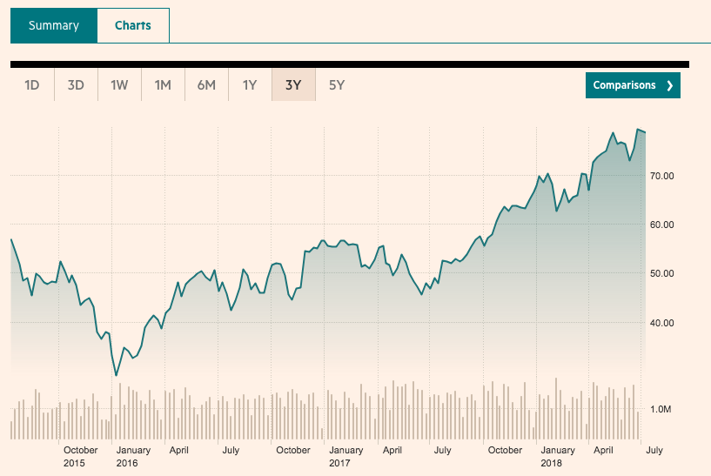
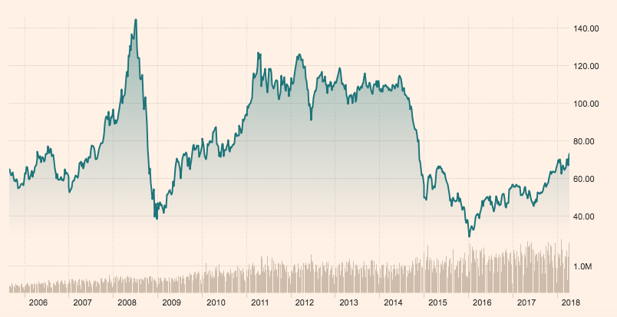
Oil Prices Have Increased 68%

Slide 4
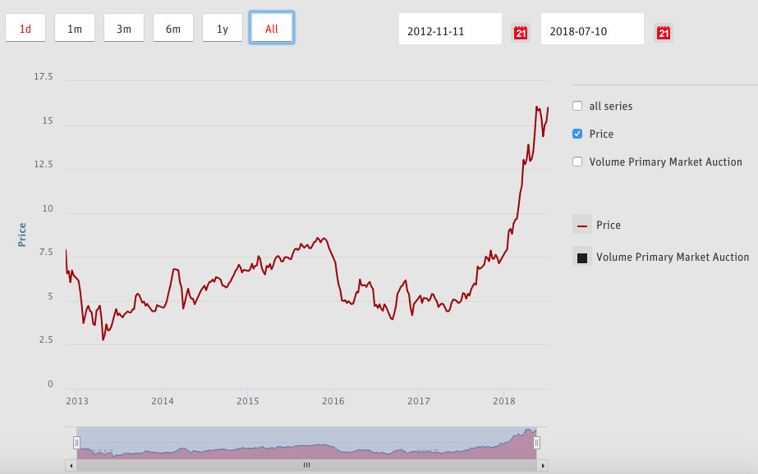
Carbon Prices Up 250% (EU)

Slide 5








Notes:
Visit: https://energyelephant.com/

Slide 6


Slide 7

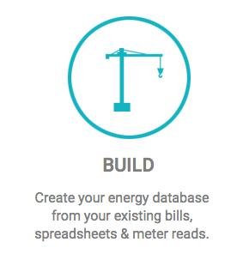

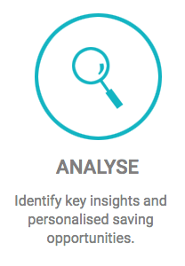

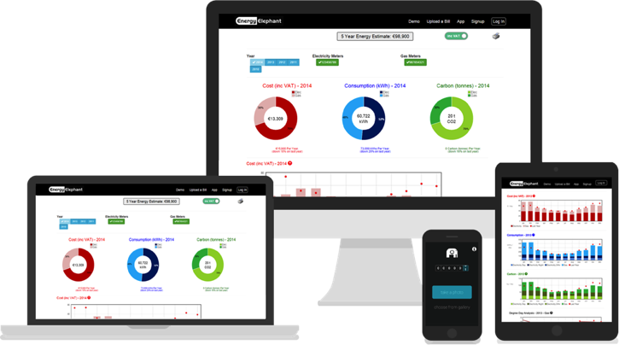


Slide 8
Smart City
Success Story

Slide 9
+
Smart City Platform.
Using Robotic Process Automation (Artificial Intelligence) To Analyse Energy Bills & Data.
Data:
Electricity (smart, metered & unmetered i.e. lighting)
Thermal Fuels (gas, oil, biomass)
Transport (petrol, gasoline & diesel)
Water
Results:
Identify €200,000 savings opportunity.
95%+ reduction in analysis time.
Payback: under 2 months.

Slide 10
Some Of The
Benefits & Features

Slide 11

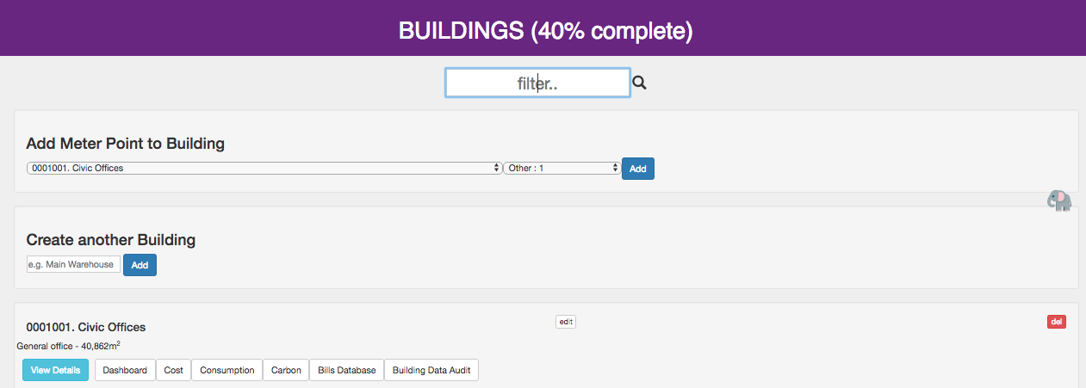
A Simple Searchable Database
–Find what you are looking for in seconds.

Slide 12
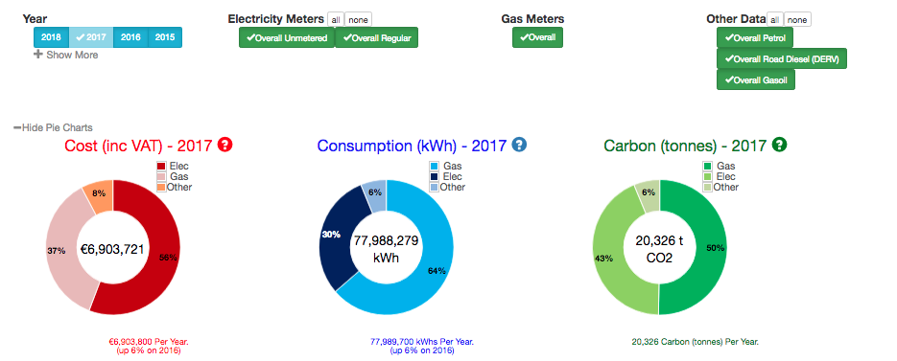
Headline Overview
- Annual & Quarterly Reporting

Slide 13
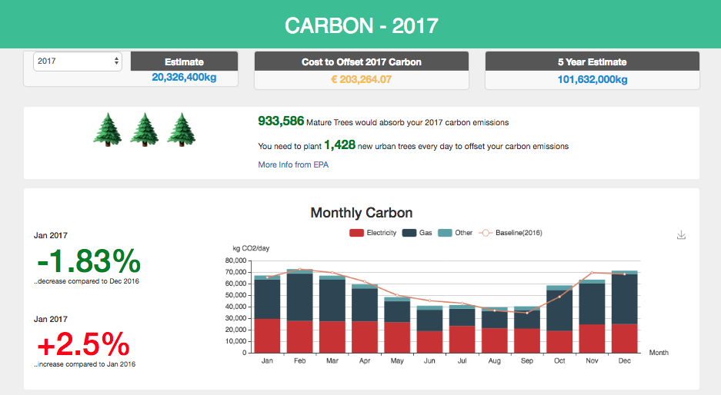
Sustainability Reporting
- Renewables, Carbon & Water

Slide 14
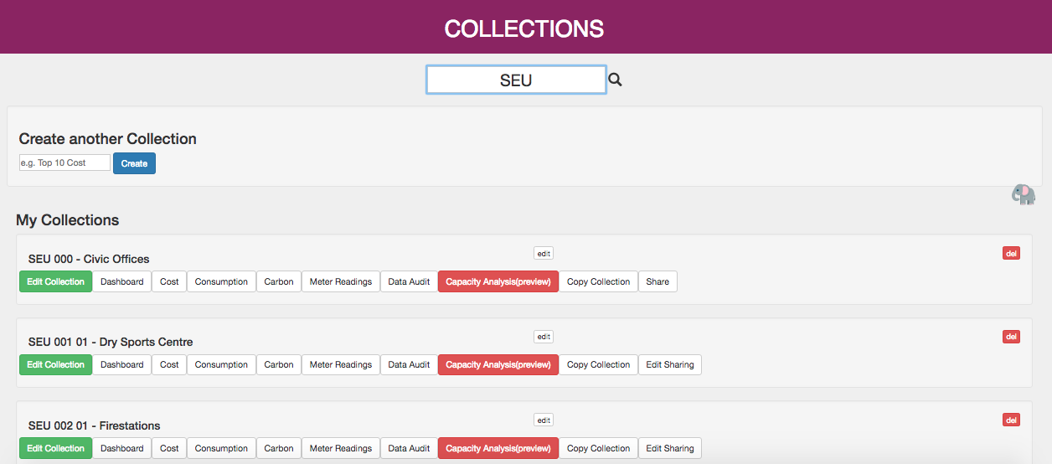
Automate Analysis
- Per meter / vehicle / zone / building / area / district / region / country

Slide 15

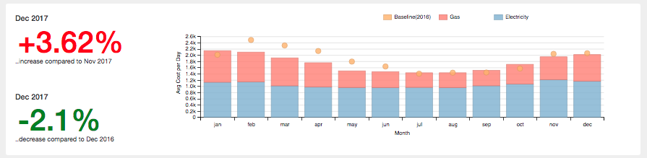
Instant Cost Analysis
- All costs validated, future projections and alarms highlighted.

Slide 16
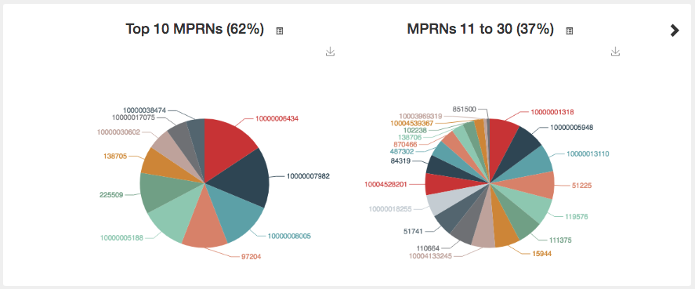
Instantly Identify
Significant Energy Users

Slide 17
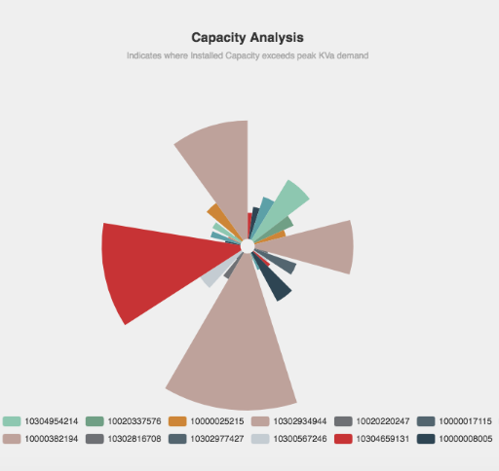
Capacity Analysis
- Instant & ongoing tracking of capacity levels

Slide 18
Simple To Share
- Multiple users with varying access Levels

Slide 19
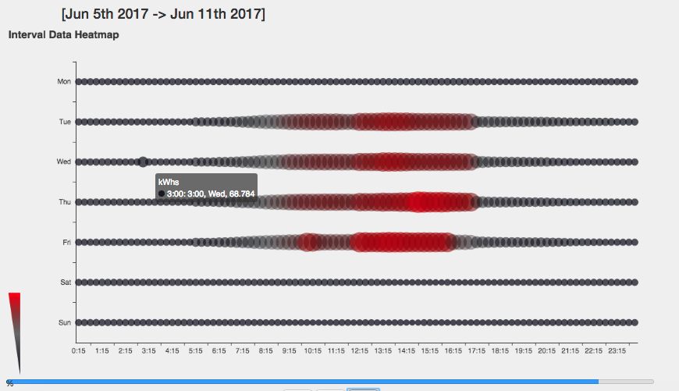
Real Time Interval
Data Analysis

Slide 20
Don’t Ignore the ELEPHANT in the room… https://EnergyElephant.com/

