Slide 1



Workforce
management
made simple!

Slide 2
5K Business Clients
1.5M Job Seekers

Slide 3
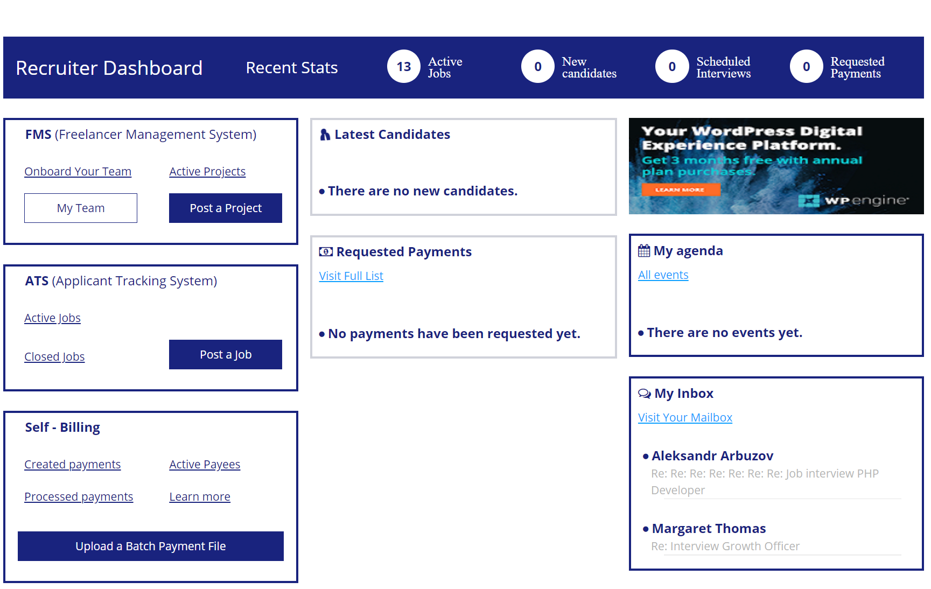
Transformify is highly Intuitive, Customizable
& Integrated!
Access...
FMS - Freelance Management System
ATS - Applicant Tracking System
Job Seekers Module
Self-Billing
... from a single dashboard.

Slide 4
What Can Transformify Do For You?
Save 60% on cost and 80% on time versus traditional
workforce management systems. With Transformify, 1FTE can do the job of 4FTEs.
B2B experience. No need to set up and reconcile thousands of one –off vendors.
Address legal and compliance requirements – IR35 in the UK, AB5 in the US, etc.
Eliminate duplicate payments and transfer payouts to 184 countries.

Slide 5
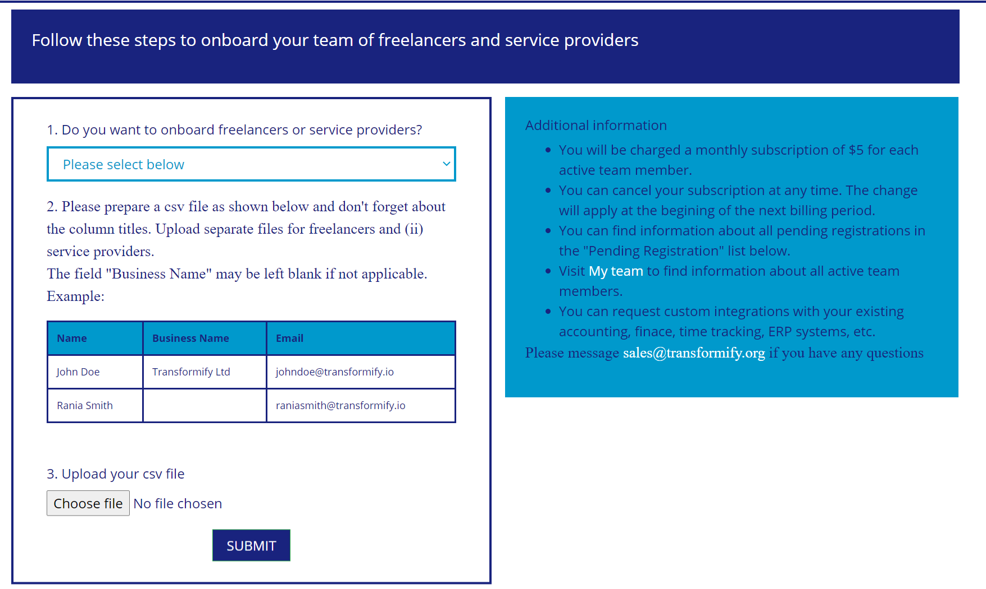
FMS
Streamline contingent workforce management and cut 60% on costs with invoice and payment automation.
Onboard Teams,
Assign Projects,
Easier & Faster!
All you need is a simple CSV file upload to get started.

Slide 6
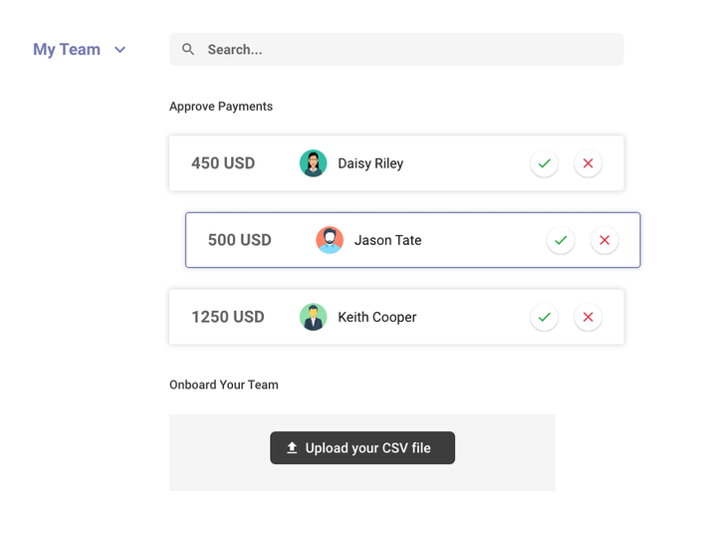
FMS
Manage Your Talent Pool in One Go.
Quickly send messages, check availability and assign service providers to projects via a click of a button.

Slide 7
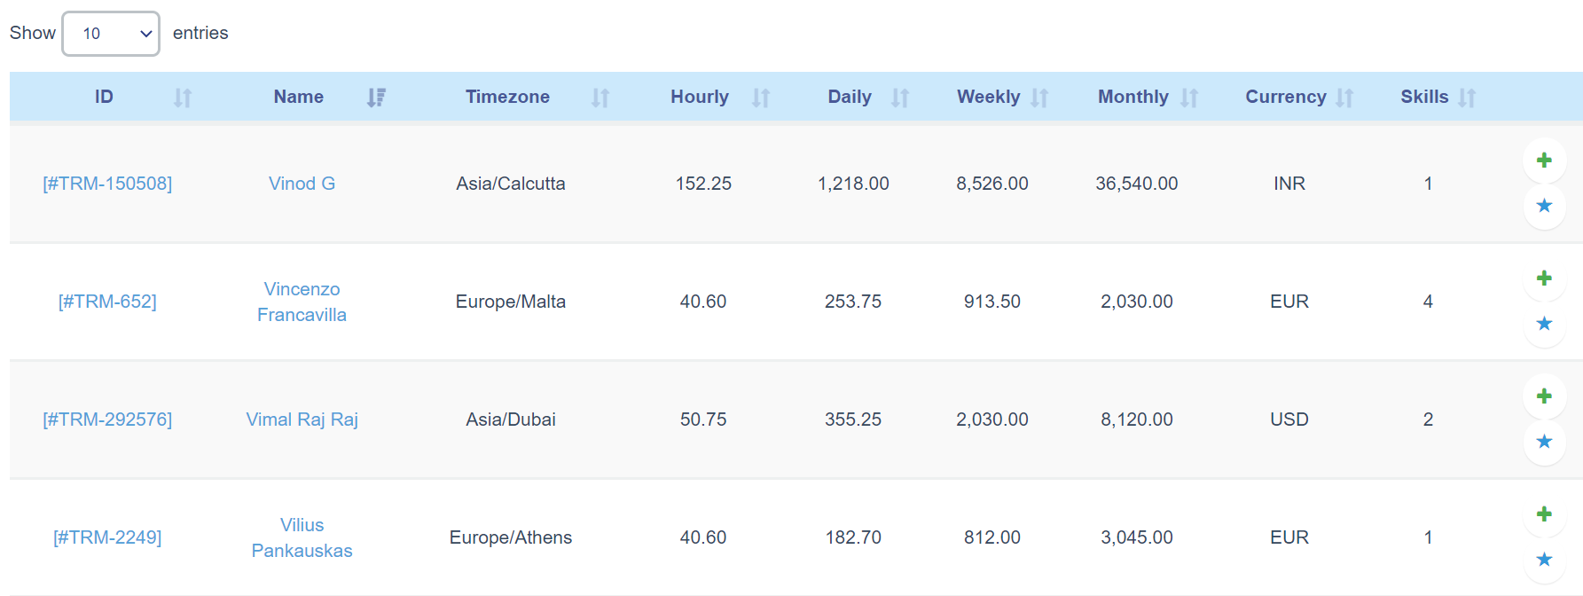
FMS
Powerful Matching Algorithms.
Skills, Languages, Time zone, Pay Rate, Currency are dynamically analyzed to provide a shortlist of top candidates based on your requirements.

Slide 8


FMS
Internal Communication,
More Collaboration.
Collaborative features including shortlists, email and calendar are available to you. If not enough, you can always ask for a custom API integration with Slack, Clockify, Zoom, etc.

Slide 9
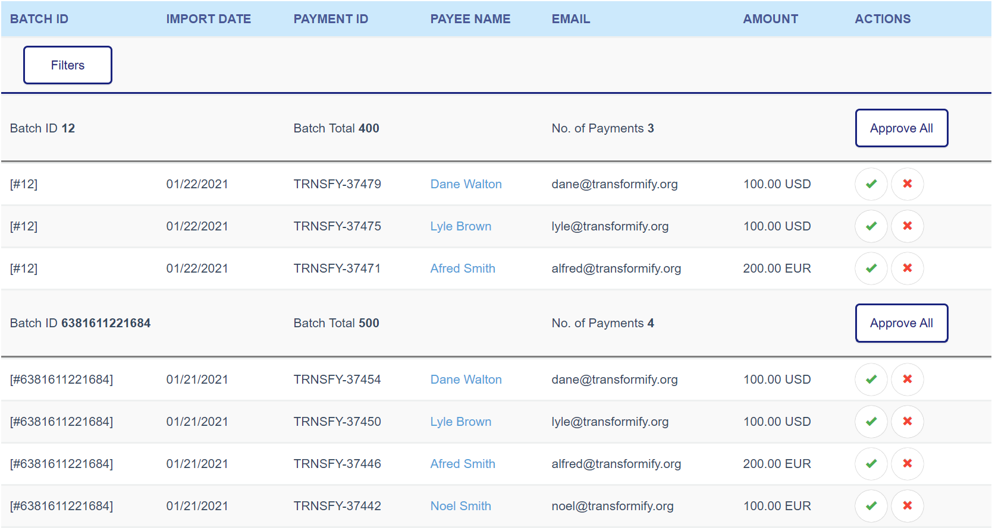
No More Duplicate Payments!
Each payout has a unique Payment ID and can be transferred only once. 4-eye checks and reconciliation automation are available upon request.

Slide 10





Supported Payment Methods
Transformify Supports:
Direct Bank Transfers to 184 countries
E-Wallets
Prepaid Card (available across the globe)
Mobile Payments
Crypto Payments

Slide 11
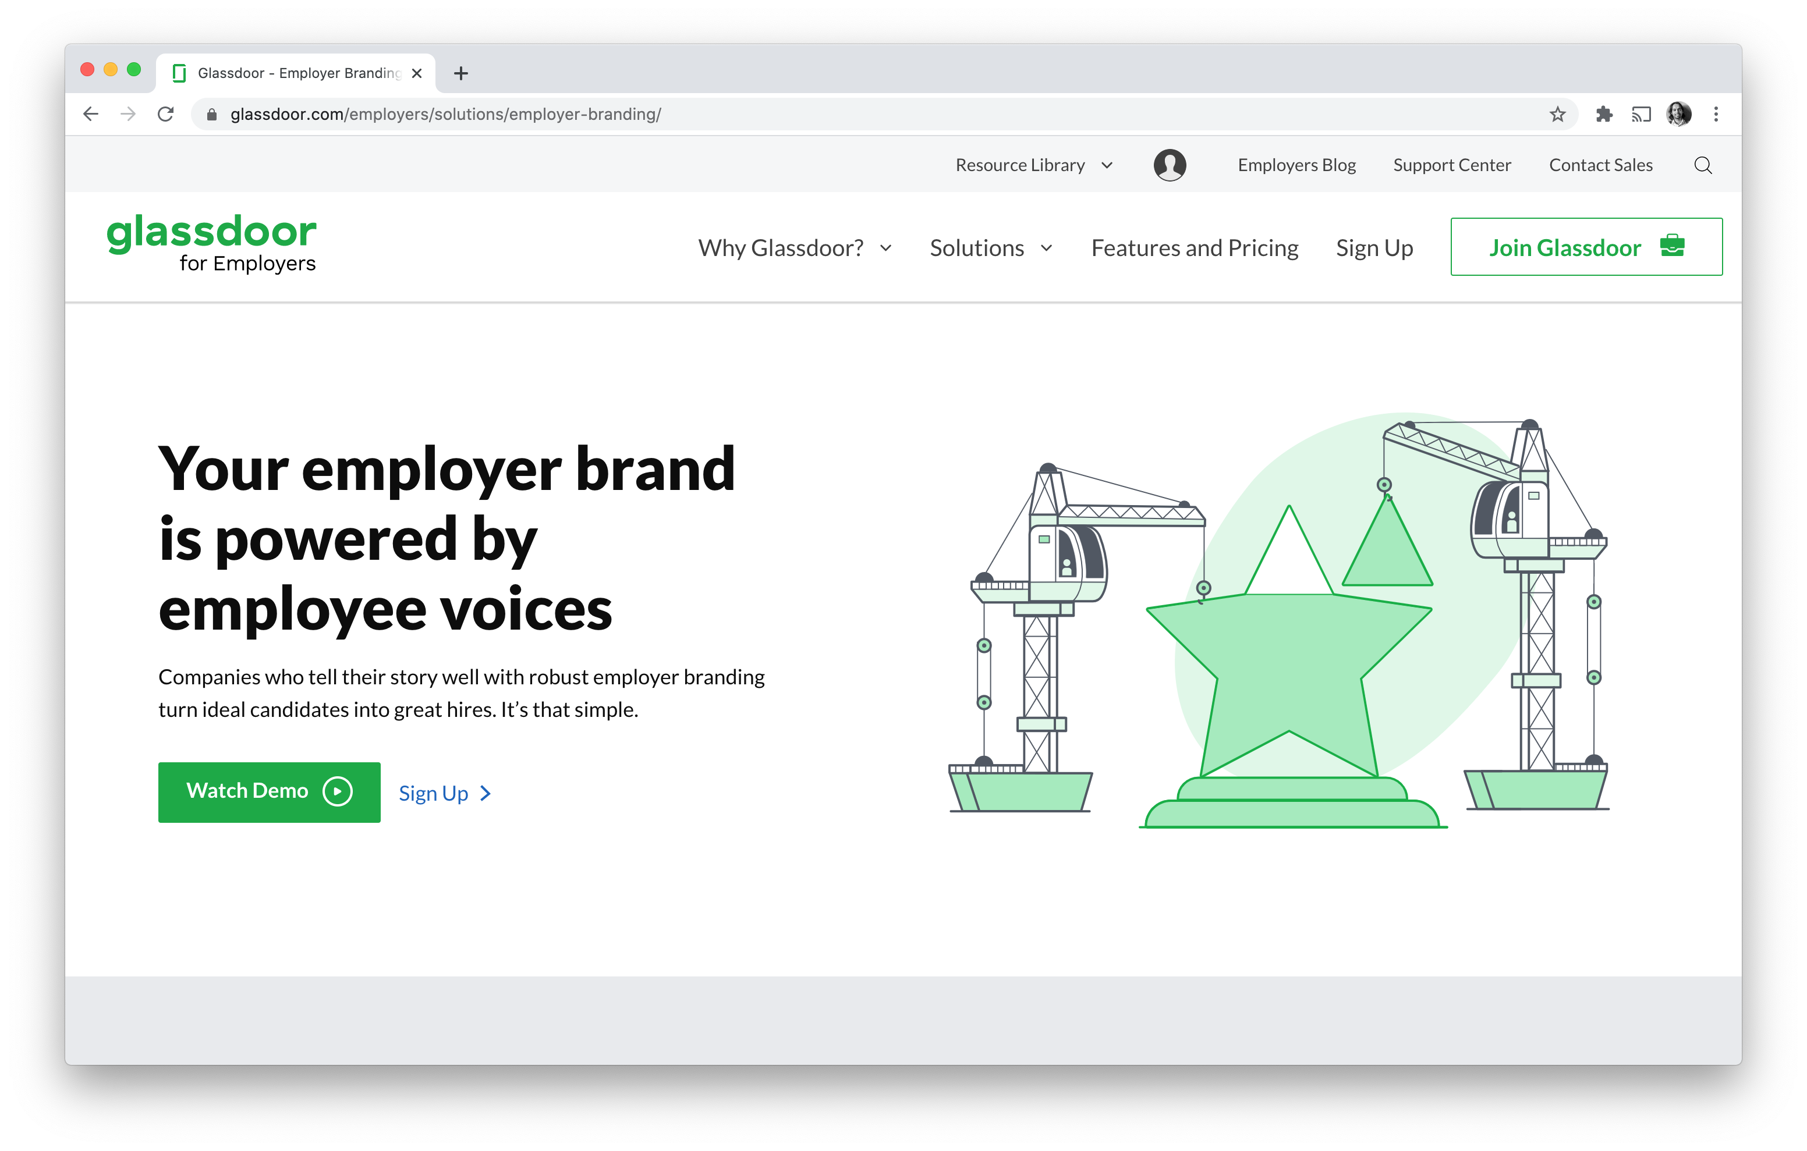
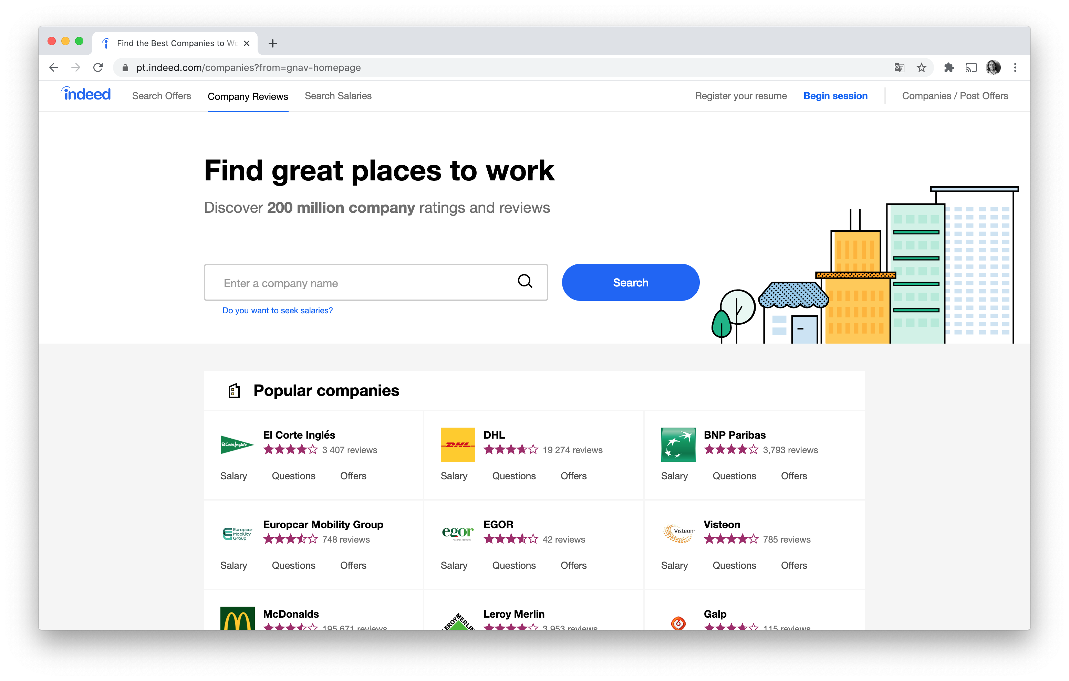
ATS
Tap into a global talent pool with Transformify Applicant Tracking System. Attract, engage, hire, and retain candidates in the most efficient and automated way, driving your business to success.
Posting at Once to 100+ Job Boards Worldwide.
Post a job listing only once, we will automatically push it to 100+ free job boards across the globe. Millions of qualified candidates will see it and you will be able to manage all applicants in one place.

Slide 12

ATS
Compliant with Data Protection Regulation.
It is time to avoid expensive compliance mistakes. Manage, store and keep track of candidates while making sure you are compliant with local laws and regulations, such as GDPR (General Data Protection Regulation).

Slide 13
ATS
Diversity Hiring & Inclusion.
Diversity, equity and inclusion are at the heart of Transformify. Using our ATS you can launch an inclusive hiring campaign using our powerful diversity filters. Besides, we have a marketing team ready to assist you with employer branding.
Now, you can help reintegrate seniors, people with disabilities or parents of children with special needs into the workforce.

Slide 14
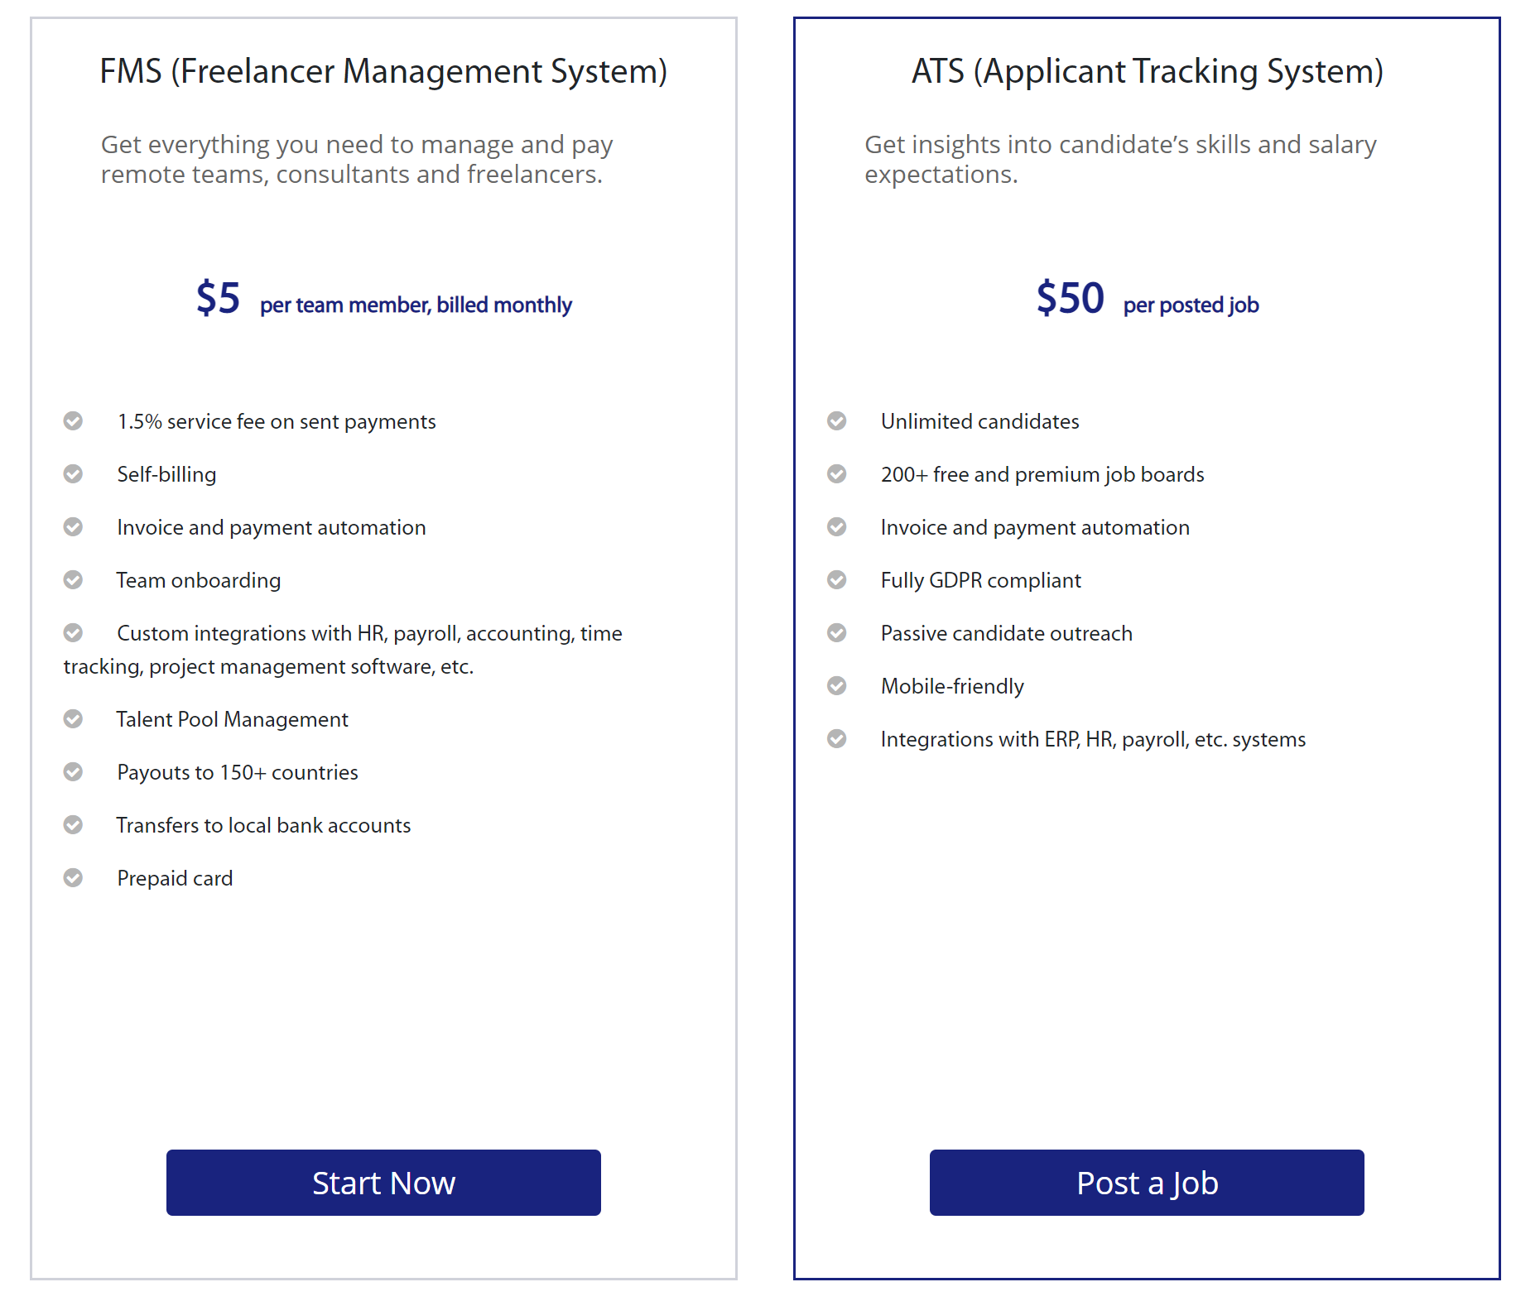
PRICING

Slide 15








Selected Clients & Partners:

Slide 16
Riddhi Dhadda
riddhi@transformify.org
www.transformify.org
Transformify Ltd. Level 3, 207 Regent Street, W1b 3HH, London, UK

