Slide 1

“Sales is as simple as story telling”
Sales Automation, Customer Acquisition

Slide 2
Win rate : percentage of valid deals closed in specific time period that were won.

Slide 3

How will Korero help achieve higher Win Rate?
Automation for faster turnaround
Understand buyer’s journey
Improve engagement with
Customers
Collaboration for quality proposals
Prioritize Opportunities
Real time insights help strategize and focus

Slide 4




Our solution
Empower your sales team – Actionable insights and Automation for high throughput
Automate
Collaborate
Real time overview
Communicate

Slide 5





Our solution
Boost sales – Faster turnaround and high quality quotes for high customer engagement
Intuitive User Interface
NO training needed
Use out-of-the-box
Automation
reduce turnaround time
increase throughput &
improve productivity
Governance in Real time
Access to KPIs
Easy reporting
Integration
improved communication
Better insights, horizon scanning
Collaborate
Internal, task governance
External, quality proposal
Automate
Collaborate
Real time overview
Communicate
Powered by InnoverenIT Services Private Limited.

Slide 6





Korero
Out-of-the-box use
Omnichannel
Tablet and laptop friendly, mobile app by Dec 2020
Simplified UI, focus on high-quality UX
Data driven approach for the right context, easy to navigate, ZERO training needed
Pay as you Go
Validations
In built bells & whistles ensures high quality data for meaningful analytics
Out-of-the-box Key Performance Indicators, analytics and reports
Pre-configured metrics and reports, ready to use
Sales pipeline / processes
Workflow driven sales lifecycle management with task governance, approval and escalation processes
Role based
Beyond “Sales” – custom modules creation to include users from other functions for quality quotations and improved operations
Geo distributed operations
Integrated Live currency exchange rate, auto calculation for reporting in a single currency
ONE platform for Customer Relationship, Communication and Collaboration

Slide 7
Differentiators
&
Interesting features

Slide 8
Highlights
Out-of-the-box
Minimal configuration, built for a sales team by a sales team
Rich Dashboard - pre configured Sales KPIs with YoY and QoQ comparison.
Intuitive
Simple User Interface, similar to social media apps
Automation
Sales is a collaborative process, include stakeholders
Custom Function - create functions / departments (finance, legal, etc) for tasks & Approvals, reduce turnaround time
Collaboration
Reports - available in reporting currency, Live Currency conversion
Sales Process - default process enabled, create opportunities on the fly.
Autofill - User Interface combined with 3rd party APIs for minimum data input leading to high productivity
Navigation - user clearly knows what’s next, improves data quality
Zero training - designed to ensure immediate start for all users
Alliance Partner - create opportunity based access for external stakeholders, improve communication and proposal quality
Teams - real time access of KPIs and transaction data
Repetitive tasks, workflows and notifications
Easy customization
Simplified rules

Slide 9
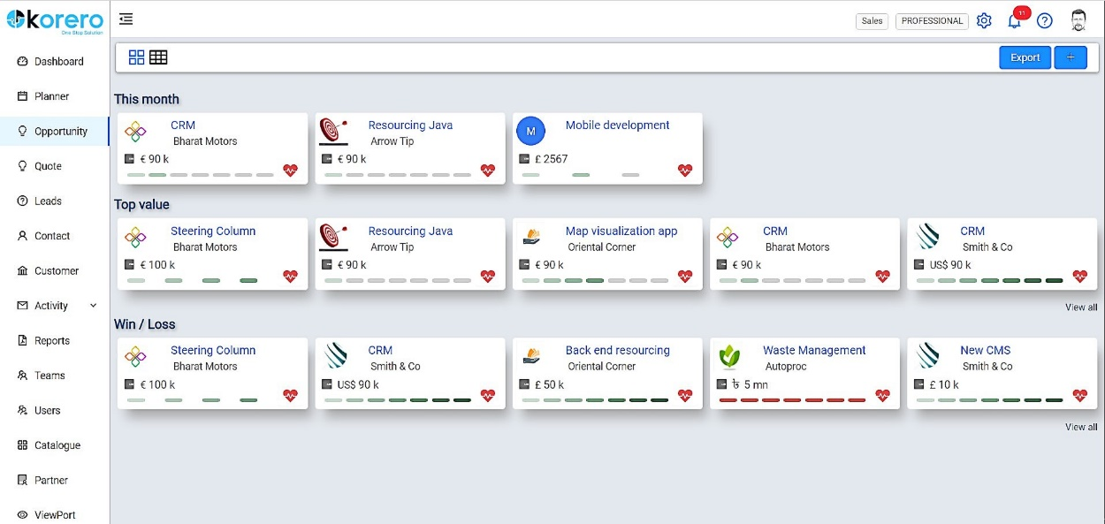

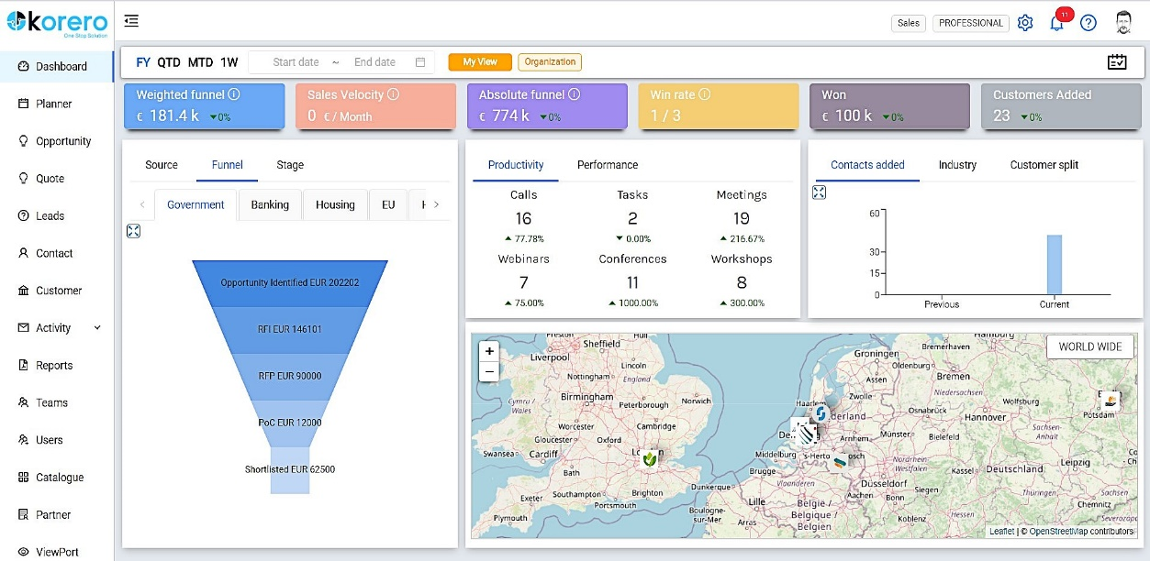
Out-of-the-box Use
Perspectives View
Identity & Quantitative data presented in Perspectives views
Real time analytics on each tile provides a quick overview with more analytics on
Out-of-the-box Analytics & Reports
Pre configured Key Performance Indicators
Configurable Fiscal period settings for deeper insights
Real time Business performance reports for CEOs & Sales leaders

Slide 10
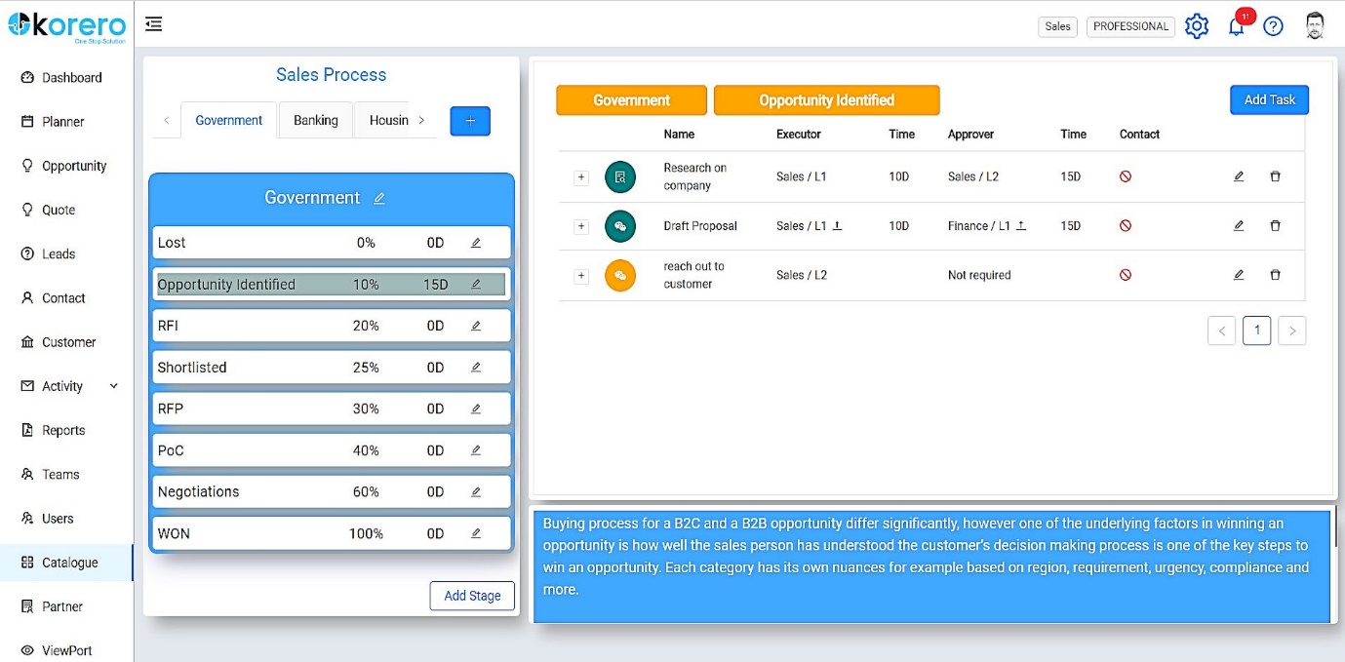
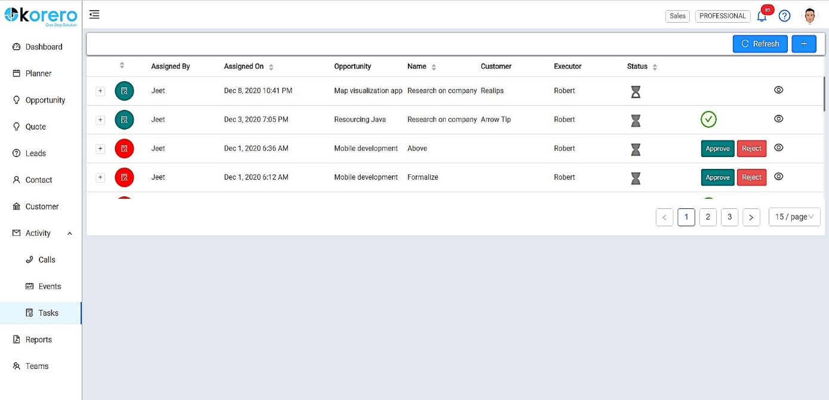
Workflow driven Processes
Customer journey management
Multiple sales processes supported, tasks defined for each stage
Workflows integrated with Opportunity Lifecycle
Ensures task governance, faster turn around, high quality proposal
Tasks & Approvals
Easy configuration of processes for managing Tasks & Approvals
Team members have access to documentation and other info to complete tasks / approvals with real time communication.

Slide 11
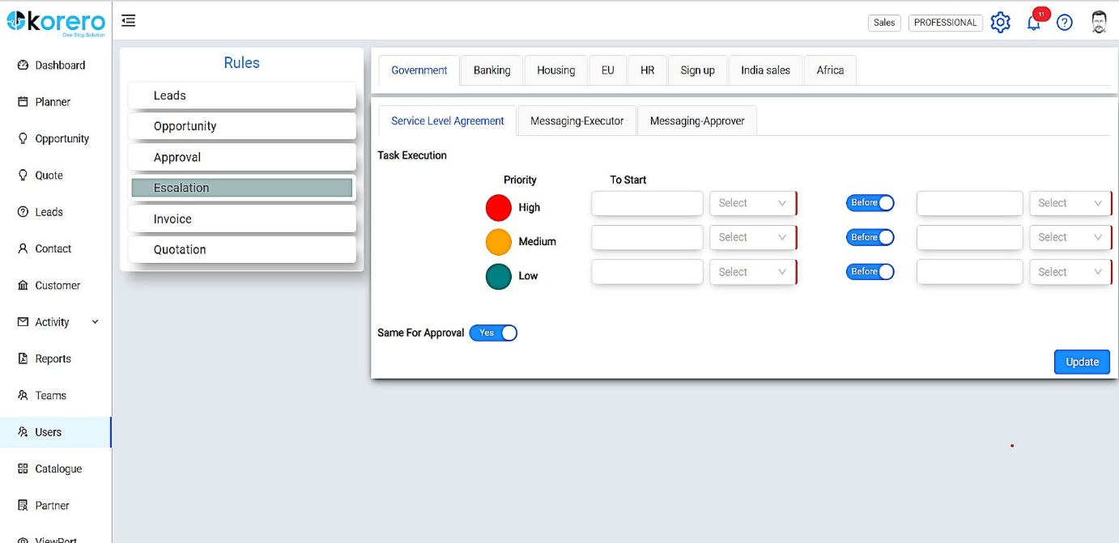
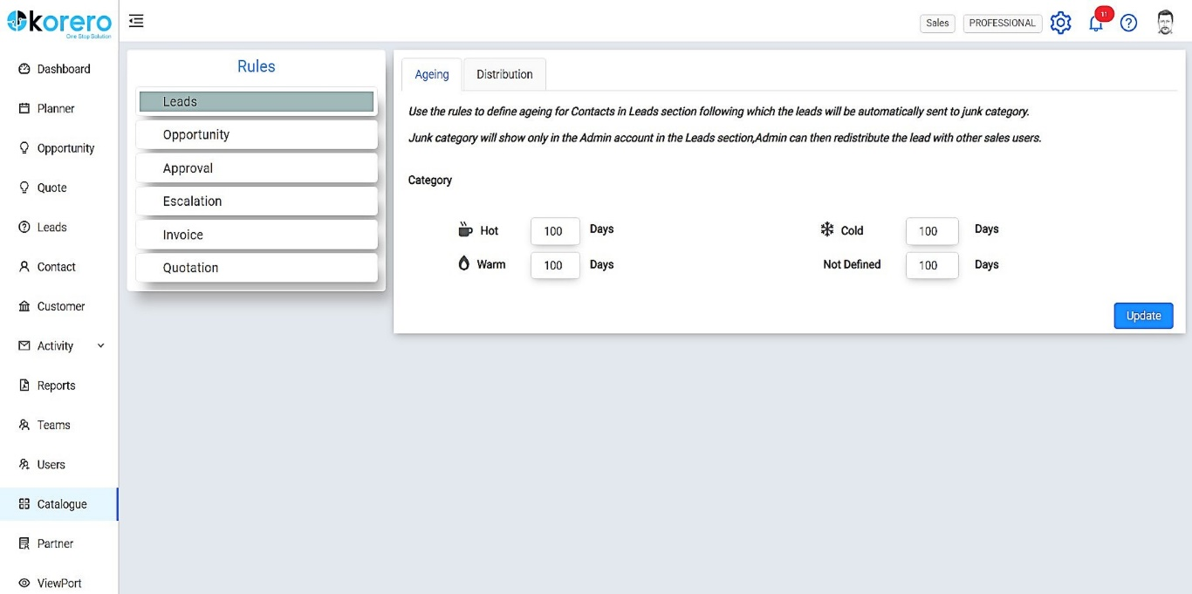
Automation
Auto Approvals / Quotations / Invoicing
Easy to configure rules for automating Approvals, send quotations and get it approved at the click of a button.
Create and attach Templates as needed for each process.
Manage Escalations / Leads / Opportunities
Automate emails and notifications to ensure governance of tasks.
Manage aging and distribution of leads & through rules.
Opportunities aging and lifecycle also automated.

Slide 12
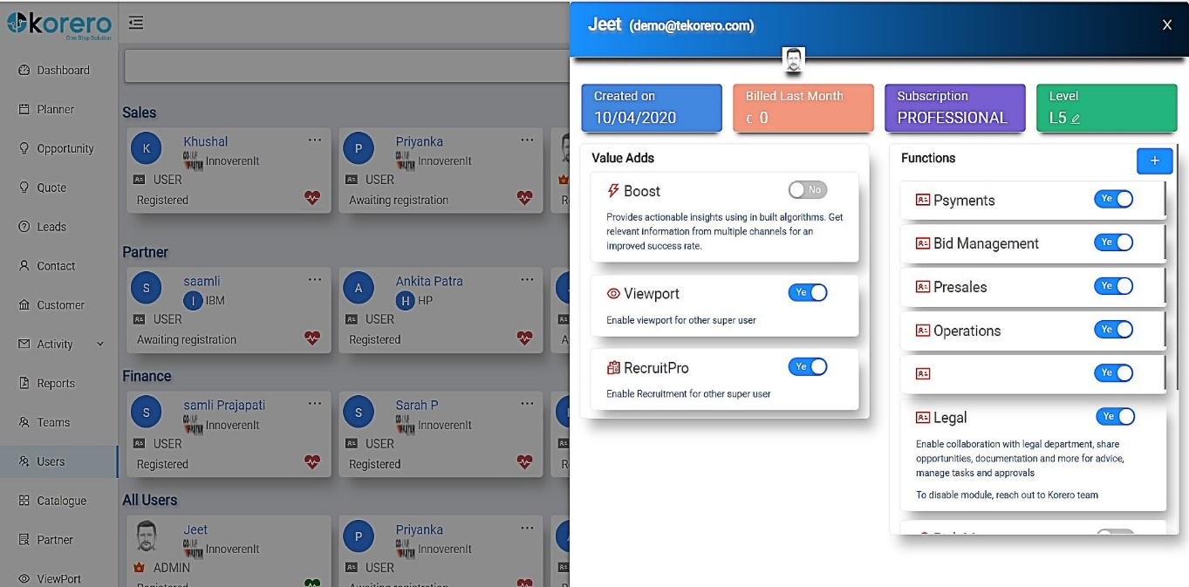
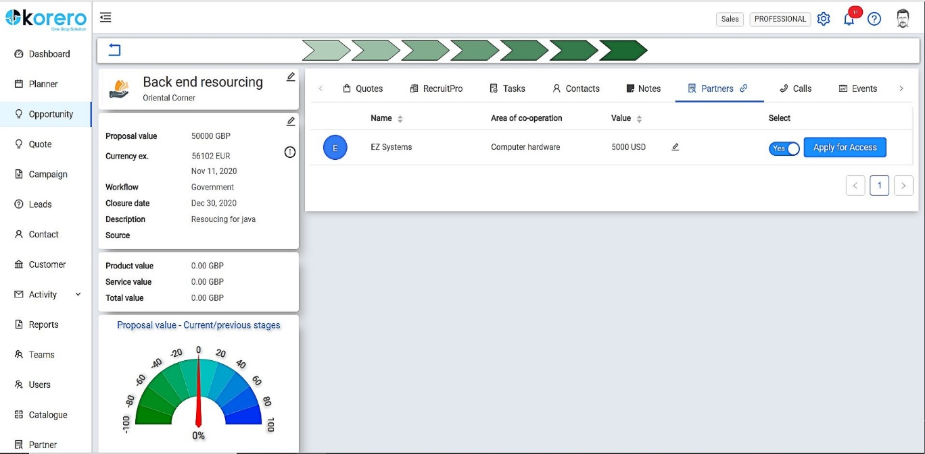
Collaboration – internal & external stakeholders
Break the Silos – Multi disciplinary
Include colleagues from other functions in Korero.
Users from other functions will be able to support sales team on key tasks, approvals and more.
Create Custom Function modules
Beyond the Enterprise
Add alliance partners as collaborators to your Korero account
Extend opportunity based login for partners to contribute in the sales lifecycle.
Tag partner users in respective opportunities, exchange notes in real time, seamless communication for quality inputs and quotes.

Slide 13
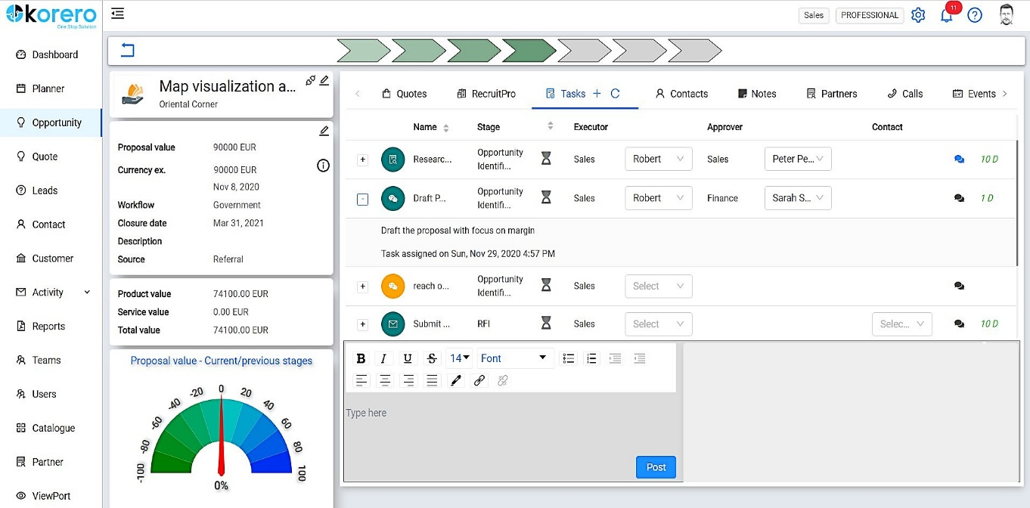
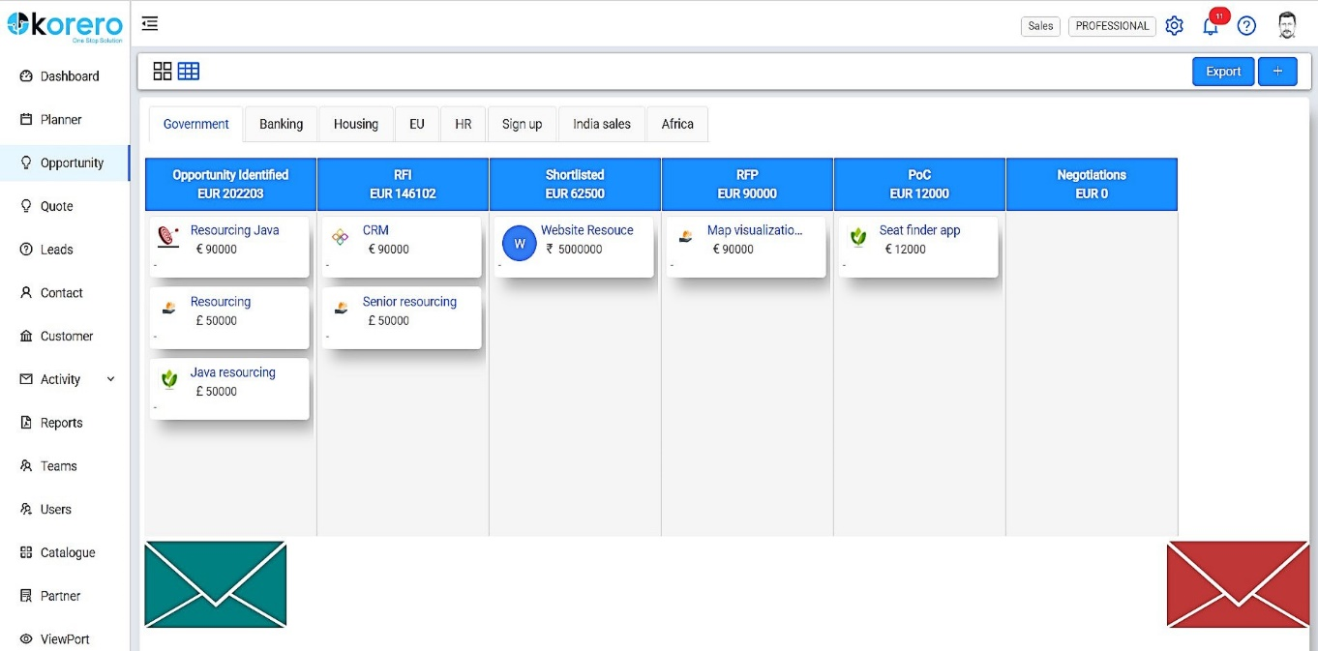
Simple UI
Intuitive features
Data driven, you have less boxes to fill while Korero does the heavy lifting with high quality output.
Easy to use
Easy to use features like drag & drop for maturing an opportunity.

Slide 14


Competition Comparison
Leading CRMs
Theme | Topics | Korero | HubSpot | Pipedrive
Configurable Fiscal year | Out-of-the-box real time reports and analytics with YoY and QoQ basis
 | Teams performance & analytics – fiscal year view, individual achievement
Integrated Live currency exchange | Currency exchange rates integrated for reporting in unified currency with Dashboards / Processes
Process Management | Sales Processes integrated with Task management & Approval Workflows
 | Automate Service Level Agreement & Escalation management with notifications
 | Automate Quotation approval by customer
Collaboration | Extend access to non sales users – task management & approvals
 | Extend opportunity linked access to Partners / Alliances
Alliance Management | Tag Partners with Sales Processes – ensure governance
Powered by InnoverenIT Services Private Limited.

Slide 15
Pricing

Slide 16
Pricing
Subscription Overview
Daily data back up
Storage for data, documents, images, etc.
Week day support
User organization hierarchy access
Metrics
Price per user per month
Basic
Yes
1 GB / user
Email only
No
Basic
9 € / 10 US$ / 7 £ / 700 ₹
Professional
Yes
5 GB / user
Email & Phone
No
Aggregated
20 € / 22 US$ / 17 £ / 1600 ₹
Enterprise
Yes
20 GB / user
Email & Phone
Yes
Additional
Contact for pricing
Per user per month
Exclusive of VAT and any surcharges

Slide 17
www.tekorero.com
Register NOW, avail your free trial!

Slide 18
Appendix

Slide 19
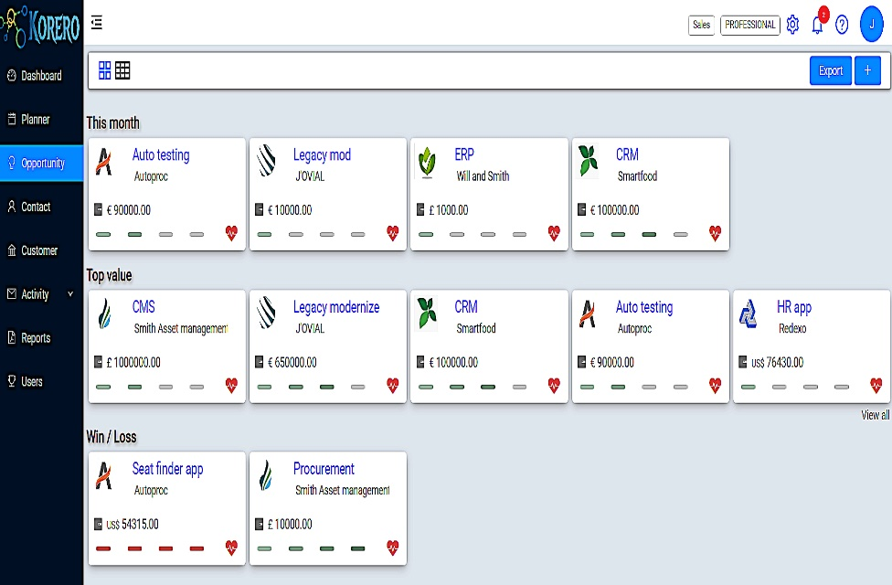
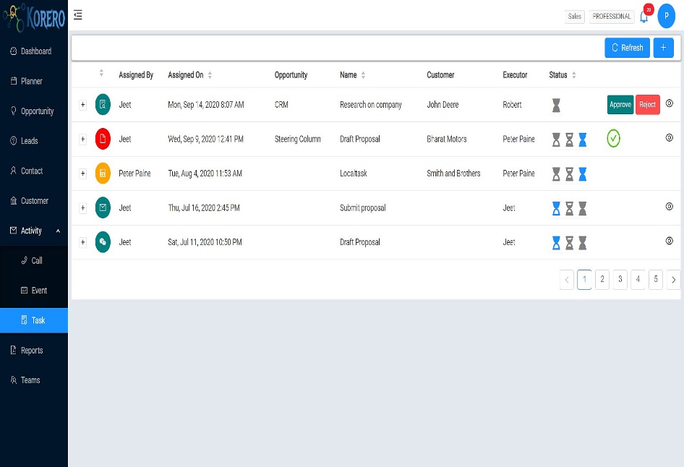
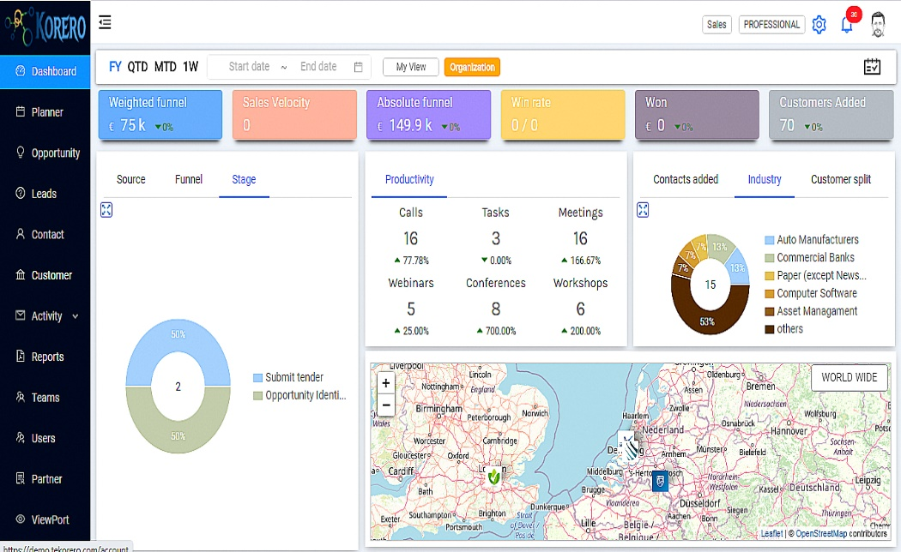











Korero
Overview
Highlights
ONE platform for Customer Relationship, Communication and Collaboration
Focused on customer experience and actionable insights
Manage geo distributed teams and opportunities
Out of box solution
www.tekorero.com
Saas
Omni channel
Cloud
Deliver Value through 3rd Party APIs
Enrichment of customer information – Clearbit, Full Contact
Multi geo opportunities - Currency Exchange
Horizon Scanning / Social media insights – Twitter, Youtube, News River
Communication (VoIP & SMS) – Twilio
Field Sales tracking - Google Place

Slide 20













How will Korero help achieve your sales objectives
Track
- Configure multi sales processes
- Manage multi currency opportunities
- Actionable insights
Enrich
- Horizon scanning on social media
- Know more about customers using powerful search
Engage
- Multi channel communication
- Rules based document share
Automate
Automate repetitive tasks – sending quotations, notifications
Notify customers and internal stakeholders
Governance
Team management
Customer
Boost
Communicate
Tasks
Opportunity
Collaborate
Quotations

