Slide 1


The most intuitive social media tool tailored for agencies and clients

Slide 2


Social Media Managament
has a complicated worflow
Agencies spend 40% of time
on operational tasks*:
Files exchange
Internal communication
Content approvals
What if this can be reduced,
while improving the content quality?
* Average estimate according to our own research made with more than 500 companies (brands and agencies)
Notes:
No more emails excels sheets averything in one intuitive platfrom.

Slide 3
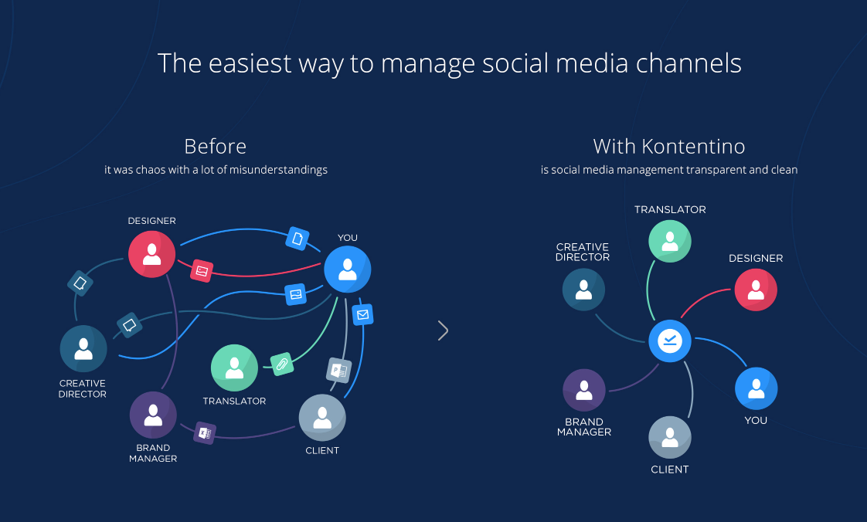
Introducing Kontentino
Notes:
Kazd je v Kontentine ma definovanu rolu, su vsetky formty v live preview, takto sa feedbackuje a schvaluje a takto sa posielaju tasky.
No more emails excels sheets averything in one intuitive platfrom.

Slide 4
Kontentino reduces operational time when managing global social media content
1 hour saved per day =>
5 hours per week =>
20 hours per month*
PER PERSON
* Average estimate according to our own research made with more than 500 companies (brands and agencies)

Slide 5
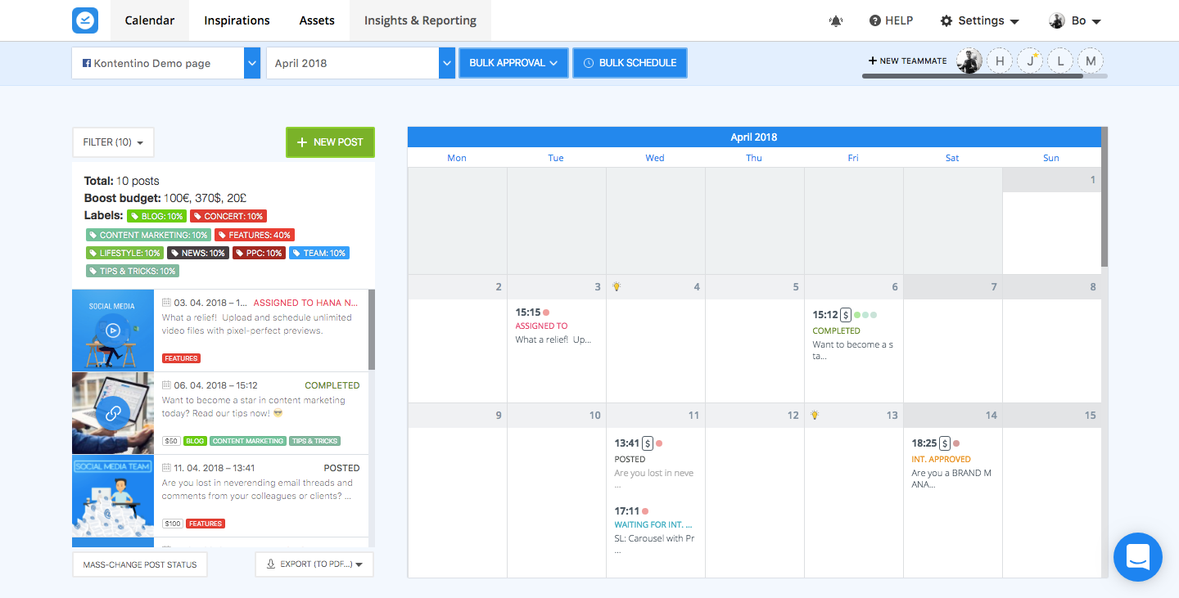
All posts in one intuitive platform
Social media managers are able to:
assign creative tasks to other team members
co-create creative assets
get the overview of created posts in the most intuitive calendar.
Kontentino supports creation and scheduling of all the post formats (including 360 photos, stories and carousels)
Notes:
Kazd je v Kontentine ma definovanu rolu, su vsetky formty v live preview, takto sa feedbackuje a schvaluje a takto sa posielaju tasky.
No more emails excels sheets averything in one intuitive platfrom.

Slide 6
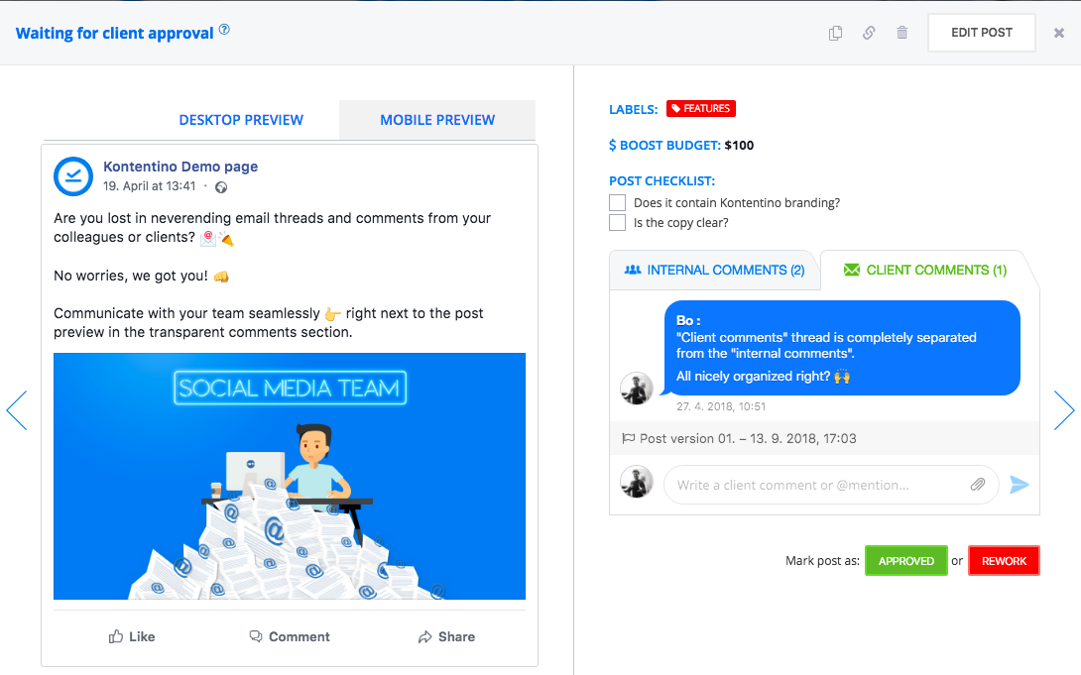
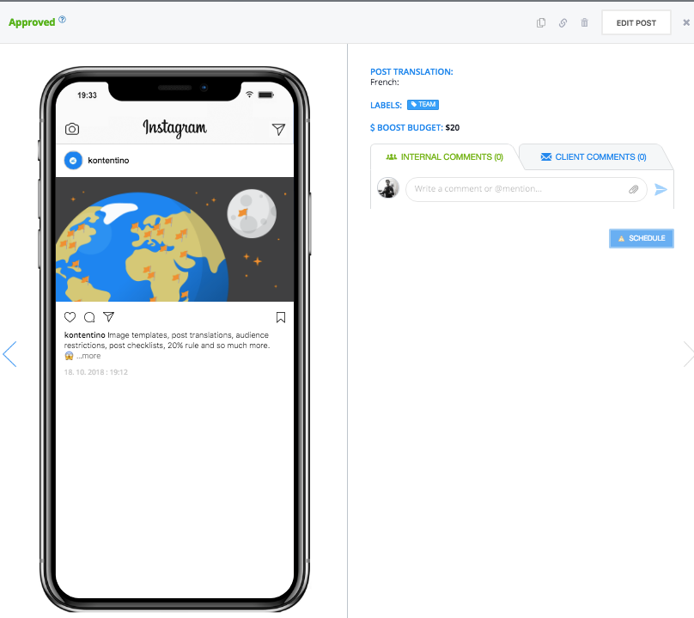
Live previews and immediate feedback
Supervisors can feedback and approve post drafts right next to the pixel perfect previews for all post formats
Notes:
Kazd je v Kontentine ma definovanu rolu, su vsetky formty v live preview, takto sa feedbackuje a schvaluje a takto sa posielaju tasky.
No more emails excels sheets averything in one intuitive platfrom.

Slide 7







More than 500 global agencies and brands
enjoying Kontentino

Slide 8



Recognized & awarded solution for marketing teams

Slide 9
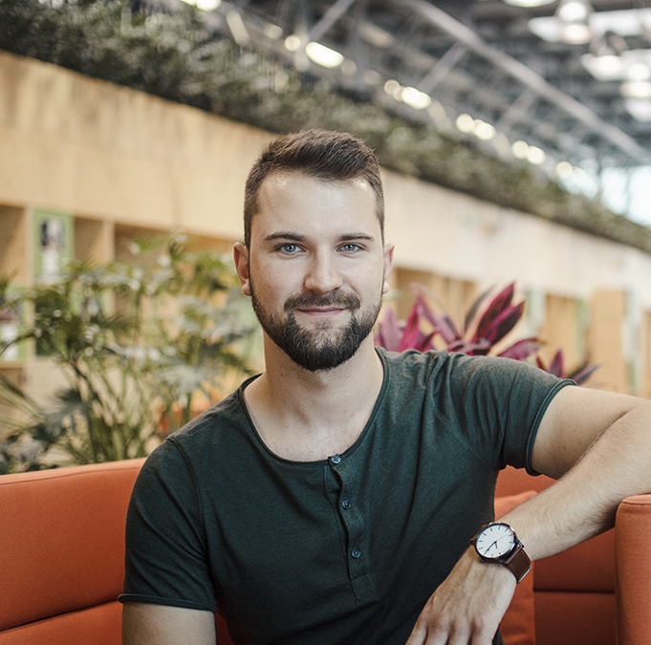
Ready to make your social media
a piece of 🍰 ? Contact me 👇
Juraj Zamborsky
Head of Sales & Business Development
juraj@kontentino.com
Arrange a call:
https://calendly.com/kontentino/demo_zambo

