Slide 1
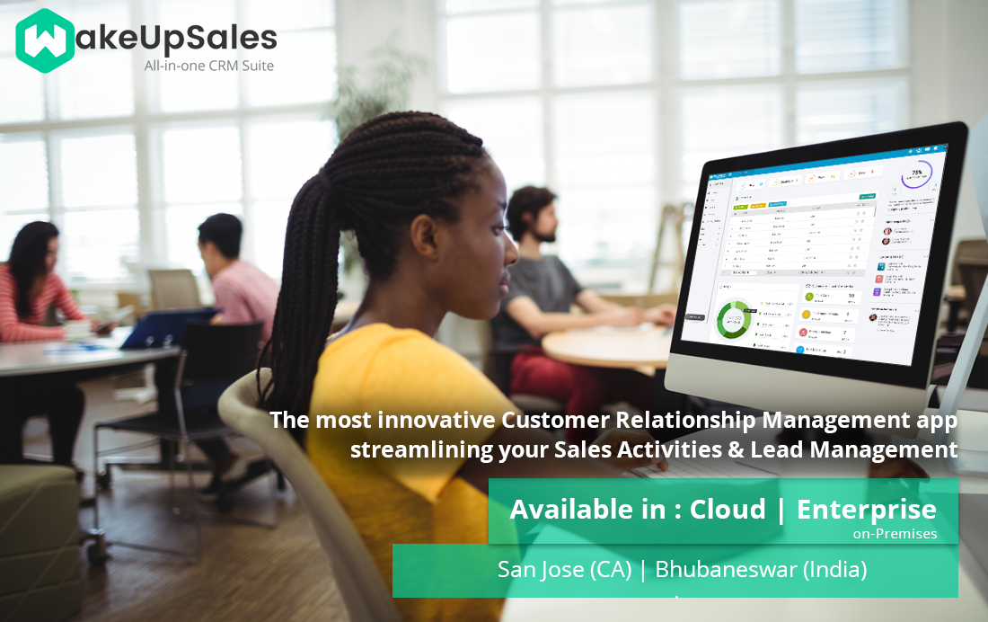

Slide 2


About Us
“We understand the complexity involved in sales process. Now Streamline your sales activities and improve your productivity through the simple and easy-to-use open source CRM.”
“WakeUpSales helps businesses create powerful & lasting customer relationships. No doubt it's the most innovative and affordable CRM solution available in the market for Free!”

Slide 3
What is CRM?
CRM is known as Customer relationship management and was first coined in the 1990s
CRM “is a business strategies and technologies that companies use to manage and analyze customer interactions and data throughout the customer lifecycle.
It is a comprehensive approach for creating, maintaining and expanding customer’s relationship.
Continue…

Slide 4
Information tracked in a CRM system includes contacts, clients, contract wins and sales leads and more
It's easily the simplest CRM tool around. Get leads, nurture them & convert them into customers; thus growing your business.

Slide 5
What is Opensource CRM?
The open source CRM is the phrase to describe an open CRM solution.
Open source programs is used by CRM system where the source code is available to the public for use and/or modification from its original design free of charge.
Open CRM gives organizations control over the CRM solution and can further develop the open source CRM software to best meet its own business goals.
Open source CRM is used by businesses of all sizes from small business to the enterprise across all vertical markets.

Slide 6
Importance of CRM
CRM is not only business but also ideate strong personal bonding within people. It is the strongest and the most efficient approach in maintaining and creating relationships with customers. Details kept centralized in CRM which can be available easily and anytime. This reduces the process time and increases productivity. The better you understand your customers, the more responsive you can be to their needs.

Slide 7



Why to go for WakeUpSales
Its built to make your sales activity processes run smoother without any dependencies or restrains. The most important ones are -
Choose from two options: Cloud or Enterprise Edition according to
your preference
Build it your way and customize it according to your business-process workflow
Wakeupsales makes sure you have total visibility on what your team is doing in real-time and their performance with lead statuses
Continue…

Slide 8



Estimate future sales, make informed business decisions & predict short-term performances.
100% ownership: if you’re using the Enterprise Edition – you own the software, code, data and can use it automate your sales customer relationship.
Let no deal slip through the cracks. Shift your team into High Gear.

Slide 9
Features Of WakeUpSales
Google Apps
QuickBooks Integration
Portfolio Management
Quote Management
Expense Management
White-label licencing
Orangescrum Integration
Payment Management

Slide 10










Plugins & Integrations
The plugins and integrations makes enterprise edition more powerful, making your sales process much more easier.
Website Integration
Segment Integration
Google Calendar
Collect user data with one API and send it to hundreds of tools
Use the Google Calendar API to interact with my Rails App
integrate with your contact us / download page with the web integration API
Email Tracker
Invoice Generator
Import Gmail Contacts
Send invoice to your contacts or a new user, track all payments
Import all your Gmail contacts by just one click & convert those to leads.
Monitor the email delivery to intended recipients, track the click/open counts
Manage Email Inbox
Zapier Integration
Mailchimp Integration
View your Inbox emails without logging into your Gmail account.
It enables you to automate tasks between other online apps like Basecamp & Gmail.
Create integrations that connect Mailchimp to a CMS, blog, shopping cart, and more.
+ Build Your Own
Just ask for it, & we will build it for you.
6

Slide 11






Technologies Used
Reliable
Rich Documentation
Scalable, flexible
High Performance
Fantastic Tooling
High Quality Code
Report Generation
Analytics to pdf
Consistent, Responsive
Customizable

Slide 12




Conclusion
Please Feel Free to Contact Us. Happy to hear from You
support@wakeupsales.org
http://www.wakeupsales.org/
https://www.facebook.com/wakeupsales/
https://twitter.com/wakeupsales
https://plus.google.com/105189506645452302028

Slide 13


Thank You
Download Now
Sign Up Today
www.wakeupsales.org
www.wakeupsales.com
Book a Demo
blog.wakeupsales.com

