Slide 1


All-in-One Customer Contact Solution
Intelligent | Intuitive | Integrated

Slide 2

1
Sobot Introduction

Slide 3
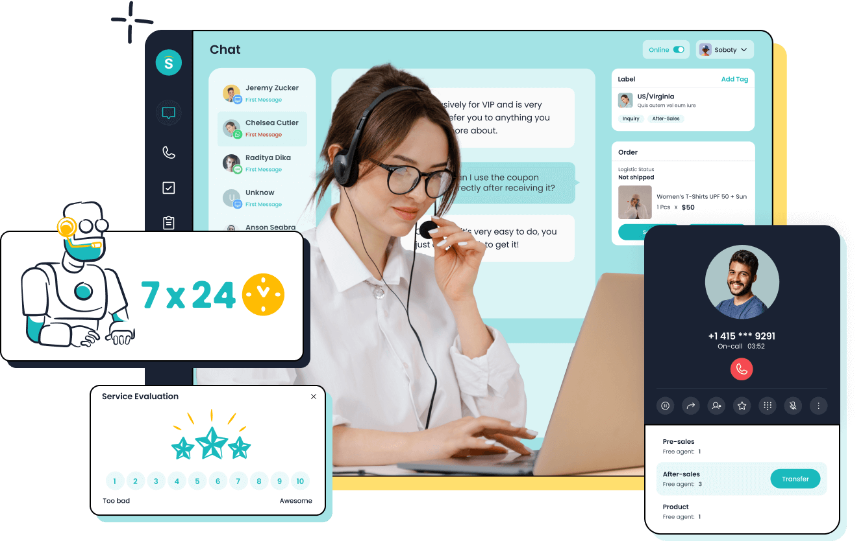



Sobot - A Contact Center Solution Company
Focus
Contact Center as a Service
Advantage
One-stop & Intelligent
Reliable
Industry solution with thousands users
Make your customers happy
We help top brands improve their customer satisfaction and NPS
Make your team more efficient
We use our products and AI to improve the productivity of customer service agent teams
One-stop Solution
Sobot provides not only SaaS but also On-premise service. Our professional team deliver customized service to our clients
Intelligent
Leveraging AI and Big Data technology for improving efficiency & revenue
Our Customers
Agilent, Pop Mart, DFS, Philips, HP, AIG, Didi, Michael Kors, Xiaomi, OPPO,Weee! Samsung ...
Industry Solutions
By Size: Enterprises, SMB, Startups
By Industry: Retail, E-Commerce, Entertainment, Financial services…
Notes:
NLP algorithm

Slide 4
Sobot - by Numbers
6M+/day
Online Communications
1.6+Gb/s
Data Throughput
550K+
Users
450
Employees
3M+/day
Number of Phone Calls
99.99%
System Stability
62%
Engineers

Slide 5
All-In-One Solution for Your Business
For Business
Decision
Maker
Scalability vs. Cost, RoI, etc
Compliance & regulatory requirement
Integration with other services & service migration
Ease of service configuration
Flexibility of service modification
One platform to manage all care
Unified standards and reporting
For Customer
Care
Supervisor
Customer profile and contact history across channels
Personalized services for different groups
Effectiveness for repetitive questions
AI assisted answers to enhance customer satisfaction
For Agent Team

Slide 6
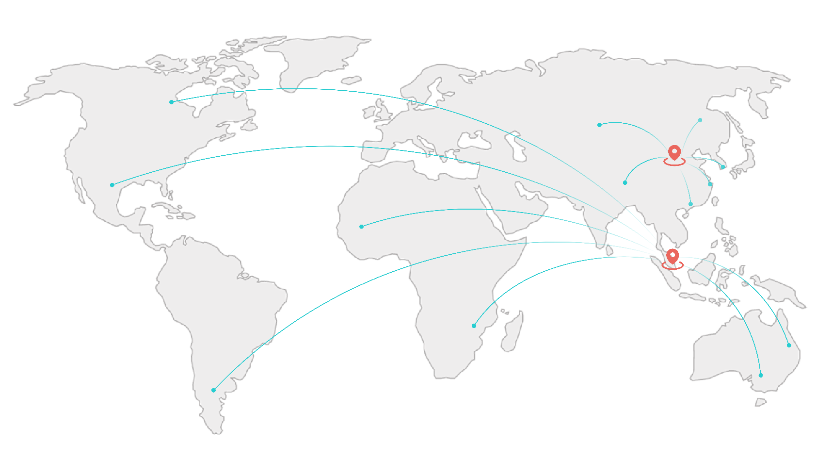

Our Offices
Beijing, Shanghai, Singapore, …
from Asia Pacific to the World
Headquarter located in Beijing, China.
Global Headquarter in Singapore.
With a professional delivery and service team, more than 1,200 Sobot employees run business in 6 continents and serve 5,000+ customers in 20+ countries.
Data isolation for compliance
2 SaaS Cloud in Mainland China
2 SaaS Cloud in Singapore and USA
Data isolation among data centers
24/7 service available
Excellent consultant and customer success Manager
Offer omnichannel & 24/7 service with global coverage

Slide 7
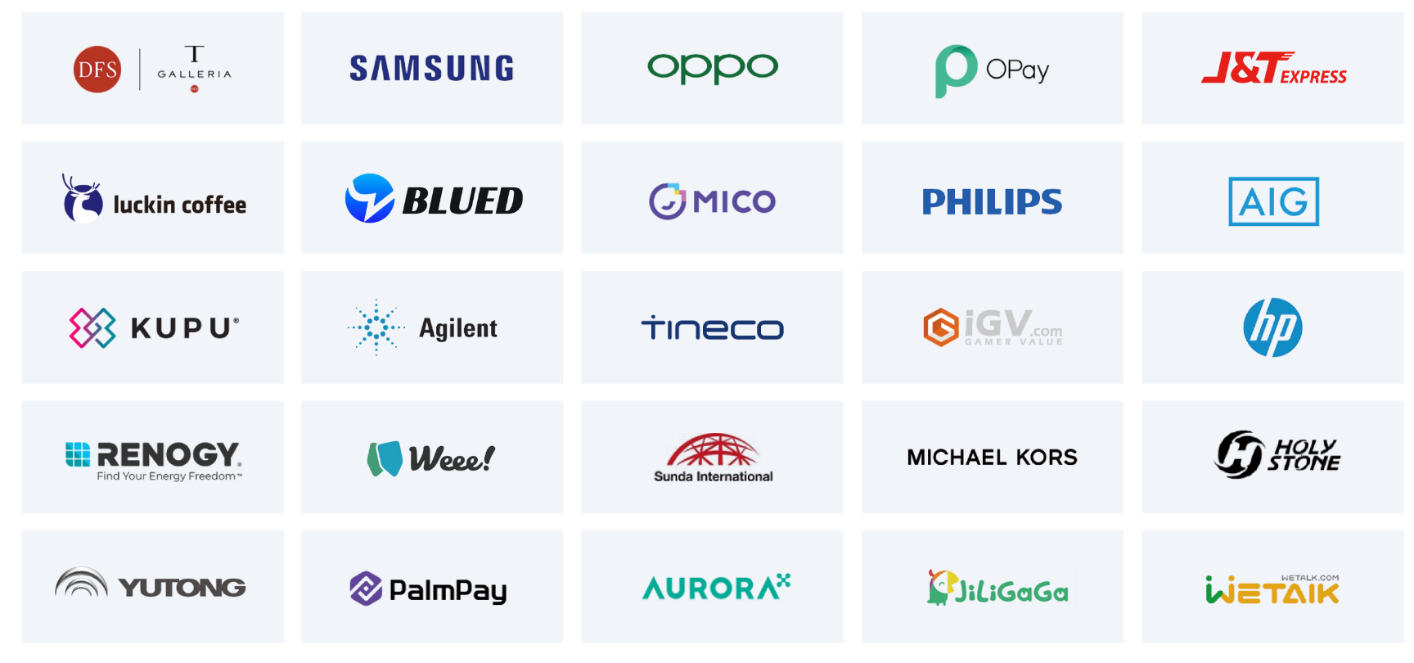
Trusted by Customers All over the World
Manufacturing | Retail & E-commerce | Entertainment | Financial | Gaming | Enterprise Services

Slide 8
2
Contact Center Solution

Slide 9


















Sobot | All-in-One Customer Contact Center Solution
Value
Omni-Channel
Personalization
AI Assisted Service Integration
Outbound Optimization
Management
Phone
All-in-one
Workbench
Customer Center
Evaluation
One ID
CSAT
Service optimization
Heatmap
A/B test
SMS
Chat
Ticketing
Tagging
Contact plan
Knowledge base
Voice
SMS
Analytics
Translate
Integration
Profile
Past comms
Label
Activities
Capability
Email
Personalized Reception
Online
Rule Engine
Statistics
Website
Mobile site
App
Form
Process management
Trigger definition
Performance evaluation
Service
Workload
Customers
Effective
Smart Routing
Social
Sobot AI
Facebook
Instagram
Telegram
WhatsApp
WeChat
LINE
Discord
Others
NLP bot & AIGC
Knowledge prompt
Auto summary
Quality control
Proactive Engage
Management
Voice
Messenger
Quality control
Churn alarm
Sensitive words monitor
Self-service
SMS
WhatsApp
Product
Voice
Live Chat
Chatbot
Ticketing
CRM
API/SDK/Docs
Infrastructure
Multi-Lingual
Time Zone Support
Compliance
AIGC | LLM
NLP | TTS | ASR
Cloud Messaging
WAF

Slide 10

Omnichannel Customer Service
Voice
Live Chat
Chatbot
Ticketing System

Slide 11



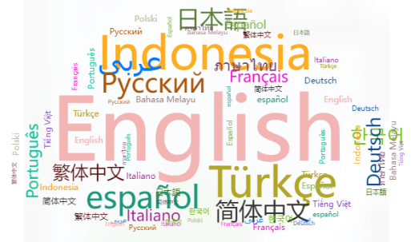










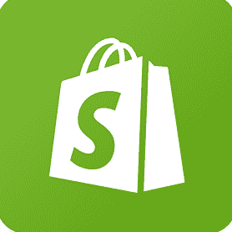


Customer Service Solution| Omnichannel+AI
Omnichannel
Multi language
AI
Improve knowledge operation efficiency
Reduce labor costs
Website
Mobile site
App
Auto-Response
Knowledge Operations
Agent Assistance
Personalized Recommendations
WhatsApp
Instagram
Facebook
Multi timezone
Line
Discord
Telegram
GMT+7:00
Jakarta
GMT+8:00 Singapore
Managing data depends on timezones
Lagre language model
NLP
Knowledge base
Personalized management
Wechat
Shopify
Amazon
GMT+1:00
West Africa time
GMT-8:00
Pacific time

Slide 12
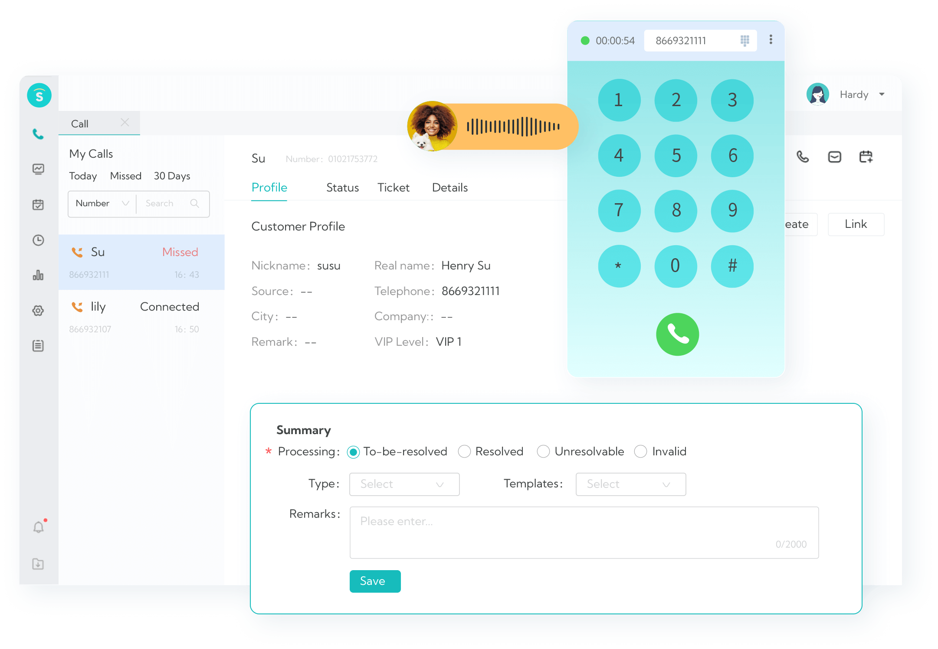
Voice
Stable System
Fast deployment
High availability and scalability
Flexible IVR
Drag-n-Drop interface
Go live real-time
Smart Call Routing
Automatic workflow
Easy to config and re-configure
Time Zone Support
Allow support teams to do data analysis based on customer area time zone

Slide 13
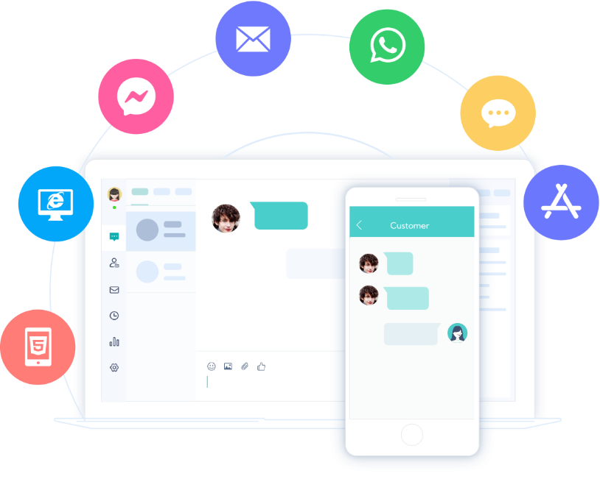
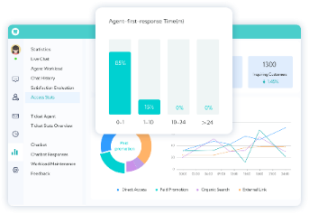
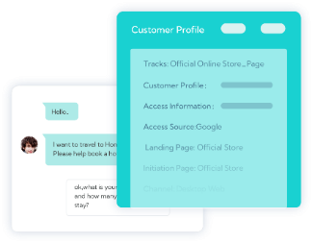
Live Chat
Unify Channels
Website, mobile site, App, Facebook, WhatsApp, Instagram... , etc
Context Synchronization
Have a unified view of all issues/requests associated wit a customer
Configurable reports
Collaborate with Ease
Cooperate with teams from Call Center, Ticketing System.... . to deal with issues
Detailed Reports
Evaluate 150+ indicators to optimize service
Omnichannel workbench (website & mobile)
Customer profile

Slide 14
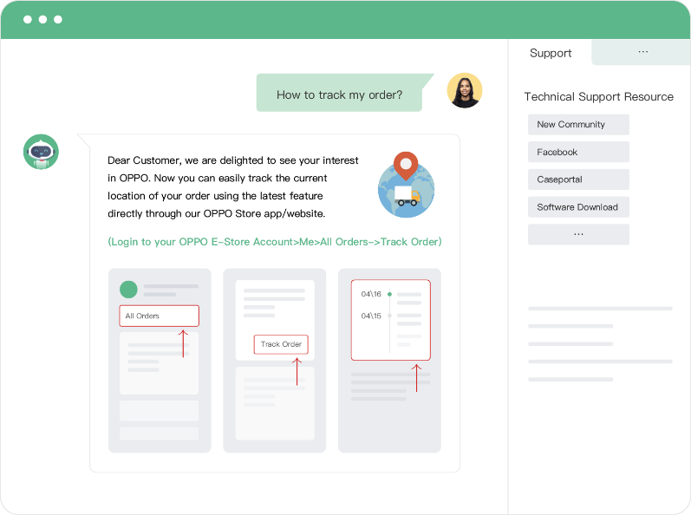
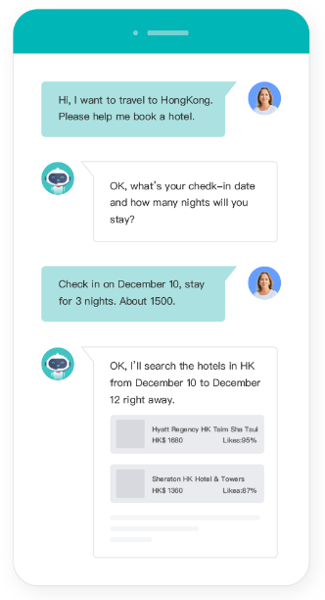
AI Chatbot
Powered by 12-Years of Vertical Knowledge
Extensive industry knowledge and laser focus on CX
AIGC/LLM
Breaking down language barriers
Fast knowledge base build up
Tuning with usage
Knowledge Base
Serving AI bots and agents
FAQs and reference answers

Slide 15
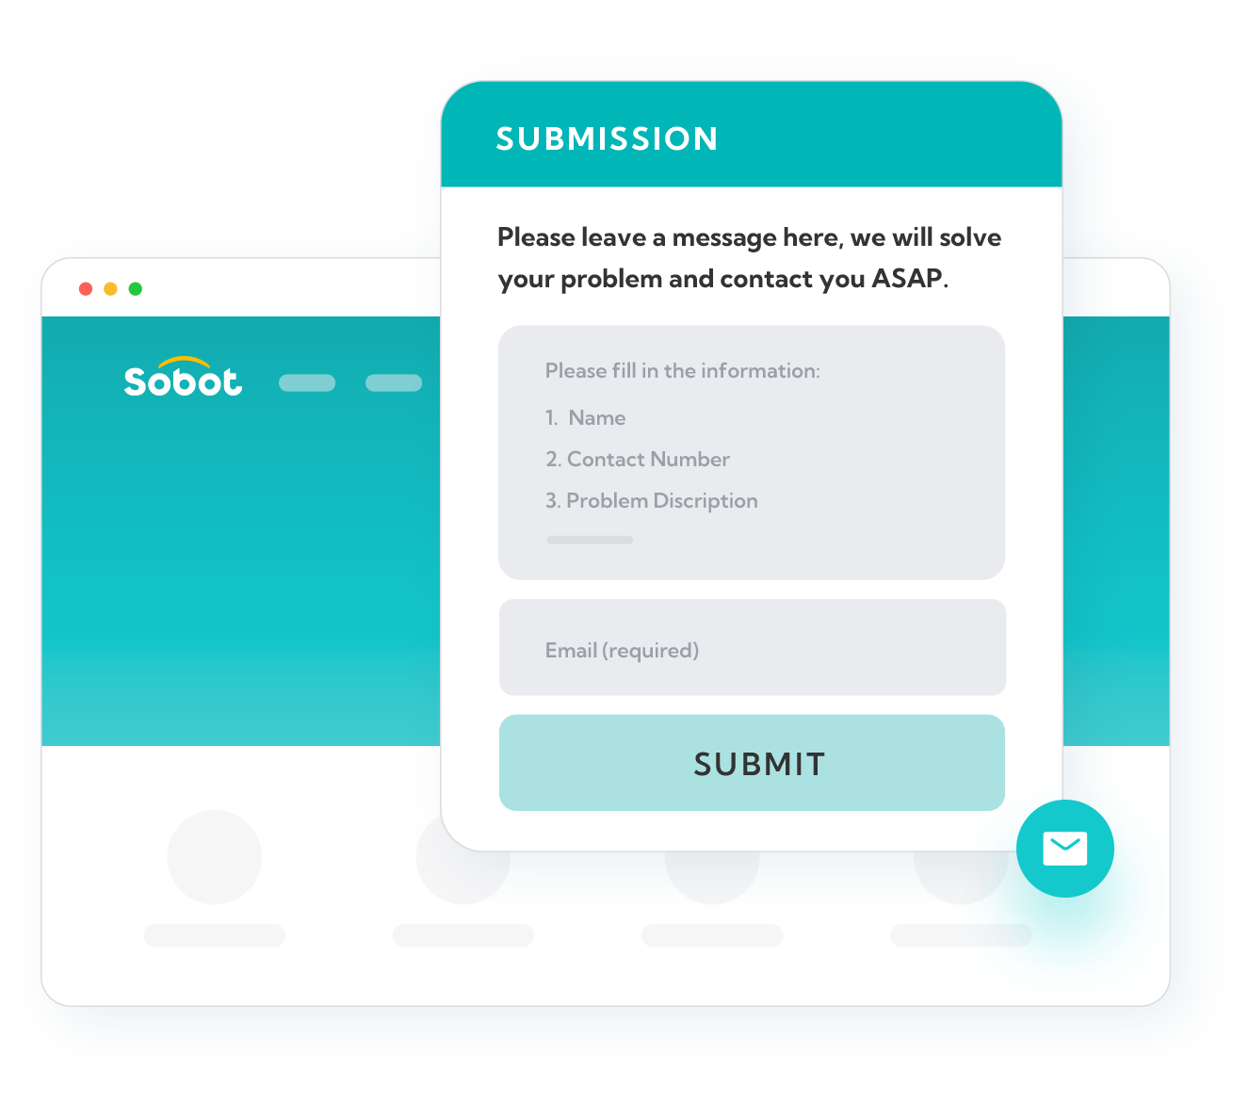
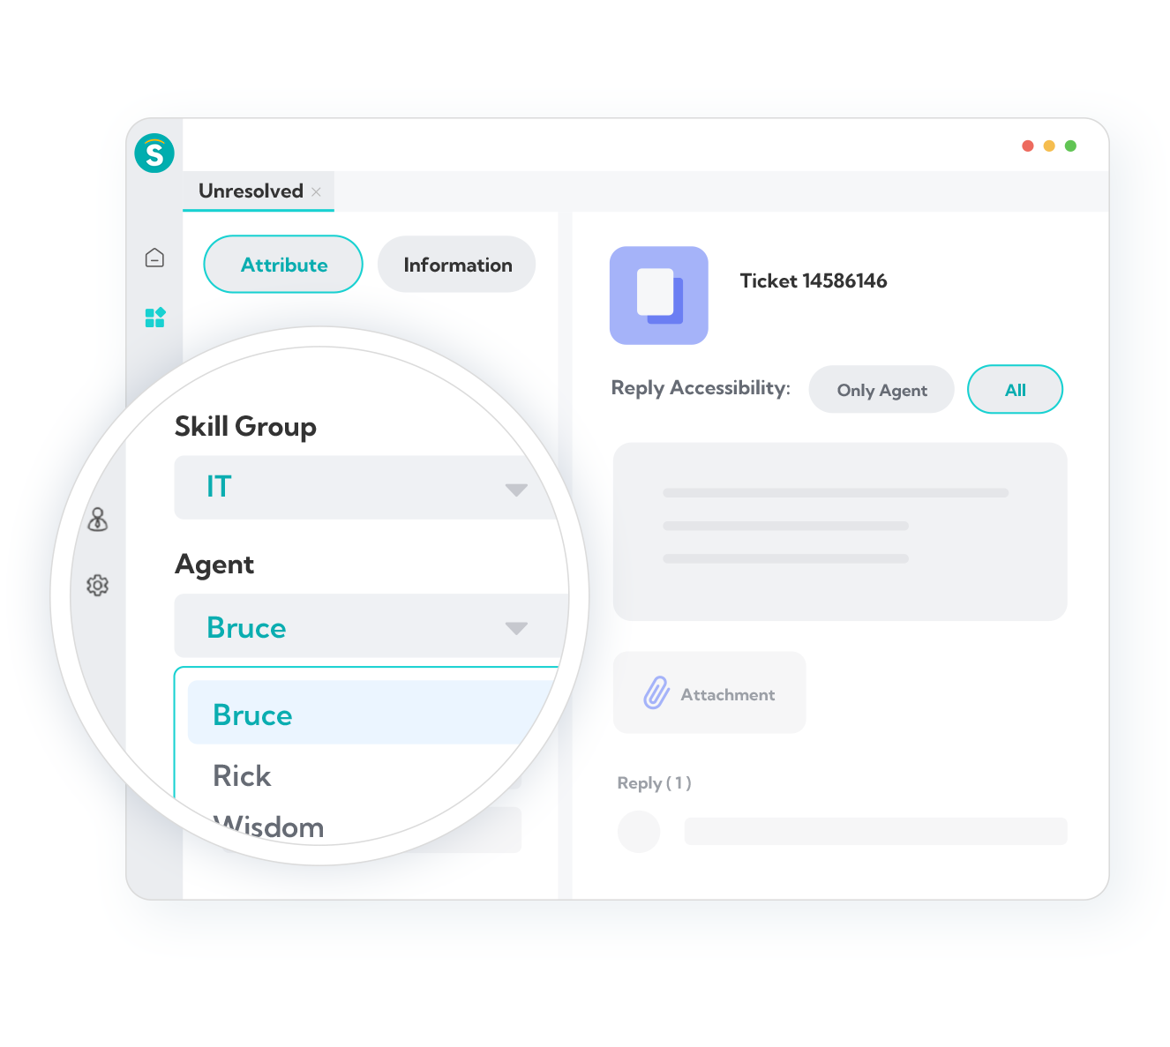
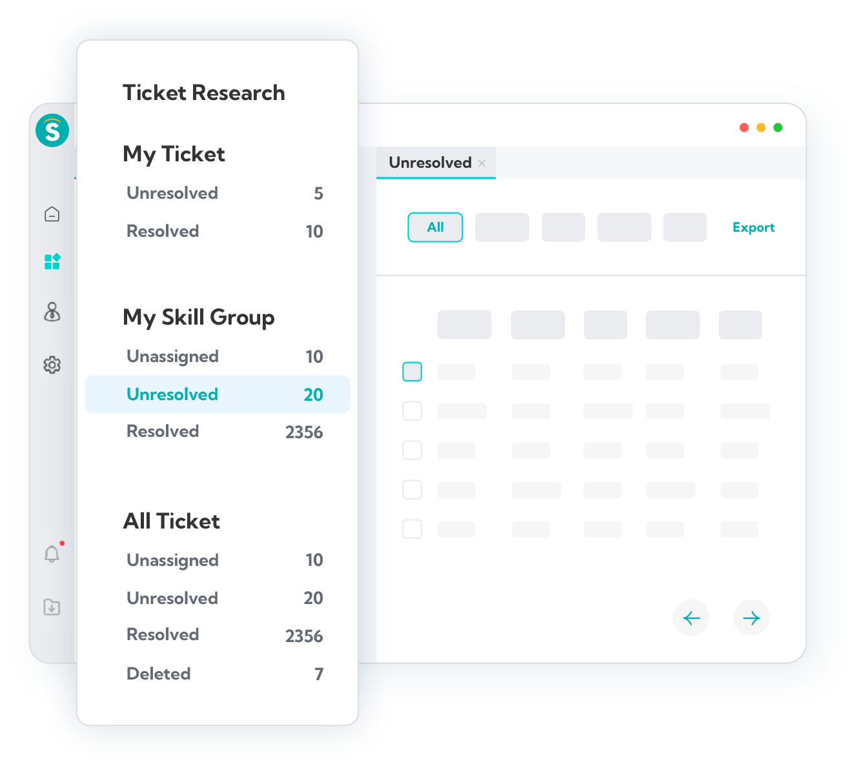
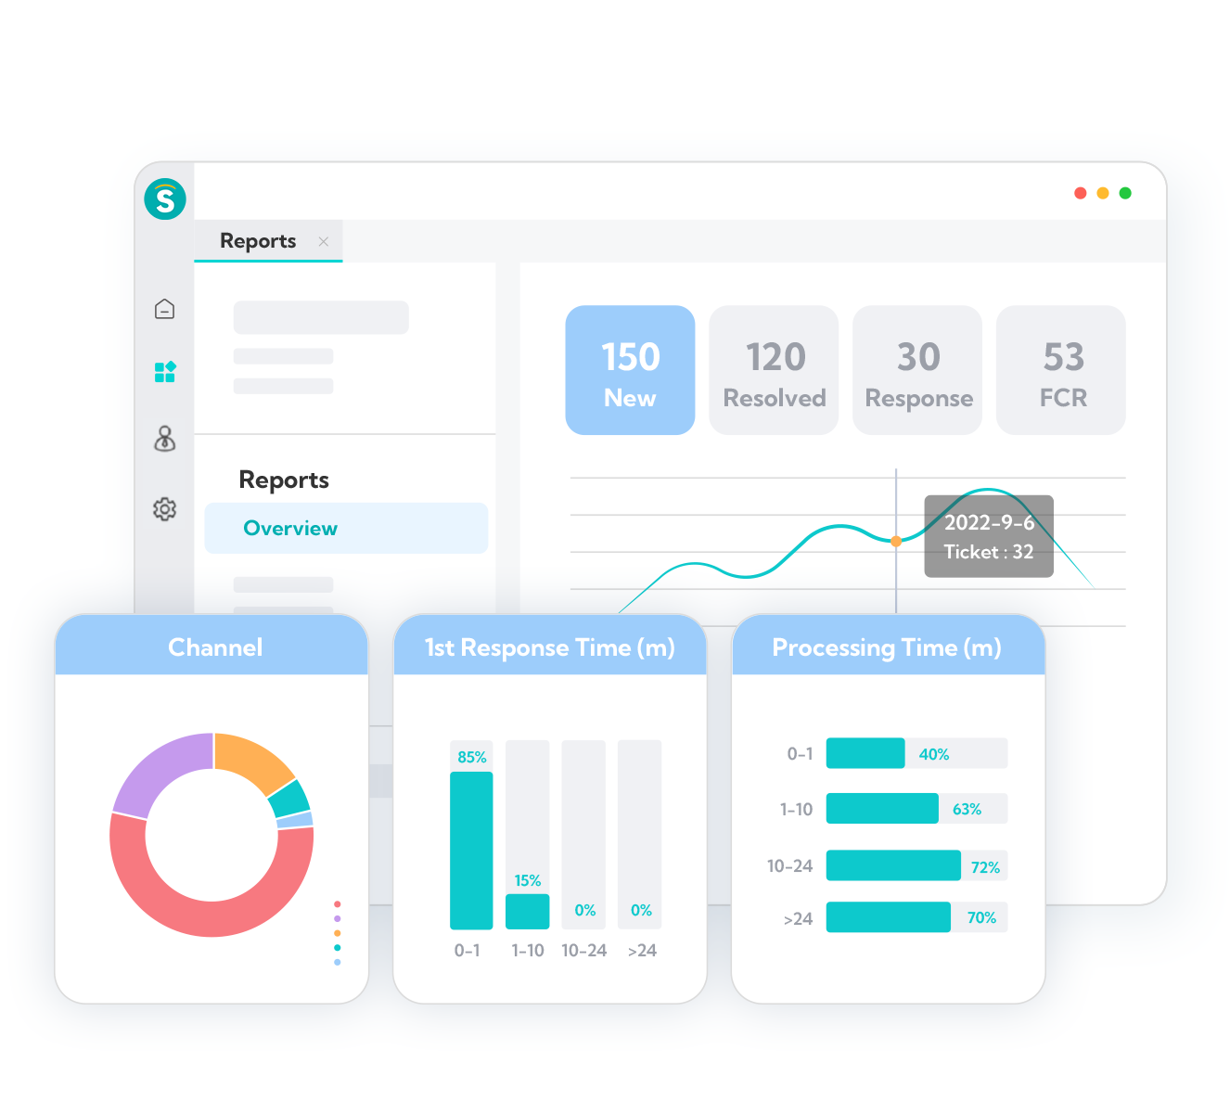
CRM & Ticketing
Support Diverse Channels
Email, messaging, social, help center, voice, and bots
Flow Triggers
Tickets will be automatically assigned to customized skill groups
Message as a ticket
Flow trigger
Service Level Agreements (SLAs)
Remind agents to process tickets in time. Never lose a request
Duty Triggers
Easier and more convenient collaboration between teams
Global search
Multidimensional reports

Slide 16
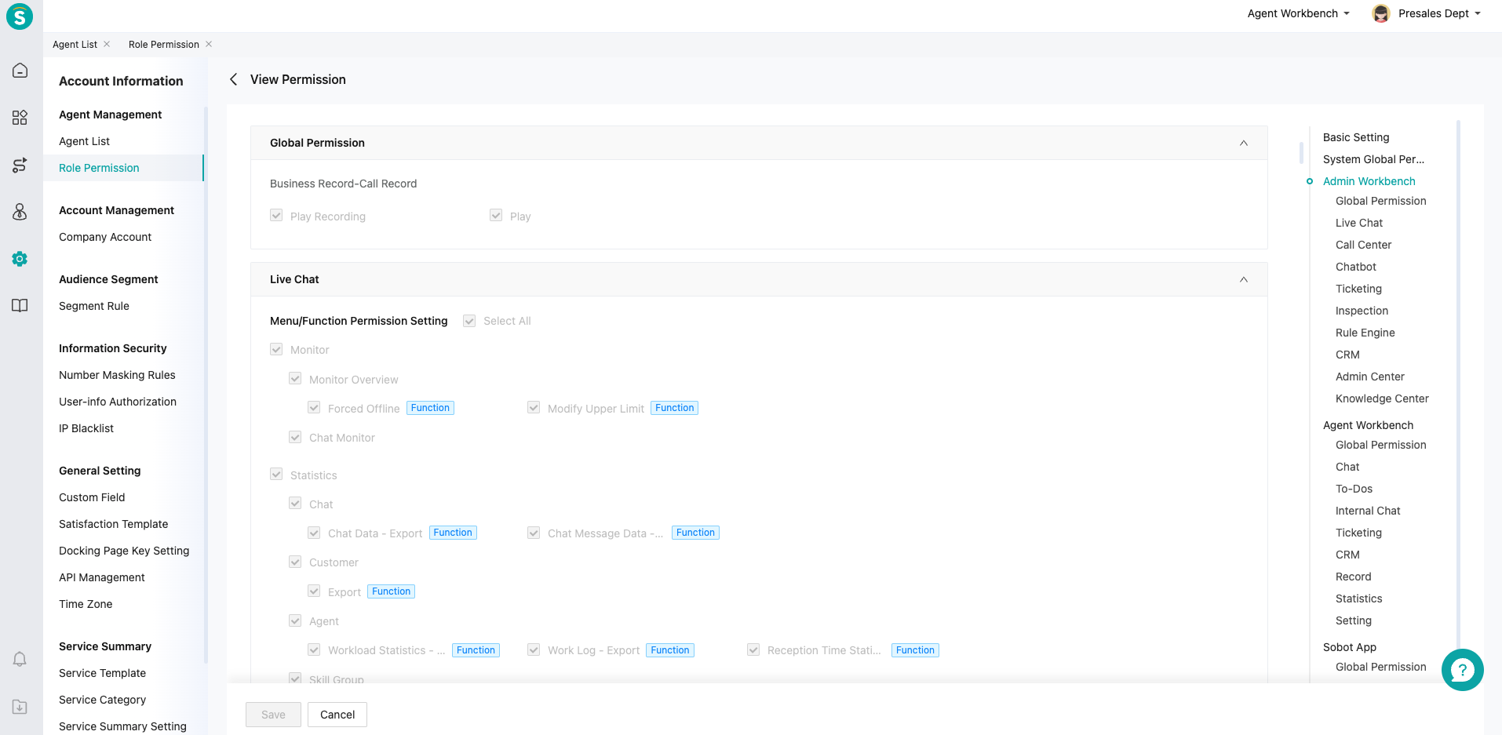
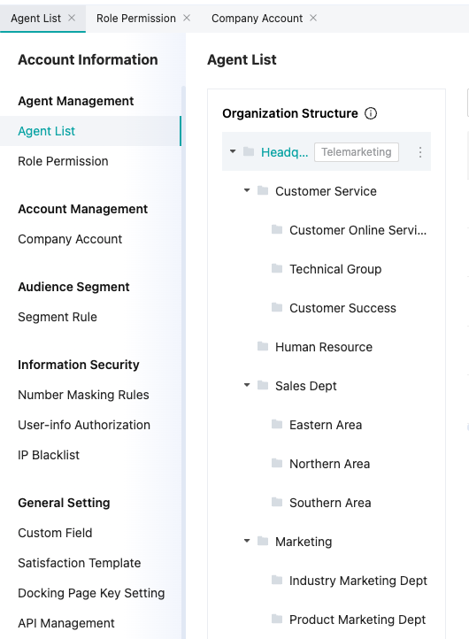




Permission Management and Role Allocation
Organizational Structure
Privileged Roles
Data Isolation
Flexible Settings
Organizational structure determines account privilege and data access levels
Privileges are granted explicitly, with clearly defined responsibilities and capabilities
Data isolation rules are applied at all levels, among all sites, to guard data security and data privacy
Flexibility and granularity provided by the system allows organizations to generate tailored config fits their needs

Slide 17
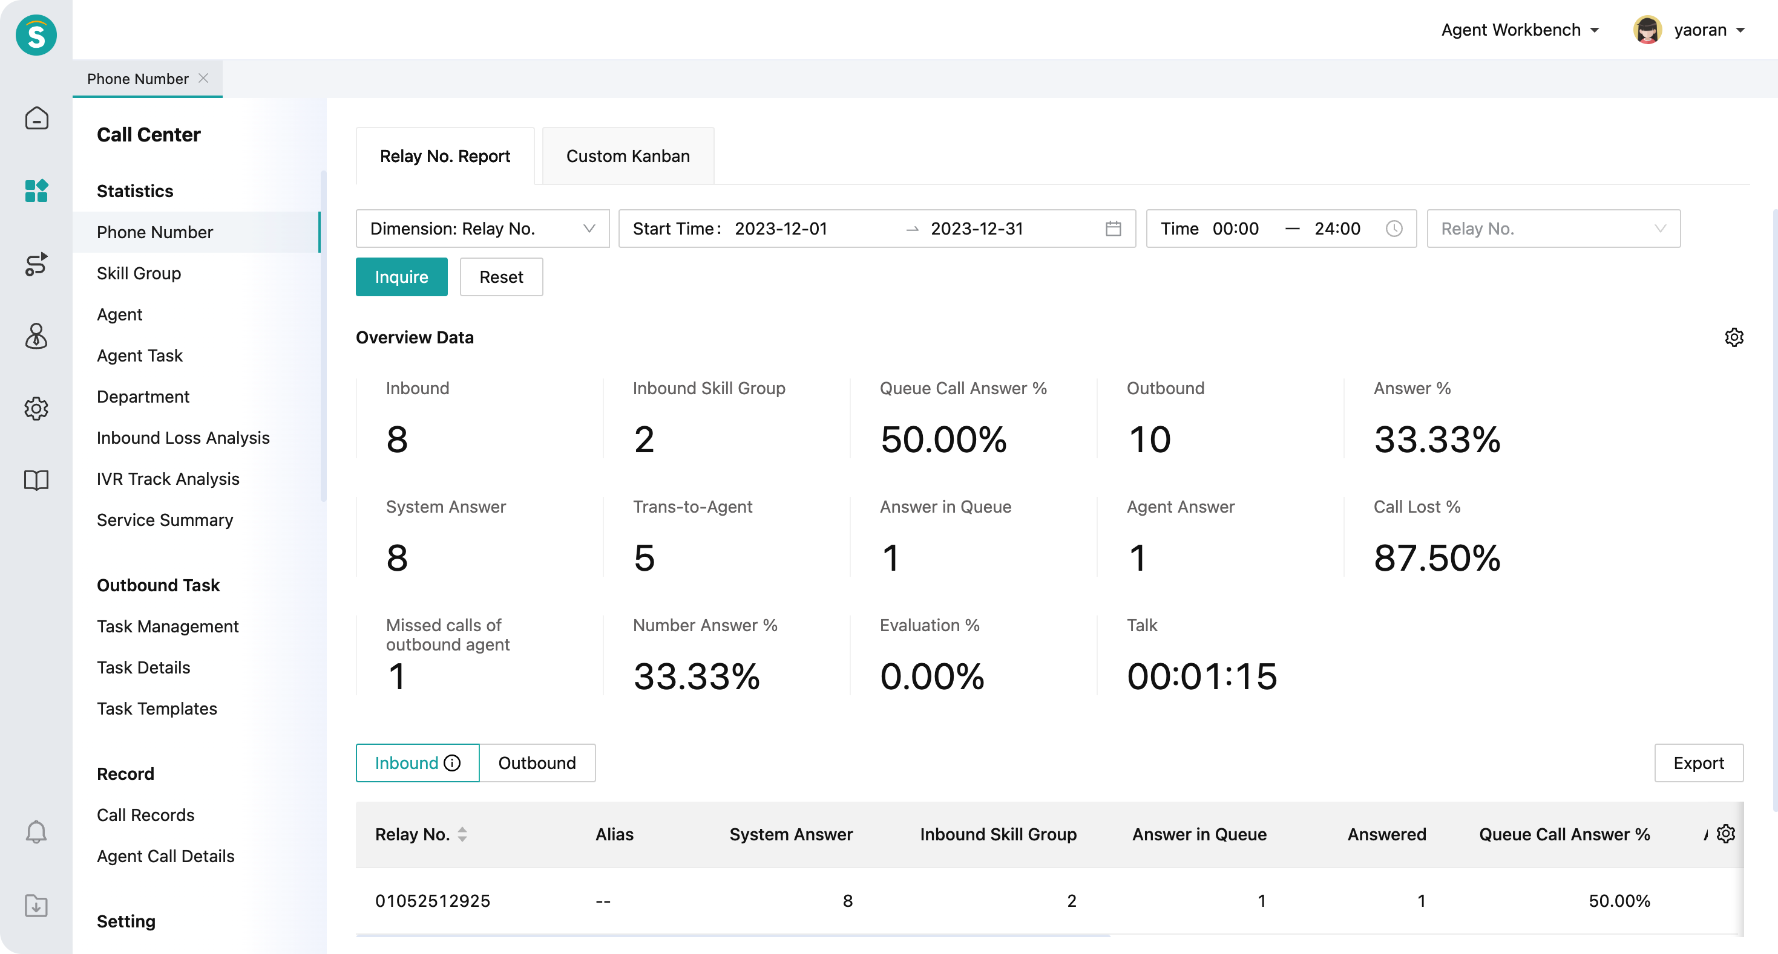
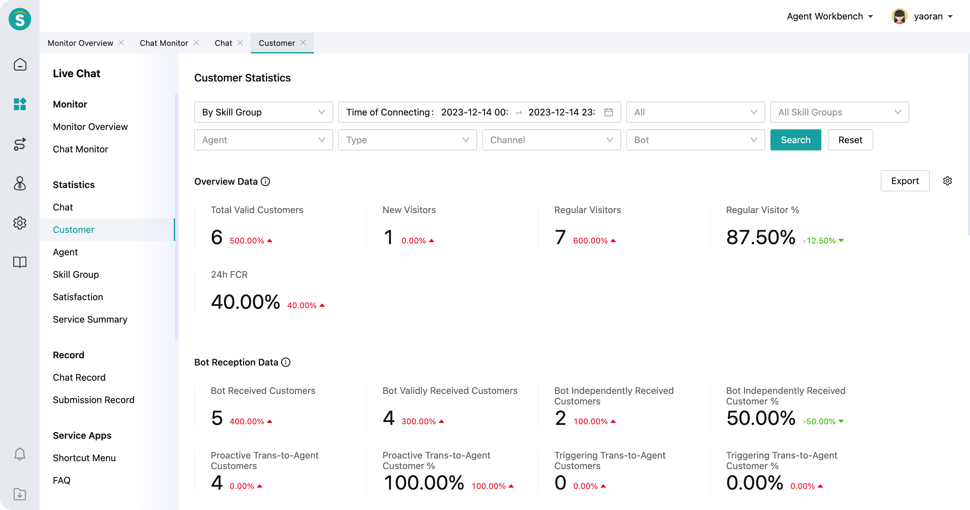
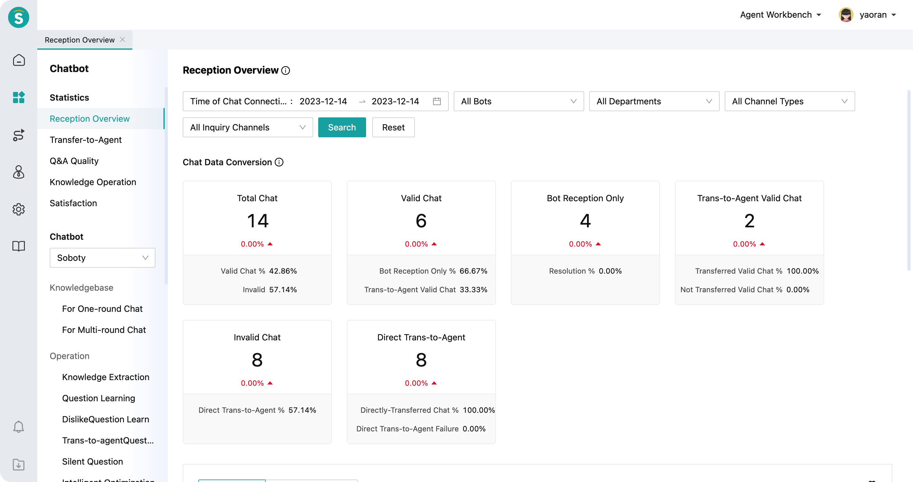
Data Reporting : Data Driven Tuning
Service statistics, up to 450+ statistical indicators
Support quantitative customer service management
Customer Service Workload Statistics
Time-share Reception Statistics
Reception Stress Statistics
Customer Inquiry Statistics
Client Session Statistics
Session Message Statistics
Inquiry Conversion Rate Statistics
Session Recording
Human Customer Service Satisfaction Evaluation Statistics
User Origin Statistics
Search Term Statistics
Statistics of Visited Pages
Landing Page Statistics
Conversation Page Statistics

Slide 18





Sobot: Full Package for Your Customer Experience Journey
Live Chat
Supporting all major messengers
Can integrate into apps, webpages and other platforms
25 Languages at Agents’ fingertip
Voice
Rich management feature
Integrated workbench
AI assisted & knowledge enabled
Bot
12 Years exp building Bot
21 vertical knowledge embedded
Rich usage models
Cost optimization
Ticketing
Guardian of customer exp
Facilitating internal collab
Can integrate into other ticketing systems

Slide 19

Proactive Engage
Rule Engine
Outbound Voice
SMS
WhatsApp Business Platform

Slide 20
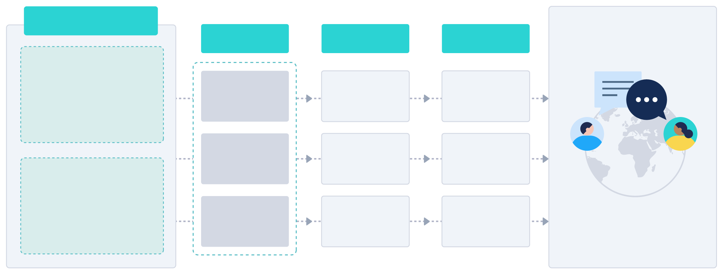



Proactive Engage Solution
Platform
Feature
Resource
Channel
Customer Center
One ID for customer identity
Tagging system for grouping
Contact records across all channels
CRM
Customer Label
Workflow Report
Information Sync
WhatsApp Offcial Business Account Certifcation
WhatsApp
Engage
Bulk Messaging
Workflow Canva
Knowleage Base
Sender ID Register & Templates Operation
SMS
Proactive Engage
Rule Engine
Process management
Trigger definition
Performance evaluation
Analysis
A/B Test
Conversion Tracking
Custom Reports
Global Number Resources & SIP Trunk
Voice

Slide 21
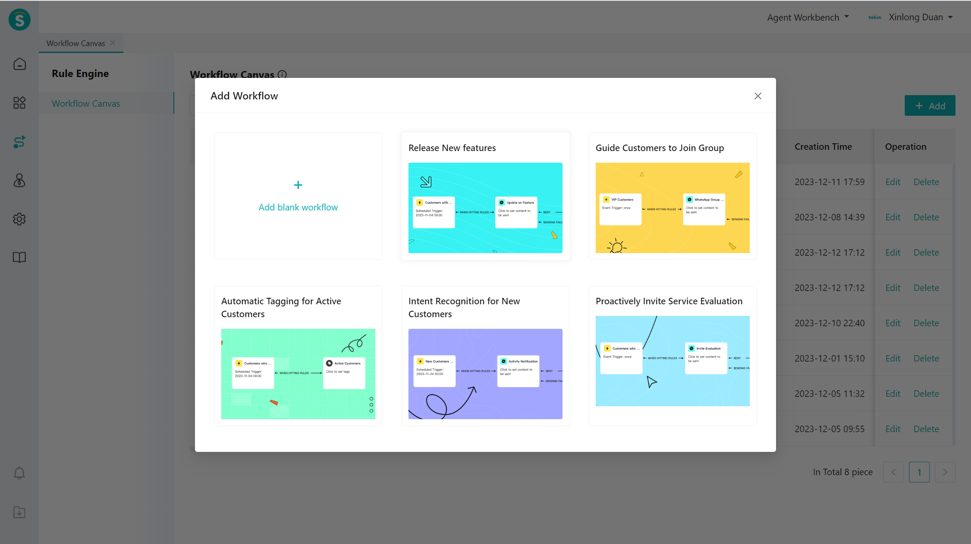
Rule Engine
Engage Customers
Broadcast messages through email, SMS, WhatsApp, etc
Workflow Automation
Trigger events based on customer identity, behavior, etc., providing personalized marketing experience
Tracking Data
Quantify the data of each node on the workflow
Report customers conversion
Collect customer portraits

Slide 22
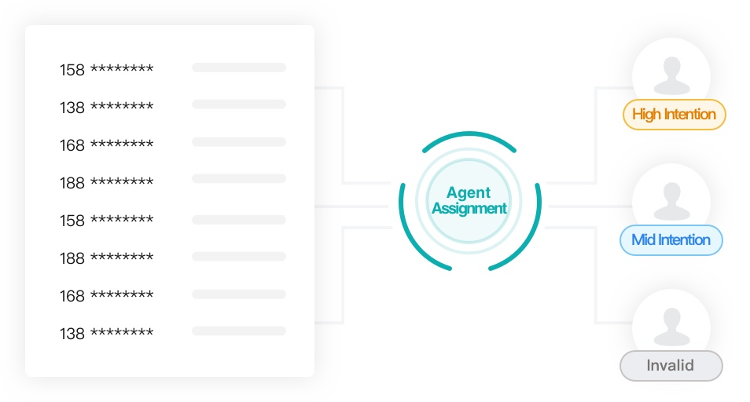
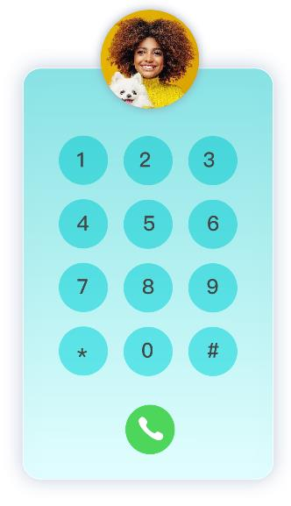
Outbound Voice
Number Resource
Abundant international number of resources
Campaign Management
Bulk marketing campaign creation and assignment
Statistics
Generate multi-dimension reports depending on business needs
CRM Integration
Generate reports depending on business needs. Integrate with CRM systems, including Salesforce, etc

Slide 23
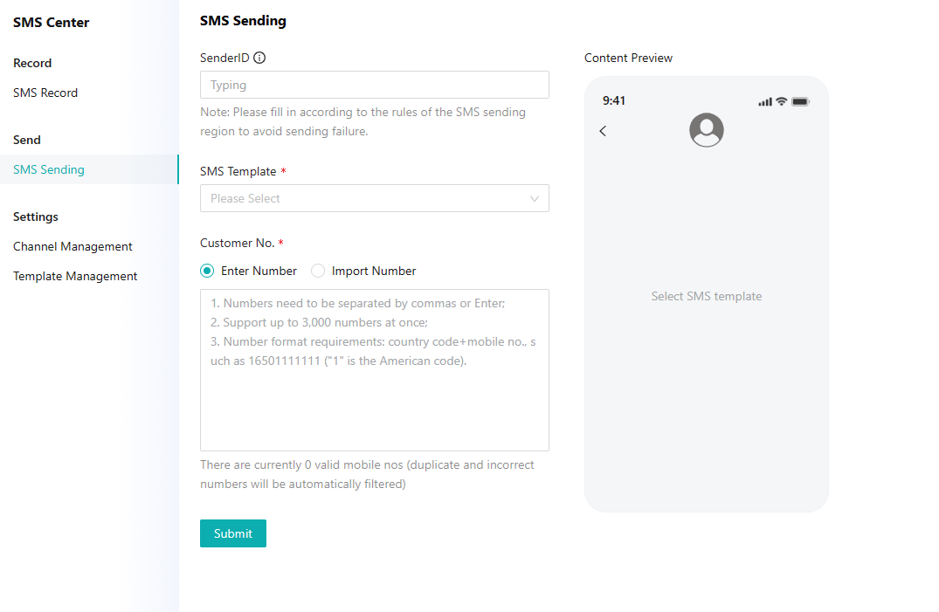
Worldwide SMS
Broadcast Messages
Bulk messages via Sobot Workbench
Easy to integrate with Sobot API: HTTP&SMPP
Design Your Templates Freely
Create and manage templates according to business reeds
Statistics Report
Directly figure out the sending status of SMS

Slide 24

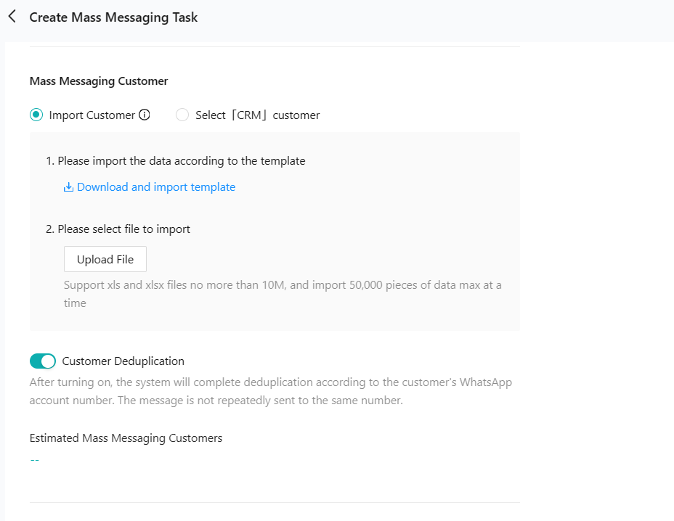
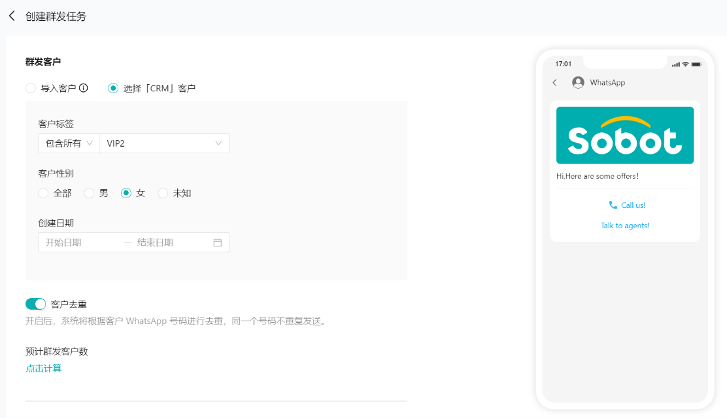
WhatsApp Business Platform
Official Business Account Certification
Win customer trust
No limited quantity of broadcast messages
Automate Marketing Campaign
Reach your target audience at scale automatically with our engagement platform
Task Statistics
Get task status details directly
API Integration
Integrate with softwares, e.g., CDP system and data warehouse

Slide 25
3
Best Practices

Slide 26
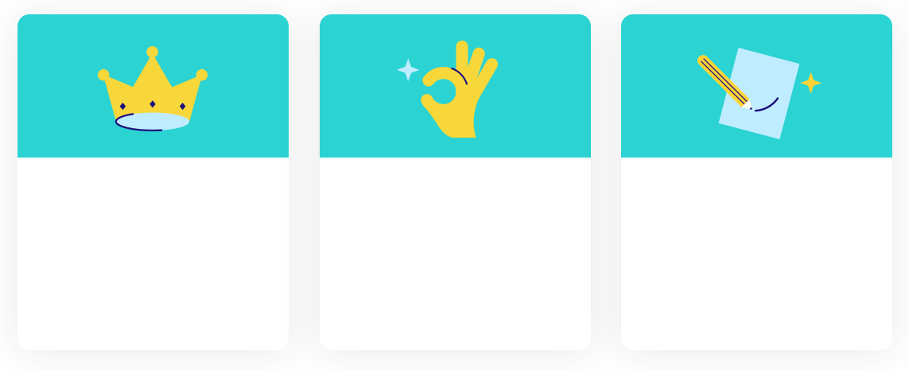
Why Customers Choose Sobot?
Products and Services
All-in-one solution with stable SDK and open API platform
Experienced global deploy team
Value added professional solution design, business evaluation, and training team
Omni-channel Support
Select Level Meta BSP, with comprehensive operational experience
Support all major communication platforms natively
Provide unified service platform for all channels
Rich Vertical Experiences
More than 12 years experience serving customers from more than 20 verticals
Operates in Southeast Asia, Middle East, Americas and Europe
24/7 support for all customers

Slide 27





Project Delivery Process and Assurance
Planning
Implementation
Going-Live
Hand-Over
Customer Success
1. Assist enterprises in sorting out business scenarios
2. Communicate & confirm the details of the requirements
3. Develop a delivery implementation plan
4. Provide appropriate counseling services
1. Strict project management system
2. Standardized project implementation criteria
3. Efficient problem- solving process
1. Professional implementation team
2. Personalized training services
3. Adequate system testing before going live
4. Applicable to different business sizes
The project was commissioned to achieve quality operations and seamless transition to provide continuous quality service to our customers
1. Customer success team intervention;
(Customer Operations Group + After-sales Service Group + Business Service Group)
2. Customer lifecycle operations
3. Continuous follow-up of advisory services

Slide 28
Why Sobot for your CS team?
Dedicated Support Team
Regular progress reports
Dedicated onboarding training
Customer success service and best practices
Quick Response and Effortless Service
Provide 24/7 after-sale support practice what we preach by giving you the catered and personalized experience
Dedicated Teams
Prompt Response
Transparent Pricing
No hidden fees
Guarantee clarity with a detailed breakdown of what you're actually paying for
Industry Reputation
Number 1 CS platform from APAC, with $200 million dollar funding in 2022 Series D Led by Softbank
Transparent Pricing
Industry Reputation

Slide 29

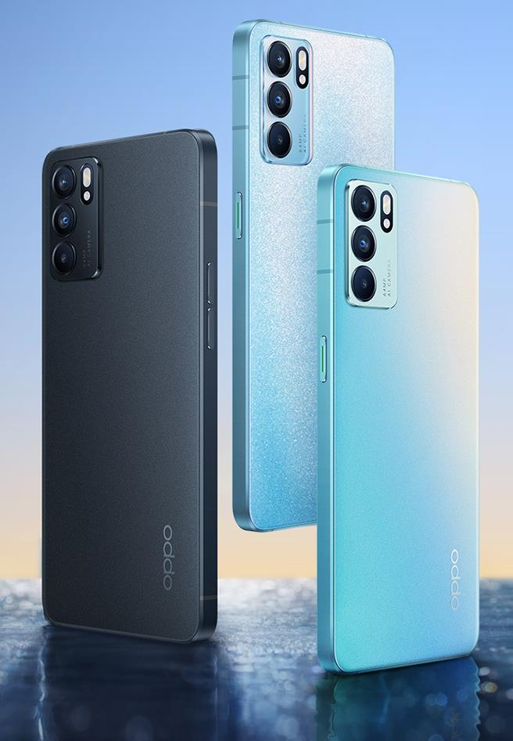
E-C & Retail | Oppo
OPPO has achieved an impressive up to 93% CSAT in their conversational support by harnessing the capabilities of Sobot.
81%+
30%+
93%+
Self-service rate
Increase in producivity
CSAT
Sobot unifies all OPPO’s channels, such as Facebook, WhatsApp, etc., improving agent productivity.
Coordination between Chatbot and Live Chat provides customers with 24/7 seamless service, increasing CSAT.
Sobot's APIs empower the omnichannel platform to harmonize data sourced from OPPO's membership system, CRM system, and knowledge database.
Read more at https://www.sobot.io/customers.html

Slide 30
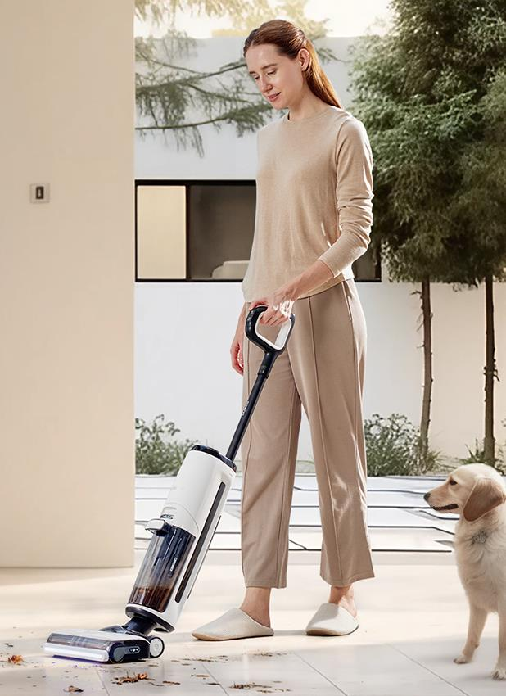
E-C & Retail | Tineco
Find how Teneco prioritizes customer-centric experiences through the implementation of Sobot.
120k+
20k+
40%+
Call volume per month
Ticketing volume per month
Increase in resolution rate
Sobot unified workspace helps Tineco focus on the right issues, move quickly, and deliver personalized support.
Utilizing the Ticketing System, Tineco handles emails from 20+ e-commerce platforms such as Amazon, Lazada, etc, enabling seamless collaboration across teams.
The Sobot product team worked with Tineco to provide seamless after-sales service on Live Chat and Call Center.
Read more at https://www.sobot.io/customers.html

Slide 31


E-C & Retail | Renogy
Renogy uses Sobot to create world-class customer experiences
and achieve 95% CSAT
95%+
45%
100+
CSAT
Increase in resolution rate
Agents No.
Sobot unifies all RENOGY channels so that RENOGY delivers customers with consistent service since customer information has synchronized.
Chatbot, powered by generative AI, works on many channels so customers can find answers wherever they are.
The Ticketing System integrated e-commerce platforms such as Amazon, eBay, etc, increasing resolution efficiency for support teams.
Read more at https://www.sobot.io/customers.html

Slide 32
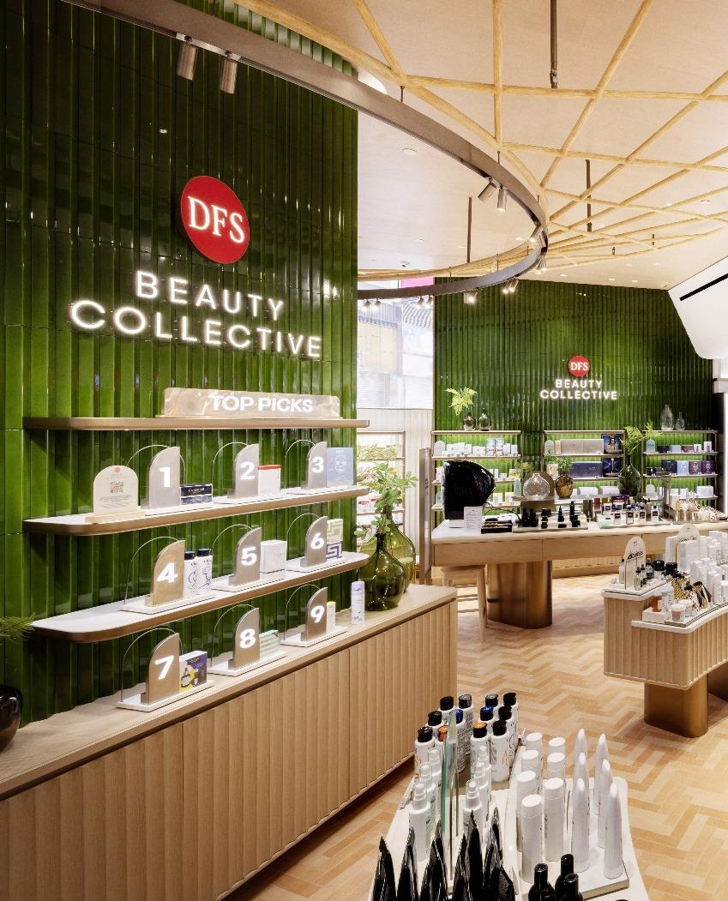

E-C & Retail | DFS
DFS collaborated with Sobot to optimize the digital customer journey, improve customer satisfaction, and increase conversion rates
80%+
44%+
91%+
Efficiency improvement
Conversion rate
CSAT
Omni channel service integration: Social networks, PC official website, mobile terminal, hotline, etc..
Virtual personal shopper solution: able to provide pre-sales and after-sales services based on user profiles and preferred products
Improving efficiency: agent & AI integration, enhance the efficiency of front-line agents and second-line in-store sales management
Read more at https://www.sobot.io/customers.html

Slide 33
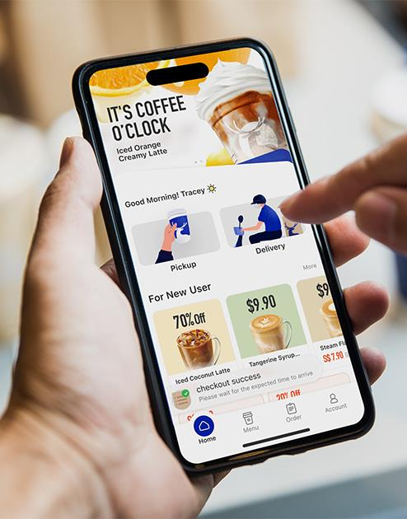

E-C & Retail | Luckin Coffee
Luckin Coffee engages customers at scale to consume in stores with Sobot's WhatsApp Business Solution.
80%+
20%+
97%+
WhatsApp marketing message open rate
Increase in ROI
CSAT of offline stores consumption
Luckin coffee reached customers with bulk marketing campaign messages on WhatsApp Business Platform for an ROI increase due to getting business account certification from Sobot, an official BSP of Meta.
Luckin coffee creates creative interactions with customers on WhatsApp to attract them to offline stores.
CSAT surveys became more accessible and accurate on a customer’s preference channel-WhatsApp.
Read more at https://www.sobot.io/customers.html

Slide 34
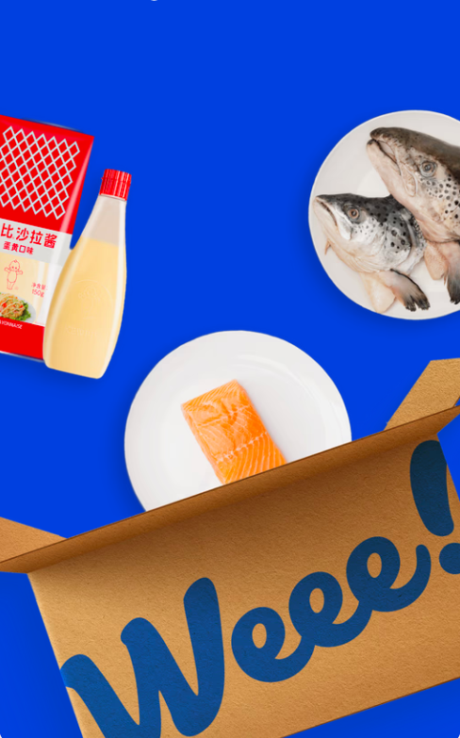

E-C & Retail | Weee!
Weee!, the largest Asian and Hispanic grocery store in North America.
Leveraging Sobot, Weee! has assembled an exceptional support team and under gone a transformative journey to enhance customer experience.
20%+
50%+
96%
Increase in Agent Efficiency
Reduction in Resolution Time
CSAT
IVR - flexible, adaptable and simple: Sobot's IVR system is both flexible and adaptable, making it easy to accommodate the ever-evolving demands of the business.
Unified agent workspace: Sobot's integrated voice solution seamlessly synchronizes with all other communication channels, providing agents with immediate access to comprehensive customer information.
Multi-dimensional CX research: Weee! has achieved not only a commendable return on investment (ROI) but also significant business growth by enhancing the overall customer experience.
Read more at https://www.sobot.io/customers.html

Slide 35
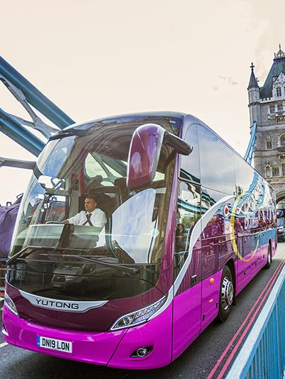

Manufacturing | YUTONG
Yutong choose Sobot and Salesforce outbound call solutions to conduct follow-up and collect feedback from loyal customers.
84%
20%+
23%
Positive feedback
Outbound call efficiency
Increase in collection rate
YUTONG sought to build closer connections with customers by calling back regularly. It cared about customers’ usage, needs, or other feedback so as to do CX research and optimize products.
Call outbound by Sobot supported bulk outbound task creation and assignment, helping YUTONG stay dialed in with customers.
Call Center was stable and flexible, easy to change with business growth while integrated with Salesforce and other CRM systems.
Read more at https://www.sobot.io/customers.html

Slide 36

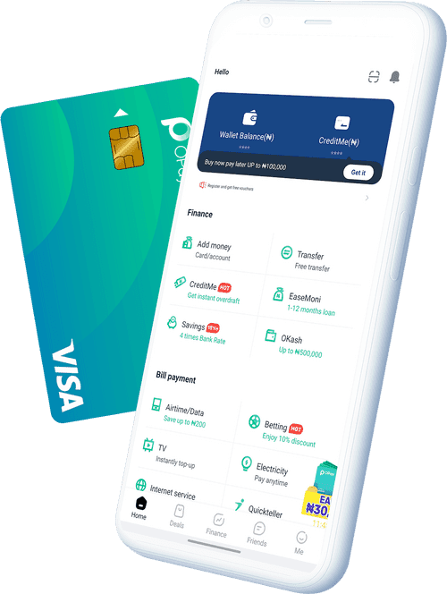
Financial Services | Opay
Opay has significantly boosted customer service efficiency across three continents through the use of Sobot.
90%
20%+
17%
Positive feedback
Overall cost reduction
Increase in conversion rate
OPay worked with Sobot teams to send mass notifications, marketing, and promotion messages via WhatsApp Business Platform. SMS is a fallback channel.
WhatsApp combined with Live Chat, so OPay solves specific business needs on the omnichannel workspace.
IVR by Call Center is flexible and intelligent and helps customers flow to the right support teams, diminishing service queues
Read more at https://www.sobot.io/customers.html

Slide 37


Financial Services | GLDB
GLDB is a leading fintech company in Singapore. It committed to providing supply chain financing services and related financial products to small and medium-sized and technology-based innovative enterprises
99.99%+
800%+
95%+
Uptime
System configuring efficiency
CSAT
On the basis of voice service, Sobot helps GLDB expanding live chat, e-mail and other service channels, covering more channels.
More flexible IVR, which can be quickly configured and optimized based on business expansion.
Interfacing with Microsoft business suite, including Teams and single sign-on authentication.
Read more at https://www.sobot.io/customers.html

Slide 38
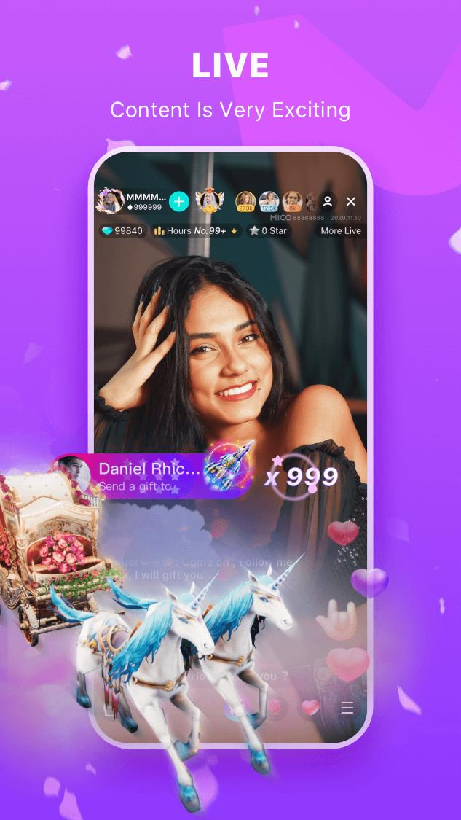

Entertainment | Mico
Mico relies on Sobot to drive communications across every stage of the customer lifecycle.
80%+
50%
95%+
Chatbot Resolution Rate
Increase in efficiency
CSAT
Chatbot (powered by Sobot AIGC) gives MICO creativity and flexibility to empower customers with a friendlier conversational experience.
Diversified reception schemes by Live Chat supply customers with distinguished service, especially VIP customers, although they may be from different countries.
MICO handles tickets from different mailboxes or other channels on only one platform.
Read more at https://www.sobot.io/customers.html

Slide 39

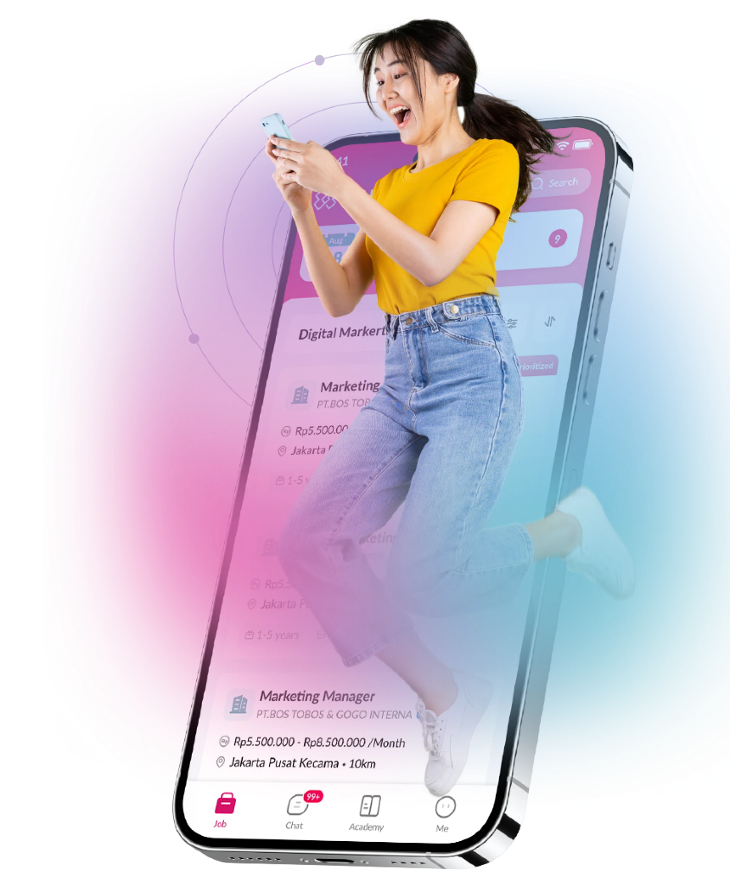
Life Services | KUPU
Leveraging Sobot, KUPU has assembled an exceptional support team and undergone a transformative journey to enhance customer experience, ultimately driving higher net retention rates.
85%+
800k+
94%+
WhatsApp marketing message open rate
Message sent No.
CSAT
KUPU reached and engaged customers with Sobot stable and intelligent Call Center.
Sobot teams worked with KUPU to deliver customers a personalized promotion experience with WhatsApp Business API at scale, conducting user growth.
A seamless omnichannel solution of Sobot for self-service, conversational support, and ticketing enhanced the CX of KUPU.
Read more at https://www.sobot.io/customers.html

Slide 40
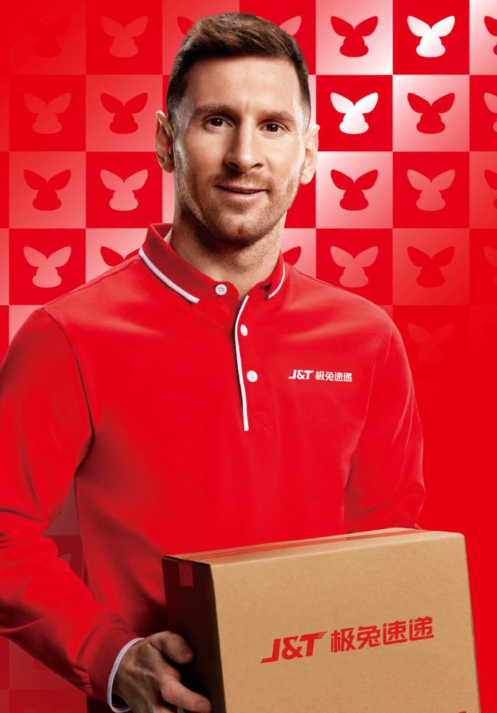

Logistics | J&T Express
How J&T Express leverages the WhatsApp Business Solution to enhance the automation and speed of their delivery services.
50%
35%
40%
Overall cost reduction
Increase in delivery rates
Increase in delivery rate
WhatsApp plays a pivotal role in streamlining the end-to-end interaction process between the delivery team and consignees for J&T Express, resulting in significant improvements:
Effortless Notification Sending: Group sending automation.
Enhanced Communication: Flexible two-way communication for delivery time.
Route Optimization: Easy to ensure geographic location.
Read more at https://www.sobot.io/customers.html

Slide 41

THANKS
All-in-one Contact Center Solution

