Slide 1
Latitude by Genesys: AIM
Agency Interface Manager

Slide 2
Latitude by Genesys
Outsource Strategy Management and Process Automation Solution for Accounts Receivables Management.
Notes:
Complete outsourcing solution for placing accounts out for collections

Slide 3
Outsourcing Overview
Leveraging external vendor partners in the collection of debt
Can be simple single source or use complex models and multi-tier strategies
Can be used to target accounts in a specific state to “best in class” or specialty vendor partners
Data intensive and potentially high human resource demand
Notes:
Outsourcing of debt collection is a standard practice in use by many organizations as the total solution for collection and recovery of debts or in a hybrid model where some accounts are handled internally and some are sent to outside partners.
Single and multi-tier strategies may be used when outsourcing however the basic requirements for data exchange and updates remain the same.
Organizations look to route the right accounts to the right partners be that based upon historical performance or the state or type of account. For example handling bankruptcy or deceased accounts.
From both a compliance and collections perspective data accuracy, integrity and currency are of utmost importance and as such the volume of files and transmission frequencies can place a high demand on resources within an organization.

Slide 4

Account Outsourcing Challenges
Understanding the nature of the accounts being outsourced
Understanding the historical performance metrics of your outsource partners
Notes:
Talk to identifying what accounts need to go to which organization based upon type, age, balance and state
Talk to ability to understand how your vendors are performing

Slide 5
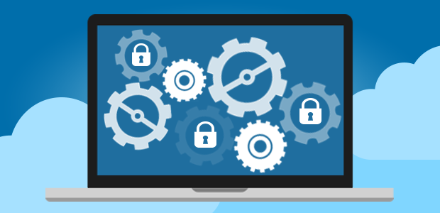

Account Outsourcing Challenges
Getting the right accounts to the right partners at the right time efficiently and securely
Inventory Management
Continuous communication between you and your vendor partner
Notes:
Talk to selection and transfer
Talk to reconciliation
Talk to data updates

Slide 6

Account Outsourcing Challenges
Effectively managing multi tier placement strategies
Performance reporting and leveraging Champion / Challenger strategies
Notes:
Talk to account flows from agency to agency
Talk to performance reporting

Slide 7
Latitude Agency Interface Manager

Slide 8

Latitude AIM Solution
Query and analysis tool allows you complete visibility to all account data
Account level data can be leveraged in placement strategies via queries or process automation
Detail reporting on vendor performance metrics and vendor vs. vendor statistics and dashboards
Notes:
Talk to Account Analysis
Talk to Workflow
Talk to fully performance reporting capabilities and dashboards

Slide 9
Latitude AIM Solution
Bidirectional data updates
  Account placements / recalls
  Financial updates
  Demographic updates
  Collection notes / work activity
  Reconciliation
  Compliance data
  Request and Response
Notes:
Talk to standard exchanges
Talk to request / response and how all is logged and worked

Slide 10

Latitude AIM Solution
Inventory Management
  Ensuring accounts are where they are supposed to be
  Confirming the balance on accounts is accurate
Notes:
Talk to the reconciliation process

Slide 11

Latitude AIM Solution
User Queries and Workflow drive account selection
User Queries and Workflow drive placement strategy
Distribution templates, business rules control volumes and which vendors receive accounts
Per vendor restrictions control placements

Slide 12

Latitude AIM Solution
Secure communications to vendors
Optional file encryption for added security
Supports both file push and file pull
Automation of file generation & transfer
Notes:
Talk to FTPS/SFTP
Talk to PGP
Talk to Job Manager

Slide 13
Latitude AIM Solution
Unlimited number of vendor partners
Multi-tier placement strategy management
Complete data updates at your schedule
Request and response between you and the vendor

Slide 14
AIM Case Study

Slide 15
AIM Case Study
Top 3 US Cable/Voice/Internet Provider
  Multiple Regions
  High number of outside collection agency partners
  True multi-tier placement strategy

Slide 16

AIM Case Study
Prior Model
  Everything on spreadsheets from multiple billing platforms with no consistency
  Totally manual process for account selection and transfer
  Historical tracking of placements challenging for multi-tier and lack of performance reporting

Slide 17
AIM Case Study
Latitude AIM Solution
  Bidirectional data bridge from billing platforms to Latitude
  Fully automated account distribution to OCAs
  Fully automated strategy management of multi-tier placements
  Fully automated secure file transfers between client and OCAs

Slide 18

AIM Case Study
Benefits from AIM Implementation
  Efficiencies
  Collections
  Compliance

Slide 19
AIM Summary

Slide 20
Latitude AIM Solution Summary
Complete solution regardless of account type, state or outsourcing model
Complete visibility to account data and vendor performance reporting
Automated and secure data transfer and support for all data attributes and types via scheduling and process automation

