Slide 1






Step 1: Determine who is the target audience
The first and the most important task which you have to complete - is to understand who is going to read your documentation. If there is such an opportunity, it would be recommended to communicate with the readers of your documentation and ask what goals they want to achieve while reading it. This very information - is the key to success!
8 STEPS
to create a help guide your customers would
love to read
What is more, it will dictate vocabulary of your documentation. Both awareness level of the product domain and the users’ age can differ from the one to another, and accordingly – the words you need to use have to be relevant to the main audience.
“
“…It would be recommended to communicate with the readers of your documentation and ask what goals they want to achieve while reading it. This very information - is the key to success!”
Created by

Slide 2
8 STEPS
to create a help guide your customers would
love to read
1
Determine who is the target audience
2
Determine the main workflows to document
3
Structure the documentation according to user’s workflows
4
Format - decide on the right representation of the documentation
5
Reference index or user guide?
6
Toolset
7
Do not underestimate the importance of documentation!
8
Automate most time consuming tasks
2

Slide 3
Step 1: Determine who is the target audience
The first and the most important task which you have to complete - is to understand who is going to read your documentation. If there is such an opportunity, it would be recommended to communicate with the readers of your documentation and ask what goals they want to achieve while reading it. This very information - is the key to success!
What is more, it will dictate vocabulary of your documentation. Both awareness level of the product domain and the users’ age
can differ from the one to
another, and accordingly –
the words you need to use
have to be relevant to
the main audience.
“
“…It would be recommended to communicate with the readers of your documentation and ask what goals they want to achieve while reading it. This very information - is the key to success!”

Slide 4
Step 2: Determine the main workflows to document
In many cases documentation is being created just for the sake of it. We believe that documentation is a live body which has to be maintained at the proper level. Unfortunately, our
“…Our task is to enhance the experience of work with the product at least with the help of the documentation.”
“
experience demonstrates that a multitude of manuals end up laying down on shelves and are never read by the end-users. And this is the worst example of how you
could waste your valuable time – by creating the materials which are never going to be opened.
If you already have a product which needs to be captured in a guide and the first clients who were using the previous or maybe Alpha/Beta versions of the product, then you surely have to get to know which workflows they find common and which of them tended to be intuitive in their usage. The truth you should admit - quite often the products we have to document don’t meet anybody’s requirements of intuitiveness while the latter is irreplaceable for the user’s business problem solution. That is why our task is to maximally enhance the experience of work with the product at least with the help of the documentation.

Slide 5
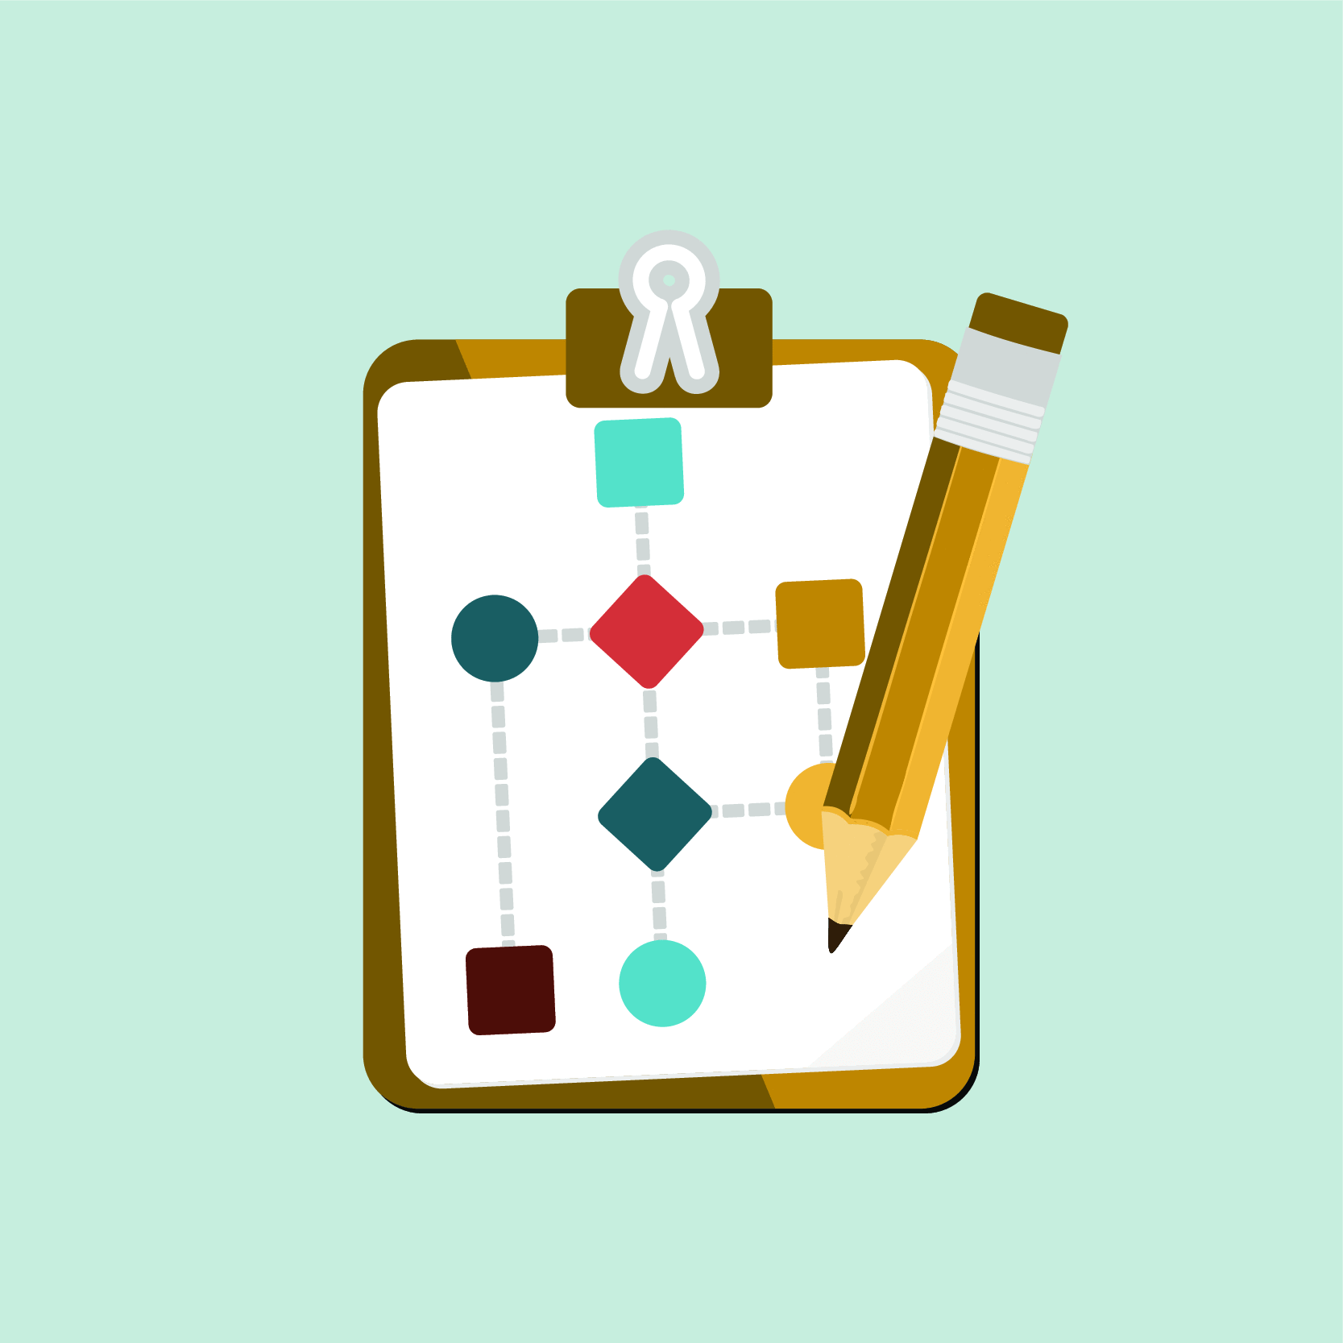
Step 3: Structure the documentation according to user’s workflows
Modern realities show that it is not simply possible to describe a business logic of a complex product (if you need to capture your product in a guide, you can consider it complex). It is hard to foresee all of the correlations of incoming data and expected results that is why it is important to focus on the main ones.
However, you should remember, nobody except for your users will give you details on the main procedures. Each operation carried out by your customers may be classified and defined as one or another kind of work, such as general configuration, work with payroll, work with orderings and so on. In other words, it is of high significance
to put each of the operations to a respective category that will make it easier for your users to find the needed flow as soon as possible.

Slide 6


Step 4: Format - decide
on the right representation of the documentation
This point, once again, is correlated with the target audience of your documentation and with their classical expectations from documentation as well. Indeed majority of your users prefer hard copies mainly due to their portability or because they are simply used to it. Thereafter, the best way is to provide both types of user manuals including online and offline.
?
Online guides usually have a form of PDF or HTML documents. This very PDF format will be suitable for offline guides printing. However, it should be noted that if in online manuals you can quickly find a needed part of a guide due to the search tools, and the only thing which will work for offline manuals - a good table of contents and terms indexing in the text.

Slide 7
Step 5: Reference index or user guide?
Similarly to the above mentioned, dependently on whoever is the primary user of your documents, you can present it as a functional index or functional workflows. First one provides a description of each individual button and text field while the second one explains how to make a particular step-by-step flow with the product help in order to solve a single problem not being distracted by all other fields in user interface.
Introductory guides are usually made for beginners. They show the very performance of general and most frequently recurring tasks and are compulsory for any product. The best way to describe them is step-by-step user instructions. Often such materials can serve as marketing materials showing what problem the product solves at the first place.
User guides extend introductory guides with additional set of procedures diving deeper into the extra functionality of the product.
Quick reference guides or cheat sheets exist as small documents suitable for printing, and contain such information as hotkeys inside of the product. Usually reference guides are vital for the advanced users who already know the domain and the product and require detailed tips how to solve very infrequent configuration or business procedures.

Slide 8
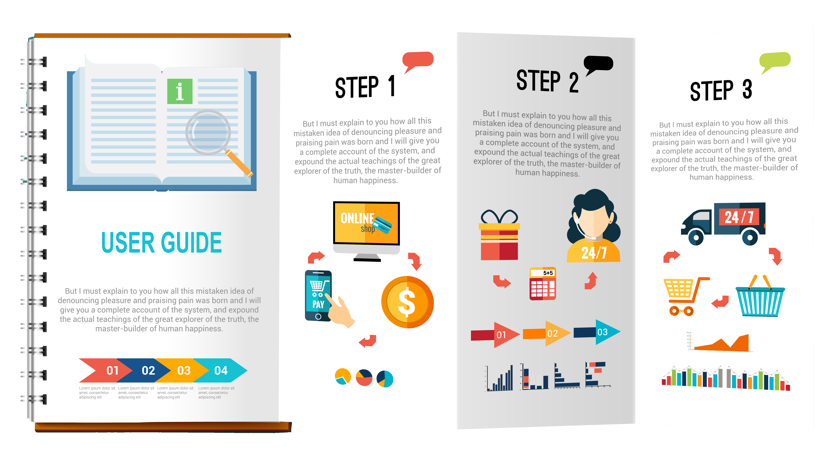
Step 6: Toolset
In fact, in order to create complex documentation the usage of such available instruments as MS Word will be enough. It allows to style your document in a profound way, add images, content, links, and also publish the finished documents in various formats. To prepare step-by-step instructions it is also good to use a tool which will allow to insert screenshots in the document. Screenshot, by the way, is a must-have part of the user instructions as without them text descriptions can often confuse the user - and therefore degrade the experience with your product.
“
“Screenshot, by the way, is a must-have part of the user instructions as without them text descriptions can often confuse the user - and therefore degrade the experience with your product. ”

Slide 9

Step 7: Do not underestimate the importance of documentation!
In modern Agile Delivery realities when product development is iterative, and, accordingly, iteratively new functionality gets to users. Similarly, the documentation of at least the main points of the new features should be provided along with them. We understand that in today's competitive market conditions, when days and hours can decide the
share market of your product, the very work on new functionality is principal on the radar of product management. Sometimes even testing and, what is more – documenting are being delayed to the better times - which actually may lead to the worst possible situation - the client gives up the product due to the poor quality and lack of documentation as an appropriate level of service.

Slide 10
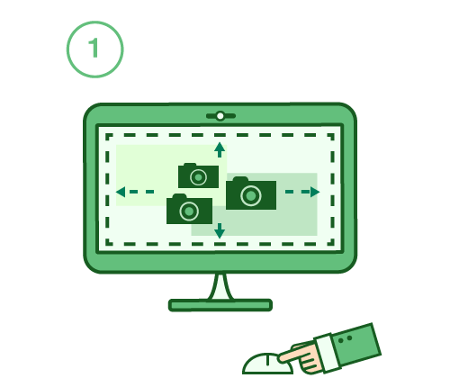
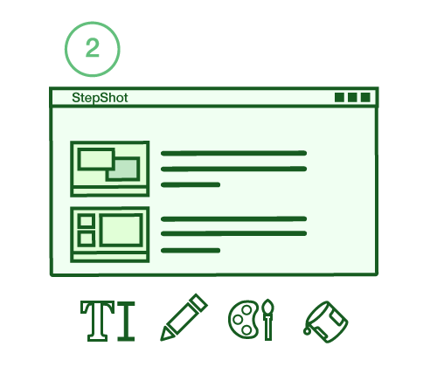
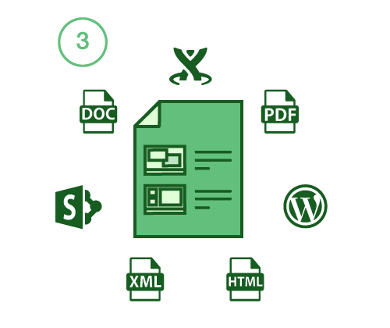
Step 8: Automate most time consuming tasks
Mouse clicks produce screenshots
We have developed StepShot as an alternative solution for creating documentation in limited terms. Automatic creation of step-by-step user guides in StepShot, forming manuals and exporting to different offline (Word, PDF) and online (HTML, Confluence, Sharepoint, Wordpress) forms using customized templates helps save up to 90% of time which is usually spent while elaborating product documentation.
We recommend you to try StepShot and personally experience the performance boost as the product has a fully functional free version.
Annotate images with text and shapes
Export or publish into various formats!

Slide 11
Life is too short for writing documentation.
Just StepShot it
TRY IT FOR FREE

