Slide 1


TRACXN GEO ANNUAL REPORT
BLOCKCHAIN TECHNOLOGY - SEA - 2024

Slide 2
Contents
Snapshot
Investments
Investors
Exits
New Unicorns
Citywise Trends
News
Funded Deadpooled Companies
Appendix

Slide 3
Contents
Snapshot |  | Snapshot
Investments
Investors
Exits
New Unicorns
Citywise Trends
News
Funded Deadpooled Companies
Appendix

Slide 4

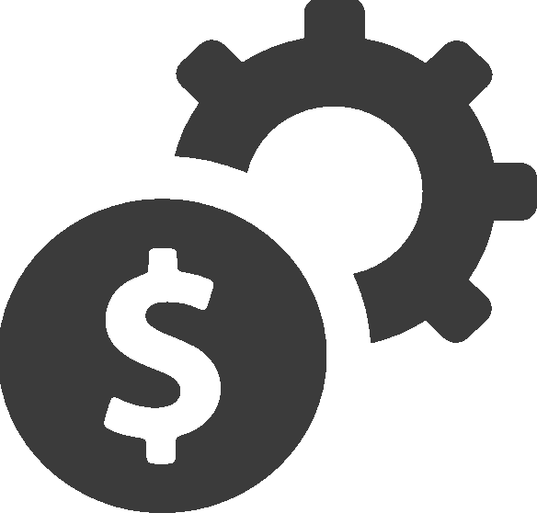
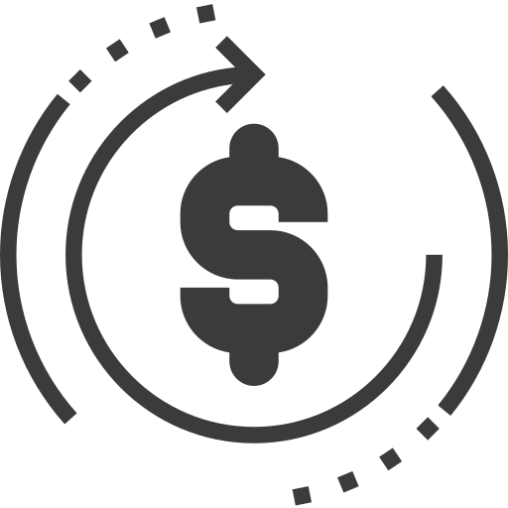



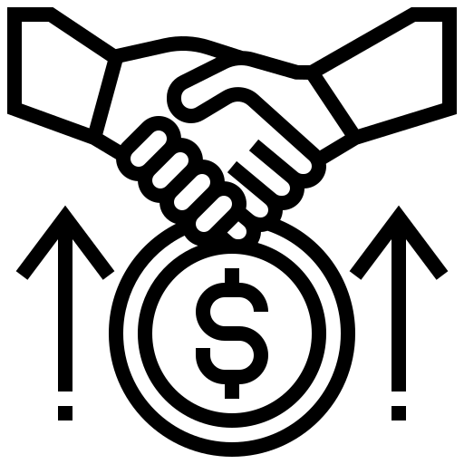




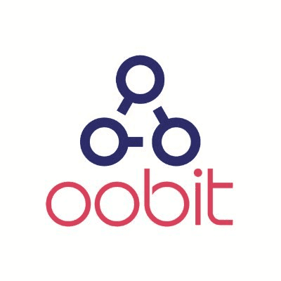

Blockchain Technology - SEA Snapshot - 2024
Blockchain Technology - SEA All time Stats
Summary
All Companies | 3,406
Funded Companies | 665
Total Funding | $5.0B
Funding in last 24 months | $999M
Cumulative Valuation of all Unicorns | $12.7B
$591M (vs $415M,▲43%)
109 (vs 96,▲14%)
48 (vs 24,▲100%)
58 (vs 69,▼15%)
$ Funding
# Funding rounds
Series A+ rounds
First Time Funded Companies
6 (vs 10,▼40%)
1 (vs -,▲100%)
7 (vs 4,▲75%)
1 (vs 0,▲100%)
New additions to Soonicorn Club
New Unicorns
Acquisitions
IPOs
Exits
Acquisitions | 33
IPOs | 4
Companies Covered
Unicorns | 6
Soonicorns | 15
Minicorns | 100
Editor’s Pick | 278
Series A+ | 131
Series C+ | 7
Acqui-Hires | 14
Deadpooled | 945
Top Funding Rounds
Company | Round Details
SDAX -2020 | $50.0M - Series B
Sygnum (2017, Zurich) | $40.0M - Series B
WadzPay (2018, Singapore) | $36.7M - Series C
Oobit (2017, Singapore) | $25.0M - Series A
Climate Impact.. (2021, Singapore) | $22.3M - Series B
Top Feeds
Feed | $Funding
Cryptocurrencies | $325M
Blockchain Infrastructure | $286M
Investment Tech | $46.0M
PC & Console Gaming | $37.5M
Air Pollution Management Tech | $22.3M
Top Cities
City | $Funding
Singapore | $482M
Hanoi | $17.8M
Kuala Lumpur | $11.7M
Jakarta | $10.5M
Bangkok | $2.8M
Top Cities | Singapore ($3.8B)
 | Jakarta ($188M)
*Data from 01-Jan-2024 to 26-Dec-2024 is considered in report
Note: Numbers in bracket indicate the values of 2023
‹#›

Slide 5
Contents
Snapshot
Investments |  | Y-o-Y Funding Trends
Investors |  | Y-o-Y Stage-wise Funding Trends
Exits |  | Top Funding Rounds in last 1 year
New Unicorns |  | Top Funded Business Models 2024
Citywise Trends
News
Funded Deadpooled Companies
Appendix

Slide 6
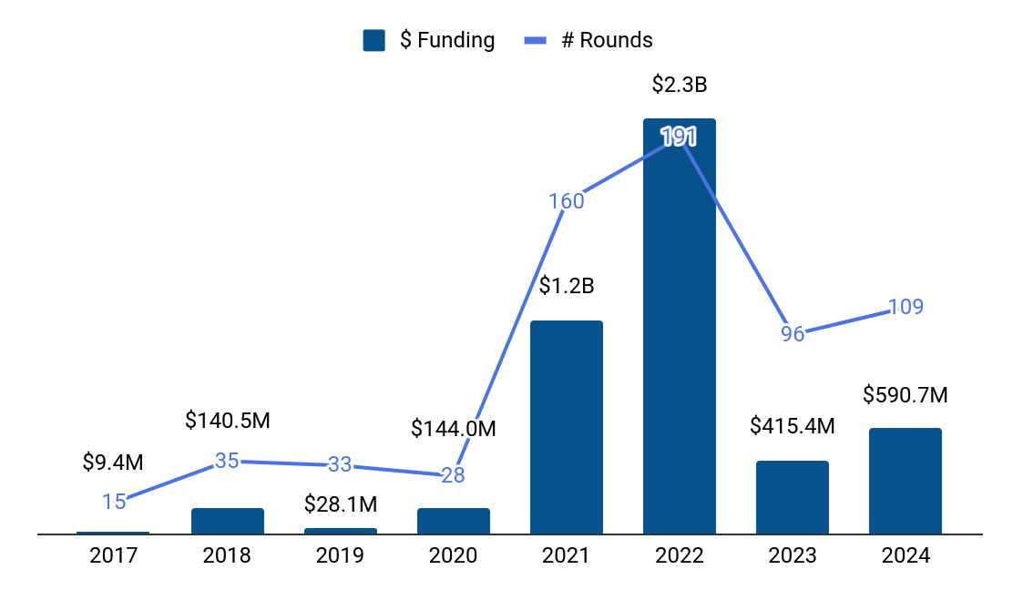







Y-o-Y Funding Trends
Top Funding Rounds in last 8 years
Company |  | Funding Round
 | Amber Group (2017, Singapore) | $300M - Series C
 | Amber Group (2017, Singapore) | $200M - Series B
 | Sky Mavis (2019, ) | $152M - Series B
 | Sky Mavis (2019, ) | $150M - Series B
 | Sygnum (2017, ) | $120M - Series B
 | Rario (2021, Singapore) | $120M - Series A
 | Pintu (2016, Jakarta) | $113M - Series B
 | Matrixport (2019, Singapore) | $100M - Series C
 | MinePlex (2020, Singapore) | $100M - Series C
 | Rubix (2002, Singapore) | $100M - Series D
$ Funding (3y) CAGR = -37%
$ Funding (5y) CAGR = +84%
Note: Funding includes only Equity Funding. It excludes Debt, Grant, Post-IPO and ICO funding.
Notes:
Add in one box

Slide 7
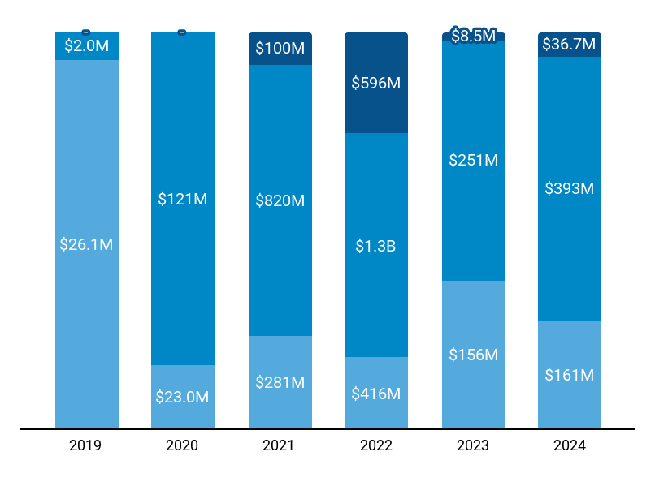
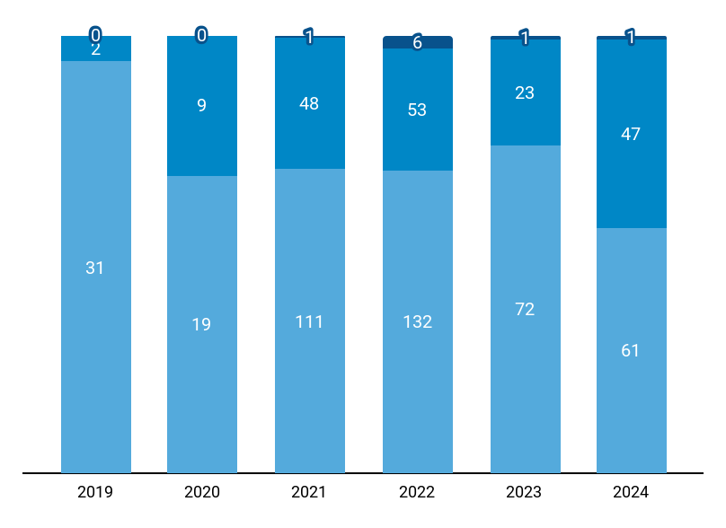
Y-o-Y Stage-wise Funding Trends
Stage-wise $ Invested
Stage-wise Number of Rounds
$28.1M
$144M
$1.2B
$2.3B
$415M
$591M
33
28
160
191
96
109
Seed
Early Stage
Late Stage
Total Funding
Seed
Early Stage
Late Stage
Total Rounds
Note: Seed includes Seed, Angel rounds. Early Stage includes Series A,B rounds. Late Stage includes Series C+, PE, Pre-IPO rounds.
‹#›
Notes:
Add Legend for Totals

Slide 8


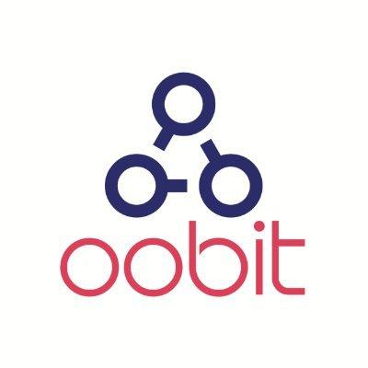








Top Funding Rounds in last 1 year (1/2)
Company |  | $ Amount | Round | Date | Investors
 | SDAX (2020, $68.00M) | $50M | Series B | Sep 2024 | -
 | Sygnum (2017, $160M) | $40M | Series B | Jan 2024 | Azimut
 | WadzPay (2018, Singapore, $36.70M) | $37M | Series C | Dec 2024 | GEM
 | Oobit (2017, Singapore, $25.00M) | $25M | Series A | Feb 2024 | Tether, 468 Capital, Titan
 | Climate Impact .. (2021, Singapore, $22.30M) | $22M | Series B | Feb 2024 | Standard Chartered, Mizuho Financial Group, SGX
 | StakeStone (2023, Singapore, $22.00M) | $22M | Seed | Nov 2024 | Skyland Ventures, Polychain, Youbi Capital, +16 more
 | Polyhedra Netwo.. (2022, Singapore, $45.00M) | $20M | Series B | Mar 2024 | UOB, Animoca Brands, Polychain, +8 more
 | Morph (2023, Singapore, $20.30M) | $19M | Seed | Mar 2024 | Pantera Capital, DRAGONFLY, Spartan Group, +5 more
 | Mystiko (2021, Singapore, $18.00M) | $18M | Seed | Mar 2024 | Peak XV Partners, Samsung NEXT, Tribe Capital, +5 more
 | DappOS (2004, Singapore, $15.30M) | $15M | Series A | Apr 2024 | IDG Capital, UpHonest Capital, Taihill Venture, +8 more
 | Particle Networ.. (2019, Singapore, $23.80M) | $15M | Series A | Jun 2024 | Spartan Group, HashKey Capital, gCC, +3 more
 | Chainbase (2021, Singapore, $15.00M) | $15M | Series A | Jul 2024 | Tencent, Matrix Partners China, DFG, +4 more
Notes:
Confine to 4 Slides

Slide 9




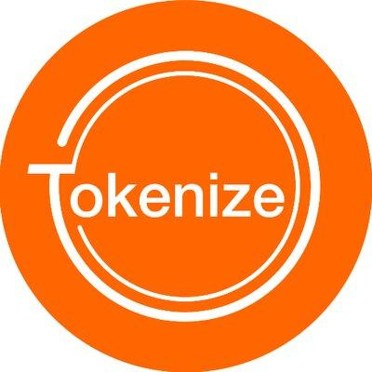






Top Funding Rounds in last 1 year (2/2)
Company |  | $ Amount | Round | Date | Investors
 | SkyArk Chronicl.. (2021, Singapore, $15.00M) | $15M | Series B | Jan 2024 | Tangent Ventures International Realty
 | AltLayer (2021, Singapore, $21.60M) | $14M | Series A | Feb 2024 | Hack VC, Polychain, IOSG Ventures, +7 more
 | U2U Network (2019, Hanoi, $13.00M) | $14M | Series A | Nov 2024 | KuCoin, IDG Blockchain, Chain Capital, +2 more
 | Waterfall (2020, Singapore, $13.60M) | $12M | Series A | Dec 2024 | Bolts Capital
 | Tokenize Exchan.. (2017, Singapore, $23.00M) | $12M | Series A | Mar 2024 | TRIVE
 | Bitlayer (2012, Singapore, $25.00M) | $11M | Series A | Jul 2024 | Franklin Templeton Investments, FalconX, Flow Traders, +5 more
 | Goldragon (2022, Singapore, $10.00M) | $10M | Series A | Jan 2024 | -
 | METACENE (2022, $15.00M) | $10M | Series A | Mar 2024 | Longling Capital, Spartan Group, Comma3 Ventures, +5 more
 | Galaxis (2021, Singapore, $10.00M) | $10M | Series A | May 2024 | Taisu, Rarestone, Chainlink
 | BEVM (2023, Singapore, $10.00M) | $10M | Series A | Mar 2024 | Waterdrip Capital, MH Ventures, ArkStream, +9 more
 | Bitlayer (2012, Singapore, $25.00M) | $9M | Series A | Oct 2024 | Franklin Templeton Investments, Polychain, Selini Capital, +1 more
 | UXLINK (2022, Singapore, $14.00M) | $9M | Series A | Mar 2024 | GGV Capital, UOB, Zhen Fund, +10 more
Full list of 109 Key Funding Rounds is available on Tracxn Platform
Notes:
Confine to 4 Slides

Slide 10


Top Funded Business Models 2024
Rank |  | Business Model | $ Funding | # Rounds | Top Funding Round
1 | <> 0 | Blockchain Protocols | $122M | 30 | Polyhedra Ne.. $20.0M - Series B
2 | ▲11 | Cryptocurrency Exchanges | $80.6M | 8 | SDAX $50.0M - Series B
3 | ▼1 | Crypto-based Financial Services | $63.0M | 11 | Oobit $25.0M - Series A
4 | -- | Cryptocurrency Mining | $44.2M | 10 | StakeStone $22.0M - Seed
5 | ▲4 | Cryptocurrency Banking | $40.0M | 1 | Sygnum $40.0M - Series B
6 | ▼4 | Cryptocurrency Trading Platforms | $38.4M | 8 | Climate Impa.. $22.3M - Series B
7 | ▼3 | Mobile Crypto Wallets | $36.7M | 1 | WadzPay $36.7M - Series C
8 | <> 0 | Dapp Development Platforms | $23.0M | 5 | Chainbase $15.0M - Series A
9 | -- | Optimistic Rollups | $20.3M | 3 | Morph $19.0M - Seed
10 | ▼7 | General Purpose Cryptocurrencies | $13.8M | 3 | U2U Network $13.8M - Series A
* Rank is based on $Invested in last 1 quarter in the Business Model. ▲- Indicates change in Rank from previous quarter.

Slide 11
Contents
Snapshot
Investments
Investors |  | Y-o-Y Investors
Exits |  | Y-o-Y Global Investors
New Unicorns |  | Most Active Investors
Citywise Trends
News
Funded Deadpooled Companies
Appendix

Slide 12
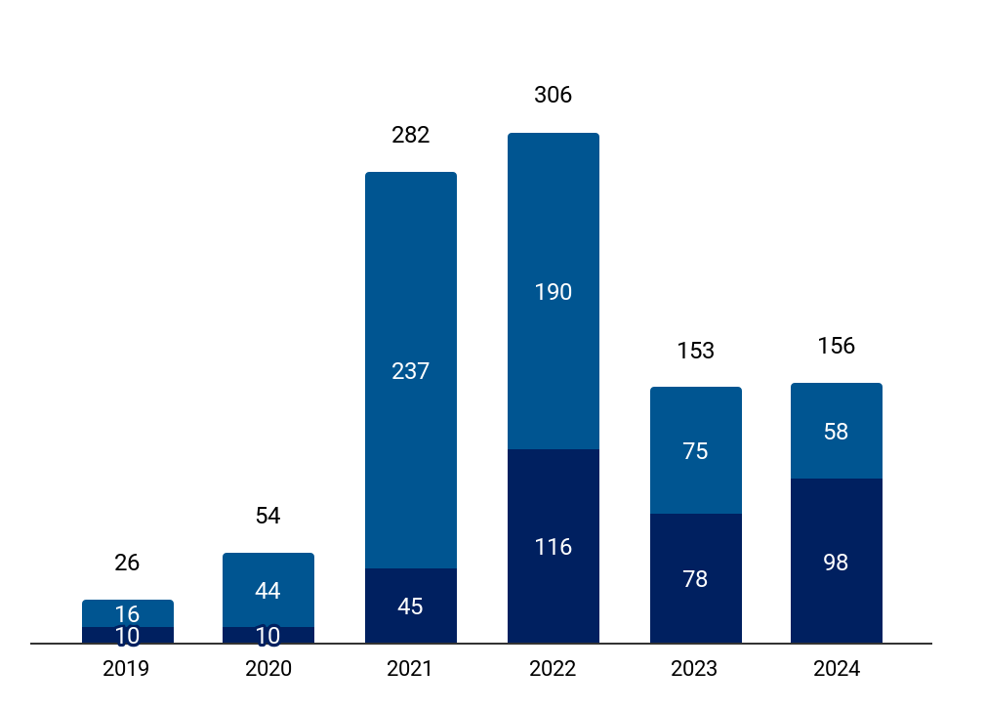






Y-o-Y Investors
Y-o-Y # of unique Institutional Investors in Blockchain Technology - SEA
Top Institutional Investors in 2024
Stage | Investor name | # Investments in 2024
Seed Stage | Spartan Group | 4 ( -- )
 | HashKey Capital | 4 (▲100%)
 | Alliance DAO | 4 ( -- )
Early Stage | UOB | 2 ( -- )
 | Taisu | 2 ( -- )
 | Samsung NEXT | 1 ( -- )
# First Time Investors (2Y) CAGR = -45%
# First Time Investors (4Y) CAGR = +7%
First-time Investors
Existing Investors
Note: First-time investors and Existing Investors are calculated from the available Equity Funding Rounds on Tracxn Platform. 1.The numbers in bracket correspond to the change from 2023.
Notes:
Includes the analysis on the investors spread across the World (US + Non US)

Slide 13
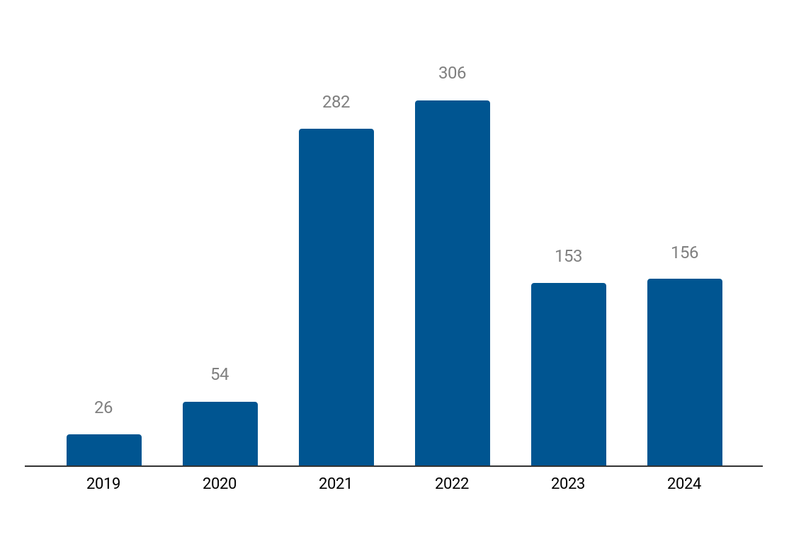
Y-o-Y International Investors
Y-o-Y # of unique Institutional Investors in Blockchain Technology - SEA
Top International Institutional Investors in 2024
Stage | Investor name | # Investments in 2024
Seed Stage | Spartan Group | 4 ( -- )
 | HashKey Capital | 4 (▲100%)
 | Alliance DAO | 4 ( -- )
Early Stage | UOB | 2 ( -- )
 | Taisu | 2 ( -- )
 | Samsung NEXT | 1 ( -- )
International Investors
Note: International Investors are the investors who are based outside of the Geo mentioned in the report. 1.The numbers in bracket correspond to the change from 2023.
‹#›
Notes:
Includes the analysis on the investors spread across the World (US + Non US)

Slide 14







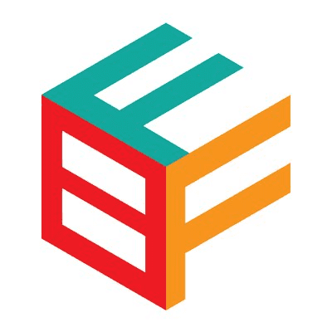
Most Active Investors: Accelerators & Incubators
# | Investor Name | Country | # Overall investments | # Investments in Geo* - 2024 | Notable Investments in Geo*
1 | Spartan Group | Singapore | 161 | 4 | Particle Network ($23.8M), Morph ($20.3M), METACENE ($15.0M)
2 | Alliance DAO | United States | 38 | 4 | Bitlayer ($25.0M), Hata ($4.2M), Qiro ($1.2M)
3 | Foresight Ventures | China | 86 | 3 | Polyhedra Network ($45.0M), Morph ($20.3M), DappOS ($15.3M)
4 | Skyland Ventures | Japan | 108 | 3 | StakeStone ($22.0M), REVOX ($7.0M), Cycle Network
5 | Binance Labs | Malta | 116 | 3 | Particle Network ($23.8M), StakeStone ($22.0M), UXUY Protocol ($10.2M)
6 | LongHash | Singapore | 44 | 2 | Polyhedra Network ($45.0M), Particle Network ($23.8M), Ordzaar ($2.0M)
7 | Jsquare | Singapore | 72 | 2 | Oasys ($20.0M), Chainbase ($15.0M), Mint Blockchain ($5.0M)
8 | Plug and Play Tech Center | United States | 1591 | 2 | Hata ($4.2M), BuildBear
9 | Antler | Vietnam | 1049 | 2 | PEXX ($4.5M), Flaex
10 | Blockchain Founders Fund | Singapore | 133 | 2 | Beoble ($9.0M), Layer Edge
Note: *Geo = Blockchain Technology - SEA. The number in bracket refers to the total funding raised by the company.
Notes:
# Investments In Geo and Notable Investments in Geo should be based on the last 1 year or till date?

Slide 15









Most Active Investors: VC - Seed
# | Investor Name | Country | # Overall investments | # Investments in Geo* - 2024 | Notable Investments in Geo*
1 | HashKey Capital | Singapore | 74 | 4 | Polyhedra Network ($45.0M), Particle Network ($23.8M), StakeStone ($22.0M)
2 | MH Ventures | United Kingdom | 136 | 4 | Polyhedra Network ($45.0M), Morph ($20.3M), Pontem Network ($10.5M)
3 | Mirana | China | 76 | 4 | Oasys ($20.0M), Mystiko ($18.0M), DappOS ($15.3M)
4 | Morningstar Ventures | United Arab Emirates | 130 | 3 | Particle Network ($23.8M), zkLink ($18.5M), Mystiko ($18.0M)
5 | Waterdrip Capital | China | 90 | 3 | DappOS ($15.3M), UXUY Protocol ($10.2M), BEVM ($10.0M)
6 | Symbolic Capital | United States | 32 | 3 | Polyhedra Network ($45.0M), StakeStone ($22.0M), Morph ($20.3M)
7 | dao5 | United Kingdom | 38 | 3 | StakeStone ($22.0M), BounceBit ($6.0M), Tomo ($3.5M)
8 | NGC | China | 304 | 2 | Oasys ($20.0M), zkLink ($18.5M), Pontem Network ($10.5M)
9 | Tribe Capital | United States | 178 | 2 | Mystiko ($18.0M), Saakuru Labs ($14.9M), KIP ($5.0M)
10 | Signum Capital | Singapore | 181 | 2 | Polyhedra Network ($45.0M), Mystiko ($18.0M), UXLINK ($14.0M)
Note: *Geo = Blockchain Technology - SEA. The number in bracket refers to the total funding raised by the company.
Notes:
# Investments In Geo and Notable Investments in Geo should be based on the last 1 year or till date?

Slide 16



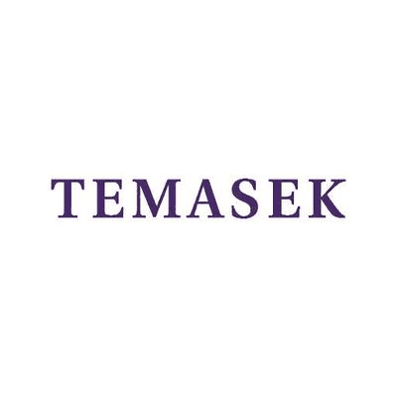



Most Active Investors: VC - Early Stage
# | Investor Name | Country | # Overall investments | # Investments in Geo* - 2024 | Notable Investments in Geo*
1 | UOB | Singapore | 80 | 2 | Polyhedra Network ($45.0M), UXLINK ($14.0M), BlonkFi
2 | Taisu | United States | 53 | 2 | METACENE ($15.0M), Galaxis ($10.0M), REVOX ($7.0M)
3 | Samsung NEXT | Germany | 290 | 1 | Mystiko ($18.0M), Beoble ($9.0M), Startale ($7.0M)
4 | IDG Capital | United States | 792 | 1 | DappOS ($15.3M), BounceBit ($6.0M)
5 | Primitive Ventures | United States | 21 | 1 | AltLayer ($21.6M), BounceBit ($6.0M)
6 | Selini Capital | Singapore | 19 | 1 | Bitlayer ($25.0M), GRVT ($9.3M)
7 | Temasek | Singapore | 494 | 1 | Marketnode
8 | GGV Capital | United States | 493 | 1 | UXLINK ($14.0M)
9 | Ventech | France | 150 | 1 | Chainstack ($6.0M)
10 | Matrix Partners China | China | 460 | 1 | Chainbase ($15.0M)
Note: *Geo = Blockchain Technology - SEA. The number in bracket refers to the total funding raised by the company.
Notes:
# Investments In Geo and Notable Investments in Geo should be based on the last 1 year or till date?

Slide 17




Most Active Investors: PE
# | Investor Name | Country | # Overall investments | # Investments in Geo* - 2024 | Notable Investments in Geo*
1 | SPE Capital | Tunisia | 14 | 1 | OpenStamp
2 | Arena Holdings | United States | 10 | 1 | Reddio
3 | Vital Capital | Switzerland | 5 | 1 | OpenStamp
4 | Emirates Consortium | United Arab Emirates | 3 | 1 | Polyhedra Network ($45.0M)
Note: *Geo = Blockchain Technology - SEA. The number in bracket refers to the total funding raised by the company.
Notes:
# Investments In Geo and Notable Investments in Geo should be based on the last 1 year or till date?

Slide 18
Contents
Snapshot
Investments
Investors
Exits |  | Exit Snapshot
New Unicorns |  | List of IPOs
Citywise Trends |  | List of Acquisitions
News |  | Most Active Acquirers
Funded Deadpooled Companies
Appendix

Slide 19

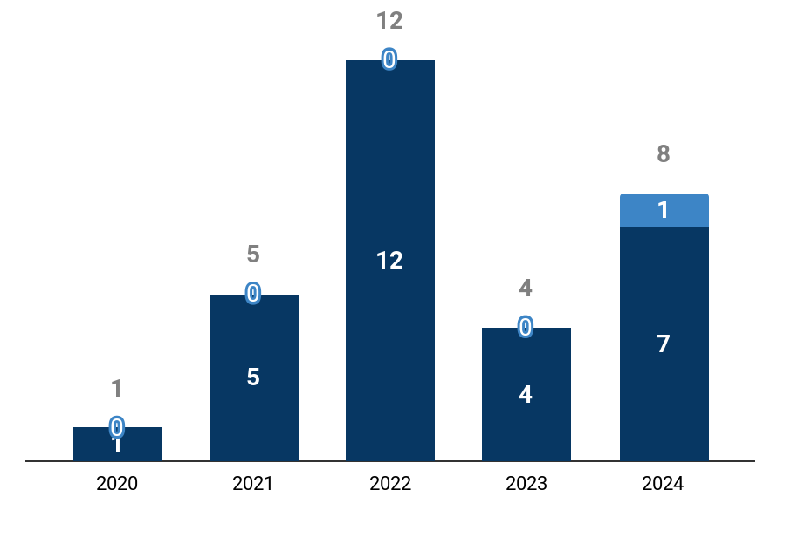








Exit Snapshot - 2024
IPOs - 2024 (vs 2023)
1 (vs 0)
- (vs -)
- (vs -)
$9.0M (vs -)
# IPOs
Avg. yrs from first funding to IPO
Avg. Funding raised before IPO
Avg. IPO Mcap
Acquisitions - 2024 (vs 2023)
7 (vs 4)
3.9 (vs 1.9)
$2.7M (vs $10.0M)
- (vs $75.3M)
# Acquisitions
Avg. yrs from first funding to Acq.
Avg. Funding raised before Acq.
Avg. Acq. Price
Top Investors by # Exits - 2024
Y-o-Y Exit Trends
Top Exits - 2024
Investor | # Exits | Notable Exit
Mavcap | 2 | Stake With Us
LuneX Ventures | 2 | Stake With Us
SGInnovate | 2 | Stake With Us
Alameda Research | 1 | Solscan
Bain & Company | 1 | Contour
Type | Company |  | Acq. Price/IPO Mcap
Acq. |  | Propine (2018, Singapore, $1.6M) | -
 |  | SolanaFM (2020, Singapore, $4.5M) | -
 |  | Stake With Us (2019, Singapore, $595K) | -
IPO |  | Tridentity (2014, Singapore) | $9.0M
‹#›
# Acquisitions
# IPOs

Slide 20
List of IPOs - 2024
Company | Investors | IPO Date | IPO Mcap
Tridentity (2014, Singapore ) |  | Sep 2024 | $9.0M

Slide 21




List of Acquisitions - 2024
Company | Acquirer(s) | Acq. Date | Acq. Price
Propine (2018, Singapore, $2M) | Komainu | Oct 2024 | NA
SolanaFM (2020, Singapore, $5M) | Jupiter | Sep 2024 | NA
Stake With Us (2019, Singapore, $595K) | Nansen | Sep 2024 | NA
Omni3 (2023, Singapore) | GDA Capital | Mar 2024 | NA
Contour (2018, Singapore) | xalts | Feb 2024 | NA
Jubi (2013, Singapore) | Exor Digital | Feb 2024 | NA
Solscan (2021, Singapore, $4M) | Etherscan | Jan 2024 | NA
View all 7 companies on Tracxn Platform

Slide 22






Most Active Acquirers
# | Acquirer | Country | # Acq. | Average Acq. Price | Companies Acquired
1 | Komainu | United States | 1 | - | Propine
2 | Jupiter | Antigua And Barbuda | 1 | - | SolanaFM
3 | Etherscan | Malaysia | 1 | - | Solscan
4 | GDA Capital | Canada | 1 | - | Omni3
5 | Nansen | Singapore | 1 | - | Stake With Us
6 | xalts | China | 1 | - | Contour
7 | Exor Digital |  | 1 | - | Jubi
Note: Numbers in bracket indicate the Acquisition Price of the company.
Notes:
Confine to 1 Slide

Slide 23
Contents
Snapshot
Investments
Investors
Exits
New Unicorns |  | Unicorn Trends
Citywise Trends |  | List of New Unicorns
News |  | List of New Soonicorns
Funded Deadpooled Companies
Appendix

Slide 24














Unicorn Trends in 2024
Blockchain... - 2024 (vs 2023)
1 (vs -)
1.1 (vs -)
$25.0M (vs -)
4 (vs -)
6 (vs -)
# Total Unicorns
Avg Years from Series A to Unicorn Round
Avg $ Funding before Unicorn Round
Avg # Funding Rounds
before Unicorn Round
Avg Institutional Investors before Unicorn Round
Global Blockchain... - 2024 (vs 2023)
8 (vs 6)
0.6 (vs 0.9)
$89.9M (vs $30.0M)
2 (vs 1)
9.6 (vs 5)
# Total Unicorns
Avg Years from Series A to Unicorn Round
Avg $ Funding before Unicorn Round
Avg # Funding Rounds
before Unicorn Round
Avg Institutional Investors before Unicorn Round
Top Seed Stage Investors
Shima Capital
Hashed
Animoca Brands
B Cryptos
Blockchain
Top Early Stage Investors
OKX
Polychain
Animoca Brands
GoldenTree
HashKey Capital
Top Late Stage Investors
1confirmation
a16z
Archetype
Canonical
Coinbase
Top Cities
Singapore (1)
+ 13 more
+ 48 more
+ 8 more
Note: Investors refers to Institutional Investors only. Top Investors are calculated based on investments before the Unicorn Round.
‹#›
Notes:
Compare Quarter data with Previous Year data

Slide 25
List of New Unicorns
Company | Short Description | Unicorn Event Date | Time from Series A (yrs)¹ | $Funding before Unicorn Round² | # Rounds² | # Investors²
Polyhedra Network (2022, Singapore, $45M) | Online platform offering infrastructure for web3 interoperability | Mar 2024 | 1.1 | $25M | 4 | 6
Full List of 1 unicorn is available on Tracxn Platform
1 - Time taken from First funding to the Unicorn Event Date. 2 - Before Unicorn Round
Notes:
Confine to 2 Slides (Include Decacorns here only)

Slide 26

Soonicorn Club - List of New Soonicorns
Company | Tracxn Score
GuildFi (2021, Bangkok) | 35.5
Note: A Soonicorn is a company which is likely to achieve US $1 billion valuation in the short to medium term. Tracxn Score is a proprietary score based on various market signals reflecting the company’s size, execution and growth.
Notes:
Confine to 1 Slide

Slide 27
Contents
Snapshot
Investments
Investors
Exits
New Unicorns
Citywise Trends |  | Cities by Total Funding
News |  | Cities by Funding raised in last 2 years
Funded Deadpooled Companies
Appendix

Slide 28
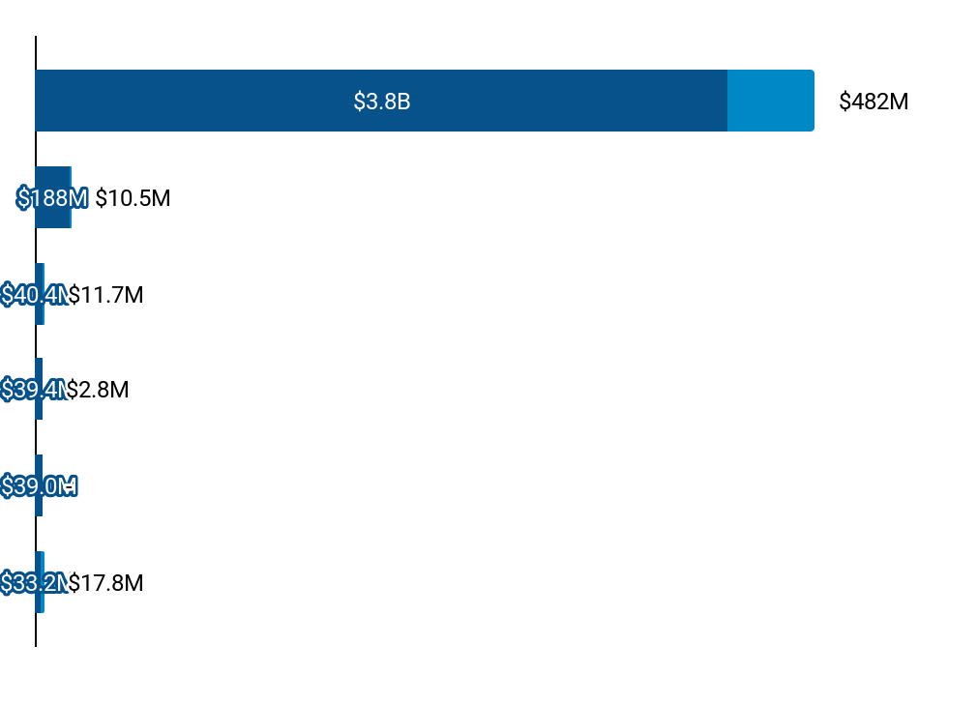









Citywise Trends - Total Funding
Distribution by Cities - Total Funding ($)
# Rounds
Top Companies funded in 2024
Singapore
Jakarta
Kuala Lumpur
Bangkok
Ho Chi Minh City
Hanoi
91
3
3
1
2
4
 | Sygnum ($40.0M) |  | WadzPay ($36.7M) |  | Mystiko ($29.3M)
 | Snowseed ($5.0M) |  | Tomo ($3.5M) |  | Bittime ($2.0M)
 | Future Tre.. ($7.5M) |  | Hata ($4.2M)
 | Contributi.. ($2.8M)
 | U2U Networ.. ($13.8M) |  | Amnis Fina.. ($2.0M) |  | Unich ($2.0M)
2024 Funding
All time Funding
‹#›

Slide 29





Citywise Trends - Funding raised in last 2y
Funding raised in 2 Yrs (Market Share %)
Rank | City | 2024 |  | 2023 |  | Top Funded Companies in 2024
 |  | # | % | # | %
1 | Singapore | $482M | 92 % | $336M | 86 % |  | Sygnum ($40.0M) |  | WadzPay ($36.7M) |  | Mystiko ($29.3M)
2 | Hanoi | $18M | 3 % | $1M | 0 % |  | U2U Networ.. ($13.8M) |  | Amnis Fina.. ($2.0M) |  | Unich ($2.0M)
3 | Kuala Lumpur | $12M | 2 % | $28M | 7 % |  | Future Tre.. ($7.5M) |  | Hata ($4.2M)
4 | Jakarta | $11M | 2 % | - | - |  | Snowseed ($5.0M) |  | Tomo ($3.5M) |  | Bittime ($2.0M)
5 | Bangkok | $3M | 1 % | $28M | 7 % |  | Contributi.. ($2.8M)
‹#›

Slide 30












Citywise Trends - Companies Founded in last 2y
Companies Founded in 2 Yrs (Market Share %)
Rank | City | 2024 | 2023 | Companies Founded in 2024
1 | Singapore | 65 % | 59 % |  | PEXX ($4.5M) |  | Parasail ($4.0M) |  | Pell Network ($3.0M) |  | BlonkFi -
2 | Hanoi | 5 % | 4 % |  | EnsoFi - |  | CoinAI - |  | - - |  | - -
3 | Jakarta | 11 % | 4 % |  | Mesa Markets - |  | CICC - |  | Tapbit Indon... - |  | OCTA FX GLOB... -
4 | Bangkok | 3 % | 1 % |  | JFIN Coin Cl... - |  | - - |  | - - |  | - -
5 | Ho Chi Minh City | 5 % | 3 % |  | Football Bat... - |  | XLP Network - |  | - - |  | - -
‹#›

Slide 31
Contents
Snapshot
Investments
Investors
Exits
New Unicorns
Citywise Trends
News |  | Recent Key News
Funded Deadpooled Companies
Appendix

Slide 32
Recent Key News (1/3)
Transactions
Usual completed US$10,000 in Series A funding, led by Binance Labs and Kraken Ventures TradingView
UTXO Stack Completes Series A Funding, Plans TGE in Q1 2025 Cryptopotato
Terra Lands $170M for First Phase of $1B Mixed-Use Dev in Miami-Dade Commercial Observer
BounceBit Secures Strategic Investment from Asia’s Bitcoin Leader bitcoinethereumnews.com
Waterfall Network Raises $11.6M As The Most Scalable And Decentralized EVM Compa.. International Business Times
SuperForm received $ 3 million in financing, and launched Supervaults high -income chain products PANews
The Asia Group Receives Strategic Investment for Geographic and Service Expansion Business Wire
Crypto.com Acquires Abu Dhabi Securities Firm to Expand Global Financial Services bitcoinethereumnews.com
Cryptio has filed a notice of an exempt offering of securities to raise $12,999,975.00 in New.. intelligence360
Crypto.com acquires Orion Principals Limited The Paypers
Company Updates
Mexc Grows Global Reach With 17 New Languages, Strengthening Its Presence in Emerging Markets BeInCrypto
Crypto.com Launches Us Trust Company assetservicingtimes.com
aelf Introduces aevatar Intelligence: No-Code, No Limits for AI Agents CryptoSlate
Allo Secures $100 Million Bitcoin-Backed Credit Line Amid Growing Tokenization Opport.. bitcoinethereumnews.com
VeChain Simplifies Web3 with Social Login Wallet Management Shareandstocks
SPACE ID launches 1st TON-based domain name on DuckChain Shareandstocks
Bybit Suspends Crypto Operations In France Amid Rising Regulatory Tensions Benzinga
Bybit to stop crypto services for French users by January 2025 The Paypers
Bybit Upgrades its Trading Bot to Support Smarter Automatic Trading Strategies PR Newswire
AIA Chain Leads Turkish Blockchain Innovation at Taipei Blockchain Week Benzinga
Notes:
New Sections to be included:
Transactions
Company Updates
Legal
Partnerships
People Movement
Others

Slide 33
Recent Key News (2/3)
Legal
SEC Charges Jump Crypto Subsidiary for Role in Terra’s Stablecoin Collapse Shareandstocks
CySEC Flags Multiple Unregistered Websites, With Bybit and VTMarkets Named Finance Magnates
Bankrupt FTX targets Crypto.com in $11 million lawsuit amid recovery effort CryptoSlate
FTX's $228M Settlement With Bybit Brings Conclusion of Epic Liquidation Closer CoinDesk
Crypto.com sues US SEC after receiving legal threat from regulator The Business Times
Crypto.com Files Suit Against SEC Over Expanded Jurisdiction Claims Bitcoin
SEC Sues Do Kwon and Terraform Labs for Fraud CoinTime
Federal Judge Rejects SEC’s Motion in Tron Foundation Lawsuit Coinspeaker
Terra sued for $1.3 billion by Three Arrows Capital gospodarka.sos.pl
Three Arrows Seek $1.3B from Terraform Labs CryptoMode
Partnerships
Foxconn to enhance its AI data centers Breaking The News
Crypto.com Renews Partnership with Formula 1 Until 2030: BTC Trades Below $100K Finance Magnates
Sygnum Singapore teams up with Moomoo The Paypers
Bitget Announces Strategic Collaboration with the TRON Blockchain including the Acquisition of $1.. CryptoSlate
Animoca JP also invests in OASYS, and also participates in ballidata neweconomy.jp
First-of-its-kind Partnership Between Sygnum Singapore and Moomoo Singapore to Offer Crypto F.. Fintech Finance
Triple-A and Rezo Money partner to enable crypto-based mobile recharges globally The Paypers
Blockchain gaming platform Oasys reaches partnership with Animoca Brands Japan and receives investment CoinTime
Plume Partners with DigiFT to Expand Regulated Digital Asset Offerings PR Newswire
Triple-A and Rezo Money Partner to Enable Crypto-Based Mobile Recharges Globally Fintech Finance
Notes:
New Sections to be included:
Transactions
Company Updates
Legal
Partnerships
People Movement
Others

Slide 34
Recent Key News (3/3)
People Movement
PGIM Investments Names New Head for Southeast Asia Hubbis
Justin Sun Joins Trump-Backed Crypto Project as Advisor After $30 Million Investment Bitcoin
Vietnamese startup Sky Mavis slashes 21 per cent of workforce Vietnam Investment Review
Sky Mavis to cut staff by 21%; plans new Axie Infinity game CryptoTvplus
Bybit Expands Shunyet Jan's Role to Drive Institutional Growth Benzinga
TradFi Veteran Shunyet Jan Joins Bybit as New Head of Derivatives Business GlobeNewswire
Singapore Gulf Bank strengthens C-Suite ahead of launch Fintechinshorts
Bybit Bolsters Compliance Prowess with Appointment of New Chief Legal & Compliance Officer Finance Magnates
Bybit Bolsters Compliance with Appointment of New Chief Legal & Compliance Officer GlobeNewswire
Climate Impact X appoints new CEO and chairman Finextra
Other
BSCS Global Secures #3 Spot in World’s Best Crypto Launchpads and IDO Platforms Cryptonews
GRVT Secures Bermuda License, Becoming World's First Regulated DEX, A Milestone for DeFi to Go Mainstream CNW
Alchemy Pay Expands U.s. Compliance With Four New Money Transmitter Licenses PR Newswire
MEXC recognized for top Liquidity performance in reports by TokenInsight and Simplicity Group GlobeNewswire
Bybit Receives Georgian VASP License, Strengthening Global Regulatory Presence GlobeNewswire
Bybit Named 'Best Blockchain Company of the Year' at Future Enterprise Awards 2024 CNW
Bybit Seeks Crypto License in Austria Following Kazakhstan Approval Finance Magnates
Tron’s $566 million Q3 revenue surpasses Bitcoin, Ethereum and Solana CryptoSlate
Bybit Receives Full License in Kazakhstan GlobeNewswire
Sygnum obtains a crypto licence in Lichtenstein The Paypers
Notes:
New Sections to be included:
Transactions
Company Updates
Legal
Partnerships
People Movement
Others

Slide 35
Contents
Snapshot
Investments
Investors
Exits
New Unicorns
Citywise Trends
News
Funded Deadpooled Companies |  | Funded Deadpooled Companies
Appendix

Slide 36

Funded Deadpooled Companies
Company | $ Funding
ChainVerse (2021, Singapore) | -

Slide 37
Contents
Snapshot
Investments
Investors
Exits
New Unicorns
Citywise Trends
News
Funded Deadpooled Companies |  | Explore more on Tracxn
Appendix |  | Explore other Reports on Tracxn

Slide 38
Explore more on Tracxn
Companies
Investment Activity
Reports
All Tech Companies
UAE Tech Companies
Online Travel Companies
Companies using AI in Healthcare
Companies founded by Stanford GSB Alumni
Soonicorn club in Fintech
Analyst Picks in Israel Tech
Recent funding rounds
Investment Trends
Most Active Investors
Top Funded Business Models
Delhivery - Company Report
Novel Foods - Business Model Report
HRTech - Feed Report
FinTech - Top Business Models Report
India Tech - Top Business Models Report
Company Due Diligence
Exits
Miscellaneous
Company Detail Page of DoorDash
Competitors of Freshworks
Cap Table for TransferWise
Financials for Ola
Employee Count for Revolut
Public Companies
Acquired Companies
Most Active Acquirers
Key News in FinTech
Events in Bay Area
Angel Investors in United States
Bluebox
‹#›
Notes:
Companies
Companies covered = All Tech companies on platform
Soonicorn club in Enterprise Applications
Editor’s Pick in Consumer
AI Comapnies in Enterprise Infrastructure
Company Due Diligence
Detailed profile <C1> - CDP homepage
Competitors of <C2> - Competitors page
Cap Tables - Last six month. Select top company. Show Captable view on CDP.
Financials - Parked. Pending API
Employee Count - Parked. Pending API
Investment Activity
Links are static
Exits
Links are static
Reports
Report category = Company DD/ Company Report, Sort by Tracxn Score for domain. Date filter = Last 3 months. Take the first company. Give link for this. Example - https://tracxn.com/a/reports/pha7h0nBCNjCF2qydnJOJz0MpSxqp9UBL7o0z0SWWEg/Vlocity%20-%20Company%20Report

Slide 39
Explore other Reports on Tracxn
Explore other Reports on Tracxn
Company Reports
Company Reports
Business Model Reports
Business Model Reports
Feed Reports
Feed Reports
Top Business Models in PA
Top Business Models in PA
Geo Monthly Reports
Geo Monthly Reports
HRTech
Cybersecurity
Food Tech
FinTech
Enterprise Applications
Artificial Intelligence
Blockchain Technology - SEA
Europe Tech
China Tech
Transferwise
Coursera
BigBasket
Blockchain Technology - SEA
Europe Tech
China Tech
Transferwise
Coursera
BigBasket
Novel Foods
Blockchain Network
P2P Remittance
Novel Foods
Blockchain Network
P2P Remittance
Unicorn Reports
Unicorn Reports
Feed Geo Reports
Feed Geo Reports
Top Business Models in Geo
Top Business Models in Geo
Monthly Unicorn Report
Monthly Unicorn Report
FinTech Europe
Consumer Digital SEA
HiTech US
FinTech Europe
Consumer Digital SEA
HiTech US
India Tech
Israel Tech
UK & Ireland Tech
India Tech
Israel Tech
UK & Ireland Tech
‹#›
‹#›
Notes:
Show recent three reports for each category

Slide 40

Any and all information either accessed from the website www.tracxn.com or having otherwise originated from Tracxn Technologies Limited including but not limited to the information contained herein ("Data") is the sole property of Tracxn Technologies Limited (hereinafter "Tracxn"). You shall not recirculate, distribute, transmit, publish, or sell the Data or any portion thereof in any form or by any means, either for commercial or non-commercial use, or permit any third party to use or distribute the Data or any portion thereof; to any other party, except with the prior written consent of Tracxn. You may however incorporate insubstantial portions, extracts, abstracts or summaries from the Data into analysis, presentations or tools for your customers or for your internal use, so long as Tracxn is clearly and visibly identified as the source of information.
For further information please refer to our Terms of Use at www.tracxn.com

